Slide 2
Work-based Learning
Office of Career-Technical Education
Brenna Bartlett – Assistant Administrator
Emma Waymire – Education Program Specialist

Slide 3
Why work-based learning?
Business & Industry Need
Governor’s Office of Workforce Transformation
Ohio Excels
Labor Market Data
Policy & Legislation
Each Child Our Future; Graduation Requirements
Perkins V & CTE
Implementation
Minor Labor Laws; SB 166; State Supported Internships

Slide 4
Work-based learning definition
From Perkins V…
Work-based learning is defined as “sustained interactions with industry or community professionals in real workplace settings, to the extent practicable, or simulated environments at an educational institution that fosters in-depth, firsthand engagement with the tasks required in a given career field, that are aligned to curriculum and instruction.”
Work-Based Learning Overview

Slide 5
Work-based learning definition
Aligned to Graduation Requirements for the Class of 2023 and Beyond:
Supporting Demonstration of Competency in Career Experience & Technical Skill
Beginning as early as grade 9, students should accumulate 250 hours of work-based learning aligned to their program of study, or their student success or graduation plans, with evidence of positive evaluation.

Slide 6
Work-based Guiding principles
Work-based learning experiences must occur at work-based learning sites (Can be virtual or within school facilities).
Work-based learning experiences must be co-supervised and co-evaluated by an instructor or other educational representative and an employer or business mentor.
A learning agreement built on professional, academic and technical competencies aligned to the student’s program of study must be in place.

Slide 7
Types of work-based learning

Slide 8
Off-Site placement or internship
Student would work at the physical location of the employer, during, before and/or after school.
Student is an employee/intern of the business and should have a designated employer/supervisor.

Slide 9
Apprenticeship/ pre-apprenticeship
Student would work at a work site as determined by the recognized operating plan.
Student is an apprentice/pre-apprentice of the business and should have a designated business supervisor.

Slide 10
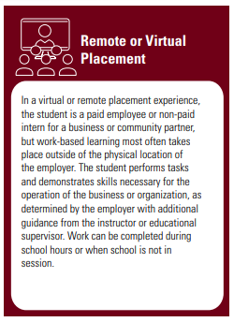
Remote or virtual placement
Student could work:
In school facilities during or after school hours**
From home before/after school & weekends
Student would interact with client/customer virtually (Zoom, e-mail, etc.)
Supervision/evaluation could occur virtually (scheduled 1:1s, e-mail, etc.) with both Employer and Educator supervisors.

Slide 11
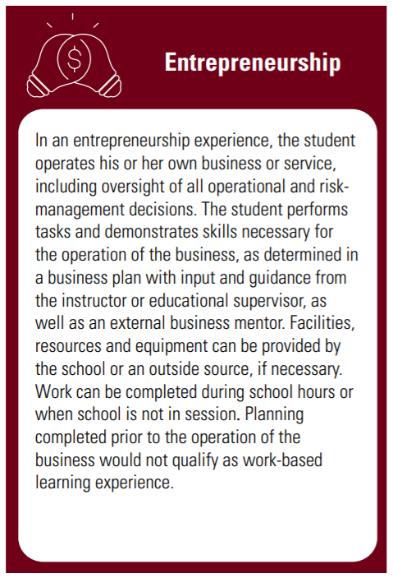
entrepreneurship
Student could work:
In school facilities during or after school hours**
From home before/after school & weekends
In another location or work site
Both the educator and the business mentor will supervise and evaluate work as it is completed independently by the student.

Slide 12
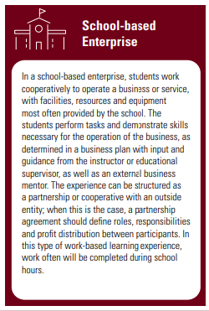
School-based enterprise
Student will likely work in the school facilities, during or after school.
Student will interact with clients/customers through services provided.
Student will likely work in the school facilities, during or after school.

Slide 13
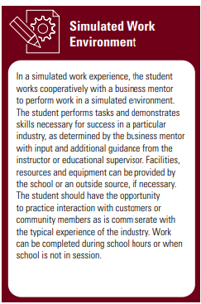
Simulated work environment
Will largely depend on design of experience
Student could work:
In school facilities during or after school hours
From home before/after school & weekends
Educator will likely be primary or day-to-day supervisor.

Slide 14
Continuum of supervision
Internship/Work Site Placement
Remote/Virtual Placement
Simulated Work Environment
Apprenticeship/Pre-Apprenticeship
Entrepreneurship
School-Based Enterprise
Scaffolding of supervision across types allows students to develop and demonstrate work-readiness – including self-regulation, ability to follow direction, etc.
All parties should be engaged regardless of setting to allow for this development.

Slide 15
Learning agreements

Slide 16
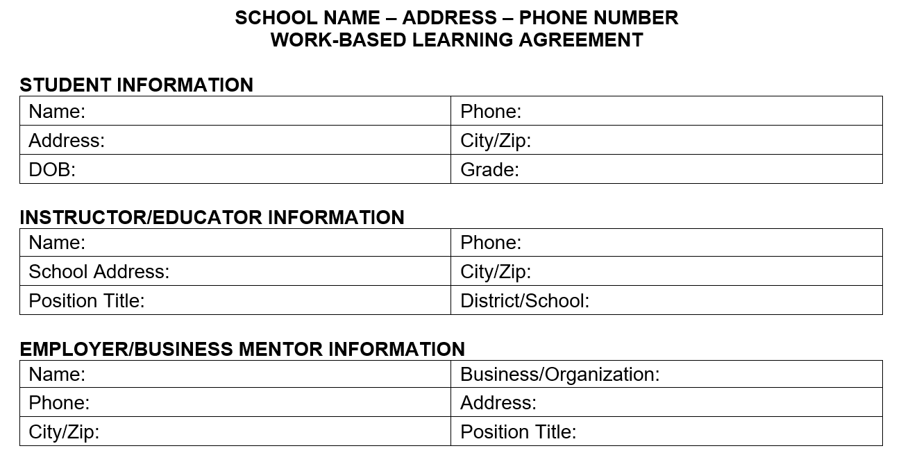
Learning agreements

Slide 17
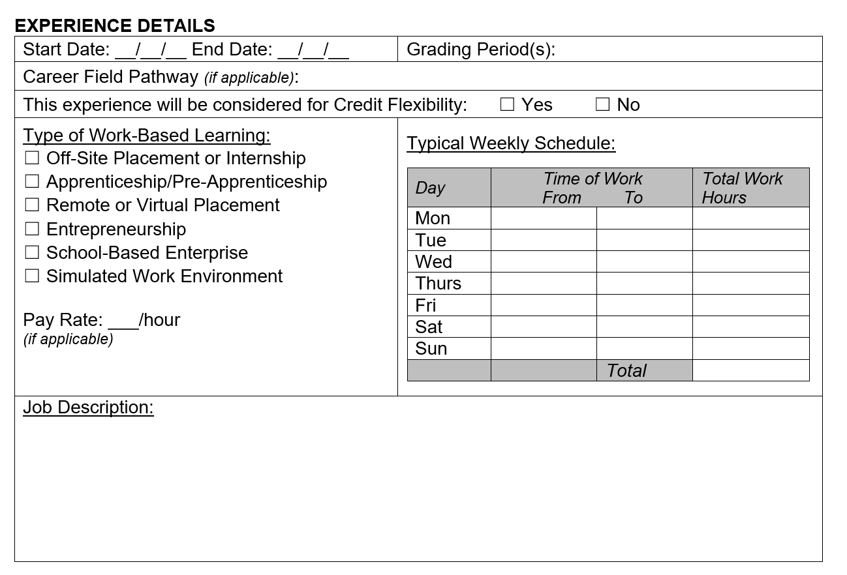
Learning agreements

Slide 18
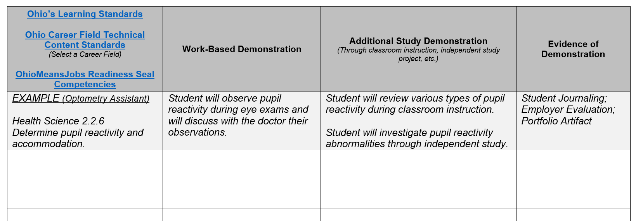
Learning agreements

Slide 19
Learning agreements

Slide 20
Roles & responsibilities

Slide 21
Why work-based learning?
Aligned Education
Industry Engagement
Qualified Workforce & Talent Pipeline
“The educational models for the past 40 years have operated with Business as an advisor. In this role, they could only inform learning experiences, with engagement being at the end of the student’s educational journey—hiring based on the level of educational attainment.
Industries and businesses need to shift their focus to engaging in the educational system as a solution partner. The time is now to invest in the supply side of this equation—WBL provides the most effective way to close the skills gap.”

Slide 22
Contact us
Brenna Bartlett
Brenna.Bartlett@education.ohio.gov
Emma Waymire
Emma.Waymire@education.ohio.gov

