Slide 1
Partners in providing paid internship opportunities to students
Patty.buddelmeyer@soche.org

Slide 2
SOCHE Overview
Non-profit founded in 1967 SOCHE, focused on engaging with colleges, universities, K-12, and industries to transform the economy through education and employment.
Annually, employs hundreds of paid interns (High School through Postdoctoral) in businesses of all types, including government agencies.

Slide 3
SOCHE Portfolio
Professional Development
Workforce Development
Vision:
An educated, employed, and engaged citizenry
High School
+
College Students
=
Tomorrow’s Workforce
Cross Registration
Councils & Committees

Slide 4
What do you know?
Notes:
We cannot talk about workforce pipeline without recognizing that most be from Generation Z
Ask what they think about Gen Z

Slide 5
Gen Z Facts
1996 – 2009
Life
Internet/Google
Smart phones
Regard September 11th as schoolbook history, but remember recessions
Social media dependent
Learn about new products
YouTube, Tic-Toc, Snapchat and Instagram
Online videos
Mental
57 million future workers
Digital photo and videos
Short attention span
Depression and anxiety
Prefer Face to Face Communication
Notes:
Oldest 26 and Youngest 13
30% of workforce
Most stressed out generation in history – cannot turn-off, pressure to achieve
8 second attention– YouTube, SnapChat, Tic-Tock
Seek authenticity and honesty which is best achieved in-person

Slide 6
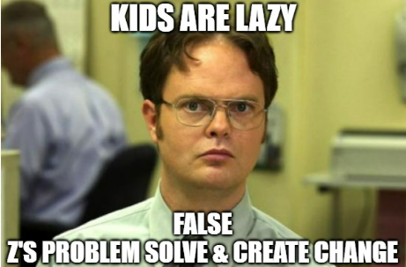
Gen Z Facts
Notes:
Gen Z does not accept “It cannot be done” or “this is how we have always done it” – they will seek the challenge to make it better

Slide 7
Attributes of Gen Z in the workforce
Problem-Solvers
Leaders and Collaborators
Creative
Drive and Commitment
Seek Knowledge and Challenges
Contributors
Notes:
Crave structure, goals, and ways to measure progress
Questions?

Slide 8
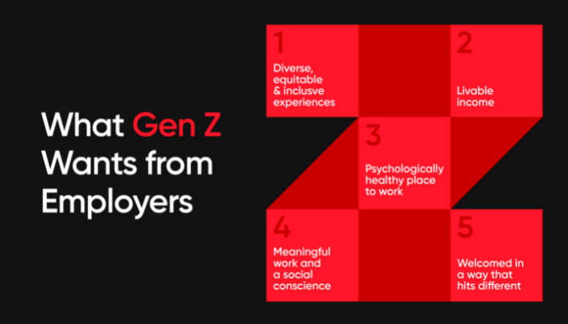
Notes:
1. Diverse –
Want a diverse slate of candidates to secure the best talent
Want training other employees (particularly older generations) on DEI
Want representation across the leadership team.
2 Income – financially responsible because of recessions and want fair pay – they will research peer pay (Looking Glass)
3. Mental Health support resources.
Manager’s role expanded as Gen Z wants to be able to speak openly to manager about both work and personal struggles
Employers need to be aware of burn-out
Incorporate fun and breaks into work environment for stress relief
Not afraid of quitting if cannot find a work/life balance
4. Want to make a difference not only in the company but world. Communicate how/what the company is doing to make the community/world better
5. How is your new employee orientation? Is it warm and thoughtful welcome?
Explain how their job relates to the company's mission
Swag
Defined support system; meet the team
Plan touchpoints to ensure they are feeling welcomed, answer question, and provide guidance

Slide 9
Communicate
Provide structure and career growth paths
Set measurable goals
Allow time and encourage creative problem-solving
Create inclusive and flexible work environment
Revisit HR policies and procedures
Provide employment opportunities to explore careers and gain experience
Strategies for Employers
Notes:
Communicate expectations and provide feedback
Tech Cred – paid companies for employees to get an industry crediental
Encourage sharing of ideas
Recognize the “normal” 9 -5 is no longer normal
Who are your policies and procedure created for? Vacation, sick/wfh. Ie. - if kid sick, do you have a take a sick day even if you can work from home.
Why does an entry-level position require 3 – 5 years of experience. Be realistic with skills and pay?
AI – ChatGPT) public domain
Out of the box – job duties – Can a job be divided up into an entry and mid-level position? Provide opportunities to explore and gain experience
Questions?

Slide 10
You Get an Intern!
You Get an Intern!
Notes:
~220,000 Juniors & Seniors in Ohio are in the pipeline every year
~43% elect College path
~57% enter Career path (~65,000 enroll in On-the-Job-Training….)
Over 200,000 college students in Southwest Ohio region
Internship programs are a great strategy to build your workforce pipeline
Enhance perspective. Augment team w/novel perspectives, fresh ideas, and specialized strengths and skill sets.
Take advantage of low-cost labor. Inexpensive & agile resources
Give back. Enhance local workforce & connect w/community
Support students. Interns gain experience, develop skills, make connections, strengthen their resumes, learn about a field, and assess their interest and abilities.
50% of interns continue working where they interned and are 58% more likely to remain at your company in 5 –year compared to a direct hire
Test drive before you buy – goes both ways.
Evaluate potential & alignment w/ culture
interns that decline FT offer state they do not like the culture, the mission did not align with their values, or do not see career growth

Slide 11
Why Hire Interns – Research says…..
Cream of the Crop - 67% of interns are offered full-time positions after their internship.
Find Future Employees - Year-round recruiting tool and ongoing pipeline.
Better Retention - Interns have significantly greater retention rates after five years when compared to outside hires. (52% vs 35%).
Test Drive - The best way to evaluate a potential employee is through an internship.
Inspire Your Best Thinkers - Interns bring fresh ideas and can work with or free time for your best employees to explore new territory.
*National Association of Colleges and Employers (NACE)

Slide 12
Why Hire Interns – Practice says….
Reduce Brain Drain – Only 69% of Ohio’s College Graduates stay in Ohio
Who stays in Ohio?
61% of Engineers
63% of Scientists
71% of Business Professionals
Demand/Competition for Talent
Fuel Ohio’s In-Demand Jobs
Ohio needs world-class talent to attract/retain companies
https://www.ohiohighered.org/sites/default/files/hei/sp18_grads_0.pdf

Slide 13
Partnering with SOCHE is easy
Step 1: (Form Partnership)
SOCHE and Business agree to work together to provide a student with an internship opportunity
Step 2: (Define Internship)
SOCHE works with Business to:
Prepare Business for hosting a high school or college student
Develop job description
Define work conditions
Step 3: (Find Talent)
SOCHE works with School to:
Ensure skill expectations are realistic
Find qualified candidates for Business to interview
Coordinate hired student’s class schedule
Step 4: (Manage Employment Cycle)
SOCHE manages onboarding, orientation, hiring, payroll actions, taxes, and insurance
SOCHE invoices business monthly for the hours the intern works
Business focuses on providing intern meaningful work and guidance
School focuses on developing student through coursework
Student continues internship opportunities through SOCHE with no transfer fees to convert to business payroll

Slide 14
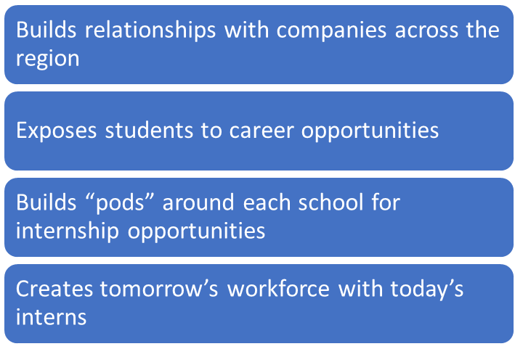
Financial Support for Companies who Hire High School Interns
Supplement’s student’s salary by at least 50% and up to 100%
Grants made possible:
Engineering & Science Foundation of Dayton
Ohio College Tech Prep
ODE
DOE
Notes:
In demand nonservice industries. Great option for your CCP students and they keep internship after graduation while going to college FT

Slide 15
Ohio High School Tech Program
Time: January – September 2024
Student Intern Hours Worked/Employer Rebate:
200 or more hours = 100% rebate up to $5000
120 – 199.9 hours = 67% rebate
Wage: at least $12 per hour
HR Services / Employer:
Option 1: student employed directly by the business (business pays student)
Option 2: student employed by SOCHE working at a hosting business
SOCHE pays student, then invoices the host business monthly for the hours the intern worked
No restrictions on the number of students in program
Rebate check sent to business in December 2024
Qualifying Positions: Electrician, HVAC, Digital Graphic Design, Help Desk, Web Design & Marketing, Video Editing, IT Field Support, Database Management

Slide 16
MVIA Grant
Time: No time windows
Hour Restriction: 250 hours per student
Wage: at least $10.45 per hour
HR Services: Student employed by SOCHE
No restrictions on the number of students in program
Rebate is applied to the monthly invoice
Sample cost:
Student Salary: $12.00 per hour (Paid by SOCHE twice a month)
Employer Hourly Cost: $8.04 per hour (valid for 250 hours, then the cost is $16.08)
SOCHE invoices the company monthly for the hours worked
Cost includes:
HR services, including intern’s salary, payroll taxes, insurance, worker’s comp, payroll fees, and onboarding/offboarding
Professional development opportunities for the intern
Qualifying Positions: Trades Assistant, Plumbing, Business Operations, Accounting, and Logistics

Slide 17
Paid Internships Opportunities
Occupations:
Aerospace
Accounting/Finance
Agriculture
Automotive
Biology, Chemistry, and Physics (all sciences)
Business Operations and HR
Computer and Cyber Security
Engineering (all fields)
Marketing/Graphic Design
Information Technology
Logistics
Manufacturing
Neuroscience
Construction/Trades
Healthcare
High School Intern
5 - 15 hours/week during school year
Up to full-time in summer
In-person, remote, and hybrid
College Intern
15 - 25 hours/week during school year
Full-time in summer
In-person, remote, and hybrid
College Co Op
Full-time for a semester
In-person, remote, and hybrid
Notes:
If struggling on what a high school or college student can do.
Ask – what tasks that I never get done?
Are there any special projects? (i.e., data entry for new crm – why pay the contractor’s rate while a high school student can do it and gain value experience?)
Where is your workforce needs in 2 -5 years?
Is there a certain department always working overtime? (Zach – reduce stress/overtime by hiring intern non-aircraft maintenance work
Increase productivity. short-term support, increased productivity
Institutional knowledge

Slide 18
How To Apply
Apply: https://www.soche.org/apply/
One application opens the door to dozens of positions at multiple organizations
Requested Information
Name, address, birth date, and phone
Non-school email address - professional
Resume, references, and work/volunteer - optional
Tips for application and employment
List skills, work, and volunteer experience
Include ALL relevant skills and courses; don’t assume the employer knows you have those skills based on your education
Be prepared to demonstrate skill knowledge
Communication
Email and phone/voicemail
Interview requests will not be sent via text

Slide 19
Items Needed to Start Employment
Proof of U.S. Citizenship or Work Visa
SSN, Driver’s License, Student ID, Passport
Bank Account in Student Name
Non-school email address
Work Permit (if under 18)

Slide 20
Student Orientation and Intern Handbook Highlights
Minor Laws (pg. 6)
Your Responsibilities (pg. 8)
Workplace Harassment (pg. 17)
Safety & Injury Reporting (pg. 20)
Drug-Free Workplace (pg. 21)
***Important for students to READ the Handbook and ASK Questions.***

Slide 21
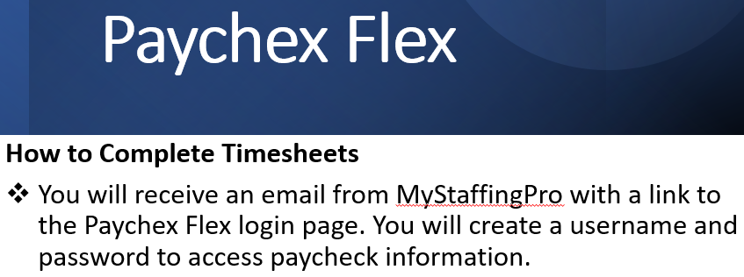
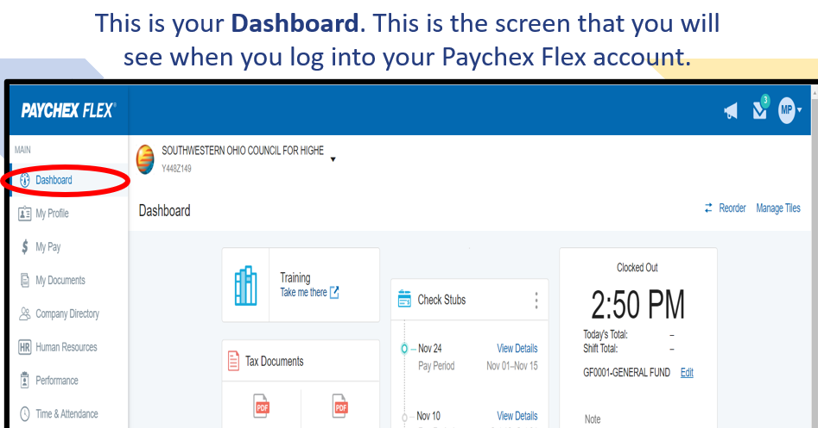
Student Pay System

Slide 22
Tips for a Successful Internship
Define clear job duties, expectations, and goals
Explain company mission and intern’s role
Conduct 30-minute individual meetings with team
Designate a mentor
Encourage two-way feedback
Include intern in team activities
Allocate time to train intern and learn from intern
Communicate long-term employment plans

Slide 23
The Impact of “Earn and Learn”?
Students paid for an internship are motivated, valued, and committed to company success
Students gain critical money management skills
The money earned during an internship helps support the student’s immediate financial needs and long-term savings goals like tuition and housing
Paid internships open the door for increased future wages and opportunities
Unpaid internships reduce opportunities for students who must work
Notes:
Find future employees. year-round recruiting tool, connect & select
Test-drive the talent. Evaluate potential & alignment w/ culture
Increase productivity. short-term support, increased productivity
Increase employee-retention rate. 40% > five-year retention rate
Enhance perspective. Augment team w/novel perspectives, fresh ideas, and specialized strengths and skill sets.
Take advantage of low-cost labor. Inexpensive & agile resources
Find free-of-charge. SOCHEengage provides extensive exposure
Give back. Enhance local workforce & connect w/community
Support students. Interns gain experience, develop skills, make connections, strengthen their resumes, learn about a field, and assess their interest and abilities.
Offering a paid internship is particularly beneficial, because it enables economically disadvantaged youth to participate. Students who have to help fund their own schooling will need a job, regardless. Providing an internship allows that job to facilitate a positive future.
Benefit your small business. When looking for fulltime work, the top talent often go for big-name businesses. But when seeking internships, learning is the leading draw. Many candidates feel they'll get more hands-on training, real experience, and mentoring opportunities with smaller organizations.
Employer takeaway: In terms of both today's workload and tomorrow's workforce, starting an internship program is an excellent way to facilitate success at your small- or medium-sized business.

Slide 24
Resources for Students, Employers, Educators, Mentors, Parents/Guardians https://www.soche.org

Slide 25
Questions?
Patty.buddelmeyer@soche.org

