Slide 1
Data Coordinators Meeting
October 17, 2023

Slide 2
Agenda
MAARS Team Introductions
State Reporting
22-23 SIRS Staff Evaluation
23-24 SIRS Staff Reporting
23-24 SIRS Student Reporting
Level 0 Updates
PD Reporting
BEDS Reporting
Enrollment start dates for Sp. Ed. Students
Level 1 Updates
COGNOS Preview of Changes
eDoctrina Imports Reminder
NYS Testing Updates
SEDREF
CBT
New Grade 2 NYSESLAT
Regents
January reminders
August updates
NYSITELL
Student Digital Resources
Trainings
New DDC
Level 1
CBT Roadshow

Slide 3
MAARS Team Introductions
Contact MAARS (monroe2boces.org)
Meeting Handouts:
https://www.monroe2boces.org/2023-10-17Meeting.aspx

Slide 4
State Reporting

Slide 5
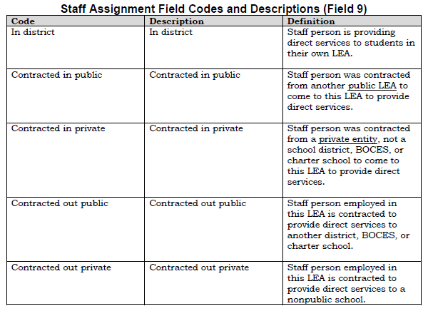
2023-2024 SIRS Changes for Staff Reporting
Staff Assignment
Added Assignment Field (9): identifies the type of assignment
Added Percent Time Assigned (18): collects percentage of time the person is assigned such responsibilities in a particular location
Only required for social workers, counselors, nurses, school psychologists

Slide 6
2023-2024 Staff SIRS Changes
Staff Assignment
Code changes for counselors and nurses
Staff Snapshot
Years of Teaching Experience: teachers new to the LEA should be asked to provide years of prior experience
Should include non-teaching professional assignments as well
ACTION | LOOKUP_NAME | CODE | DESC
ADD | STAFF ASSIGN CODES | 0717 | DIRECTOR OF DIVERSITY, EQUITY AND INCLUSION
ADD | STAFF ASSIGN CODES | 2214 | PHYSICIAN ASSISTANT
ADD | STAFF ASSIGN CODES | 4611 | CERTIFIED ATHLETIC TRAINER
REMOVE | STAFF ASSIGN CODES | 2107 | ELEMENTARY SCHOOL COUNSELOR
REMOVE | STAFF ASSIGN CODES | 2108 | ELEM SCH COUNSELOR-BILINGUAL
REMOVE | STAFF ASSIGN CODES | 2109 | MIDDLE SCHOOL COUNSELOR
REMOVE | STAFF ASSIGN CODES | 2110 | MIDDLE SCH COUNSELOR-BILINGUAL
REMOVE | STAFF ASSIGN CODES | 2111 | JUNIOR HIGH SCHOOL COUNSELOR
REMOVE | STAFF ASSIGN CODES | 2112 | JUNIOR H S COUNSELOR-BILINGUAL
REMOVE | STAFF ASSIGN CODES | 2113 | SENIOR HIGH SCHOOL COUNSELOR
REMOVE | STAFF ASSIGN CODES | 2114 | SENIOR H S COUNSELOR-BILINGUAL
REMOVE | STAFF ASSIGN CODES | 2115 | MIDDLE/JR.-SR. H S COUNSELOR
REMOVE | STAFF ASSIGN CODES | 2116 | MIDDLE/JR-SR H S COUNSELOR-BIL
REMOVE | STAFF ASSIGN CODES | 2202 | DIRECTOR SCH HEALTH SERVICES
REMOVE | STAFF ASSIGN CODES | 2209 | NURSE PRACTITIONER

Slide 7
23-24 Staff BEDS Day Reporting
Preliminary Staff Snapshot & Staff Assignment data due Thursday, November 16, 2023
Preliminary Course Instructor Assignment & Student Class Entry/Exit due Thursday, January 25, 2024
Be sure to report Special Education and English as a New Language teachers in their own courses or by using the correct indicator/teacher role on the course section.
Be sure to report librarians by assigning them to the course 99000- Library (Library Media Specialist).
Check out SIRS Manual for new course codes for counselors who teach classes.
Final Teacher Out of Certification data due Thursday, May 16, 2024
The official NYS Out of Certification match is performed based on data through May 16, 2024. SIRS-328 Out of Certification report will be frozen as of this date.
Recommendation: Give appropriate HR staff SEDDAS entitlements to the Staff folder in L2RPT so they can review the SIRS-328 and SIRS-329

Slide 8
Questions?

Slide 9
2023-2024 Student SIRS Changes
Assessment Fact
Removed ALTREG and CCR test groups All AP and IB exams should be reported under ADV test group
AP and IB exams that have an asterisks are approved alternative to Regents and need to have a Standard Achieved code reported
LOTE Checkpoint B is now World Languages Checkpoint – B
Added Regents Algebra I (NGLS) – Jun
New Course Code for Algebra I – 02050
Grade 5 Science Course Code – Grade 5 Science - 53235
Program Fact
Removed 0330 – Title I Migrant Services
Report Migrant students with migrant indicator in Student Lite Template
Will receive notification letter from METS office
Migrant students remain eligible for METS for 36 consecutive months

Slide 10
SIRS Updated Guidance
When a Home Schooled student transfers out of your district
Use Reason for Ending Enrollment Code 255 – Transferred to home schooling by parent or guardian if parent plans to continue homeschooling in new district.
When a home schooled student transfers to home schooling in another district or state, the district should exit the student with a Reason for Ending Enrollment Code 255 – Transferred to home schooling by parent or guardian. A formal notice of transfer and intent to instruct the student at home in the new location is required.
First Date of Entry into Grade 9: Month, day, and year on which the student first entered grade 9 anywhere. Do not enter this information until the student first enrolls in grade 9. This date should not be changed unless the student is an ELL with low literacy level (see Secondary-Level students in Chapter 2). Students with disabilities, who are reported as ungraded for enrollment purposes, must be assigned a first date of entry into grade 9 not later than the first school year during which the student:
is enrolled in a school where the earliest grade is grade 9; OR when a school has grades earlier than grade 9 (e.g., K-12, 7-12), the first school year during which the student participates in any instructional and/or noninstructional activities with his/her same grade 9 aged nondisabled peers (e.g., student participates in extracurricular activity with 9th grade peers; student enrolled in music class with 9th grade peers; student attends grade 9 special or general education classes); OR
turns age 17, whichever occurs first.

Slide 11
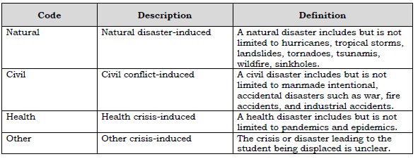
Crisis/Disaster
A youth of compulsory school age presented at the school for registration that may or may not have all required documentation due to a disaster must be reported with the appropriate crisis/disaster code (category) and when known, the name of the crisis or disaster that led to the student being displaced. This would be reported only in the school year in which the impacted student is first presented at the school for registration. If the student also meets the criteria as an Immigrant student, Program Service Code 8282 must also be reported in Programs Fact. Report this information to the SIRS as early as possible each school year, including students who registered over the summer.
Data due Thursday, October 19

Slide 12
Questions?

Slide 13
IMF BEDS Data (Districts, BOCES, Charters, and Non-Public Schools)
This data is not collected through SIRS
IMF (Institutional Master File) form is available on the Data Exchange (IDEx) via Application Business Portal
Religious and independent school immigrant student counts should be included on your BEDS District Summary form. This data is collected for Title III funding allocations.
Due Friday, November 17
Resources: https://www.p12.nysed.gov/irs/beds/IMF/home.html

Slide 14
Student BEDS Data (Districts, BOCES, & Charter Schools)
BEDS Day Enrollment Extract (SIRS 312, 313, 314, 316, 319, 350)
Enrollment by grade, district of residence, district Pre-K, and supplemental enrollment counts are collected for calculating preliminary State Aid allocations
BEDS Day Free and Reduced Priced Lunch Extract (SIRS-323 and SIRS-327)
Due Thursday, January 4

Slide 15
August Graduates
SIRS Templates: Student Lite, School Entry/Exit
Data:
Student Lite: Credential Type and Career Path
School Entry/Exit: Enrollment Exit Date and Enrollment Exit Code
Verification L2RPT: SIRS-308 Annual Graduation Report
Data due: Thursday, October 19

Slide 16
Student Digital Resources Survey
SIRS Template: Student Digital Resources Survey
Annual Collection – Districts, BOCES and Charter Schools are to survey parents/guardians each school year
Verification L2RPT: SIRS-336 Annual Digital Resources Survey Report
Data Due: Thursday, January 25

Slide 17
Program Service Data
SIRS Templates: Program Fact
SIRS BEDS Day Extracts
Free & Reduced Lunch and Poverty (5817, 5806, 0198)
Only students who meet the eligibility requirements
Verification L2RPT: SIRS-323 and SIRS-327
Data due Thursday, January 4
Eligible for Alternate Assessment (0220)
Verification L2RPT: SIRS-401 Reasonableness Report
For enrollment load to KITE Educator Portal for NYSAA
Data due Thursday, November 9
Summer School Program Services
Verification L2RPT: SIRS-401 Reasonableness Report
Data due Thursday, August 15

Slide 18
Questions?

Slide 19
Level 0 Updates
Current version 19.0a
Updated level0.monroe.edu 19.0 on September 24th to open 2023-24 School year
Revalidate all records upon import
Informational error counts column and a refresh button on the dashboard
Staff attendance codes ( Districts and Charter Schools )
Password expiry notifications

Slide 20
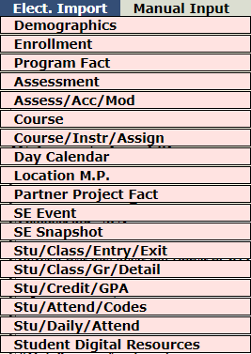
Level 0 19.0
Re-validation of all records
Upon electronically importing for any data domain, level 0 will re-validate all records on import.
Previous versions of level 0 would filter-out any unchanged records from re-validation upon import.
Notes:
Implemented as part of Ed Law 2(d)
14 days is the maximum allowed

Slide 21
Level 0 19.0
Informational Error Messages
There are three different types of Level 0 errors:
• Import
• Warning/Fatal
• Information/Warning
Import and Warning/Fatal errors must be resolved before a school district can move their data to the next level of the Data Warehouse
Information/Warning errors allow the data to move, however, the data should be reviewed for necessary corrections prior to finalizing the submission to SIRS

Slide 22
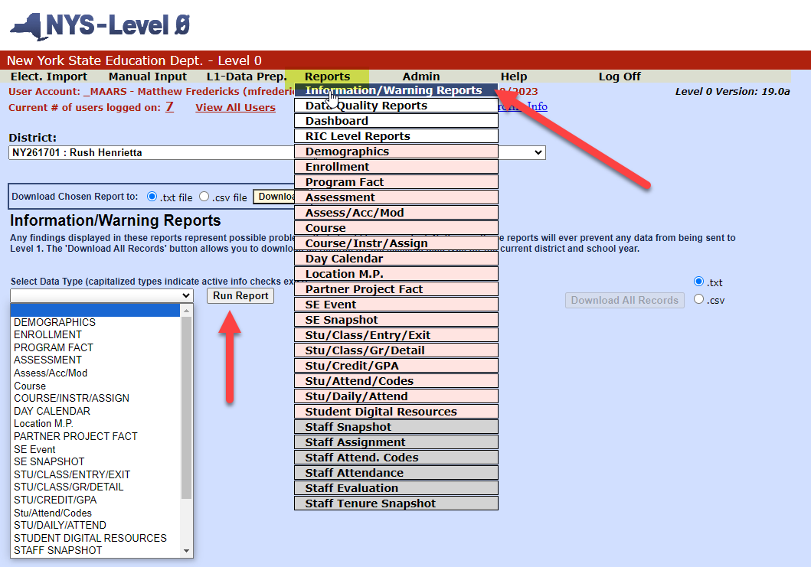
Level 0 19.0
Informational Error Messages
View Informational error messages – old method.
Notes:
Implemented as part of Ed Law 2(d)
14 days is the maximum allowed

Slide 23
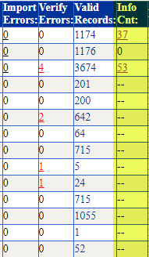
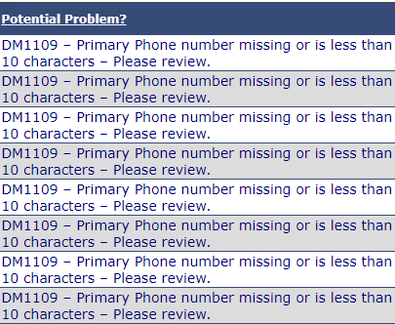
Level 0 19.0
Informational Error Messages
Informational Error Count column – viewable from dashboard
Information error messages will be refreshed when:
“Run All Information Checks” button is selected from the Dashboard.
Individual templates are run from the “Information/Warning” reports screen.
Validations are run from the L1-Data Prep.
Dashboard view
Sample Report

Slide 24
Level 0 19.0
Staff Attendance Codes
Only applicable to Districts and Charters that report staff attendance
Codes are pre-populated in level 0
Still require DDCs to export to Level 1 via the L1-Data Prep

Slide 25
Level 0 19.0
Password Expiry Notifications
Passwords expire after six months
Expiry notifications will be periodically sent out to users whose password has expired in the past 12 months
Includes users with passwords that are about to expire in the next 10 days
Sample:
EXPIRED
Hello,
This is a friendly reminder that the password for the Level 0 user account with the following information has expired:
User Name: Matt Fredericks
User ID: mtest
Password Expired On: 2023-10-15
Last Login Date: 2022-11-30
You may reset your password at any time by going to your Level 0 login page:
https://level0.monroe.edu/login.aspx
Thank You

Slide 26
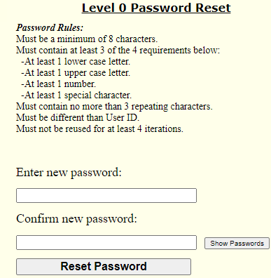
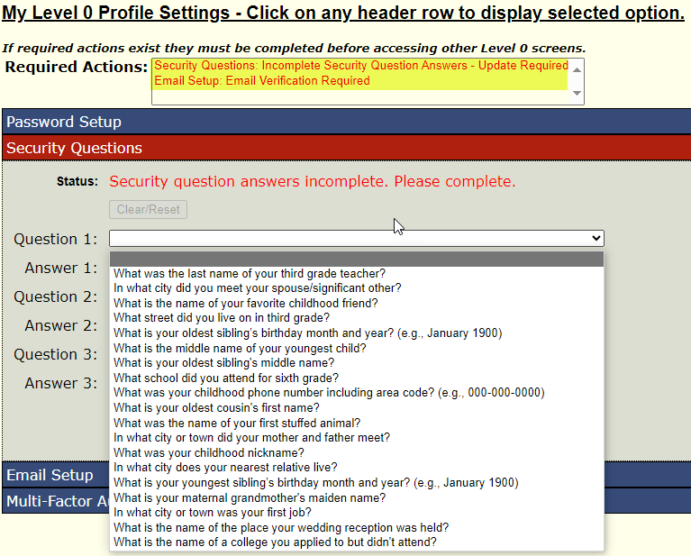
Level 0 19.0
Security Questions and email confirmation from 17.0
New users to either https://level0.monroe.edu or https://level0-test.monroe.edu must complete upon first log-on. Passwords for each site could be different. Returning users who request their password to be reset will need to redefine new security questions. But you may pick the same ones.

Slide 27
Reminders:
Security Forms for Student and Staff data were due 10/6/23
Private Schools and Charters: Email your rollover requests to mfrederi@bocesmaars.org for Demographic, Enrollment, and Program Fact. Staff snapshot rollovers request can made at this time.
Please check the Help section for template changes and other helpful documentation for this release and future level 0 changes.

Slide 28
Pupils with Disabilities Reporting
Notes:
Pupils with Disabilities Reporting

Slide 29
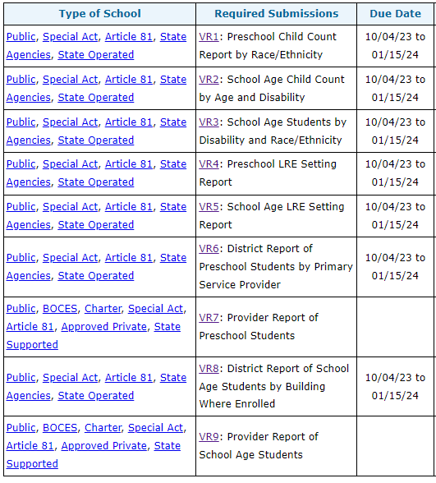
PD BEDS Reporting
Special Education Snapshot Data for BEDS day
Populates VR’s 1-6, and VR 8 in the PD Data System
Preschool Reports: VR1, VR4, VR6, VR8
School Age Reports: VR2, VR3, VR5
VR7 and VR9 informational reports – review for accuracy
Required submissions and instructions for each report can be found on the SEDCAR site:
https://www.p12.nysed.gov/sedcar/data.htm#subschedule
Notes:
The October Snapshot reports preschool and school age SWD data and is certified in the PD Data System by your PPS/SPED Director or Superintendent

Slide 30
PD BEDS Reporting
SPED Data to Upload through SIRS for BEDS Day Reporting
Type of Disability Preschool and School Age disability codes
BEDS / October Snapshot Includes students with an IEP in effect on BEDS day, and with programs or related services that span BEDS day 10/4/23
Notes:
Coordinate the upload of the special education data which is contained in the Type of Disability and BEDS/October Snapshot.

Slide 31
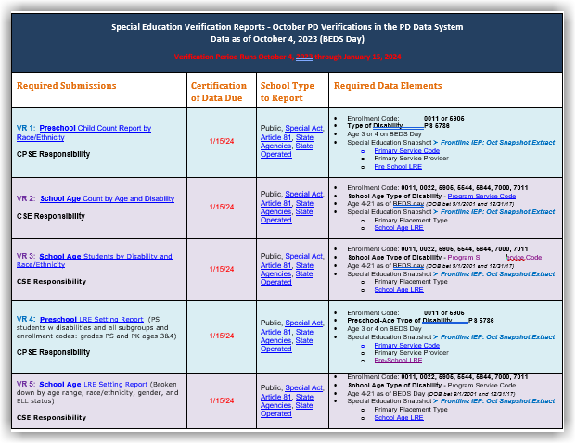
Verification period is open - PD Data System is accepting data and refreshing daily
Certification in the PD Data System is due by January 15, 2024 – LAST Level 0 upload date: 1/11/24
Make your due date at least 2 weeks prior
Notes:
HANDOUT:
This reporting table handout lists the data points used to fulfill each VR, and which entities need to report and/or review

Slide 32
PD Reporting: Enrollment Reminders
Preschool Students - 4034 Determining Eligibility enrollments need to be reported throughout the year as they happen
Start Date: Date of Referral to CPSE
End Date: Date determination made, or the process ended
In Frontline, the determination date is contained in the student’s Process Tracking record – this is the date the 4034 enrollment should end
End Code: ALWAYS 140
Start 0011 the next day for students found Eligible (See TRR for PS Age and PK Students, Scenario #2)
Use location code of provider
If unable to procure provider or on a waitlist, use 0777 home bound location

Slide 33
PD Reporting: Enrollment Reminders
To Avoid Level 0 Errors on Your TOD Import:
All preschool-age students with disabilities (CPSE) who transition to Kindergarten in September require a 'summer enrollment', even if they did not receive ESY services, including those declassified as CPSE at the end of the summer.
Needed to report the 5786 PS Type of Disability Code captured in the Year-End Snapshot reporting for VR13
Grade Level: Report Student with a PS grade level UNLESS they were enrolled in PREK in the previous year, then continue the PREK grade level
0011 Enrollment for Students who did not receive ESY:
Use 0777 location code, OR the previous year's location code
011 Enrollment: Students who received ESY:
Report enrollment with the location of the service provider
NOTE: CPSE students declassified before July 1 do NOT require a 'summer enrollment’ and can be started at the Kindergarten grade level starting 7/1

Slide 34
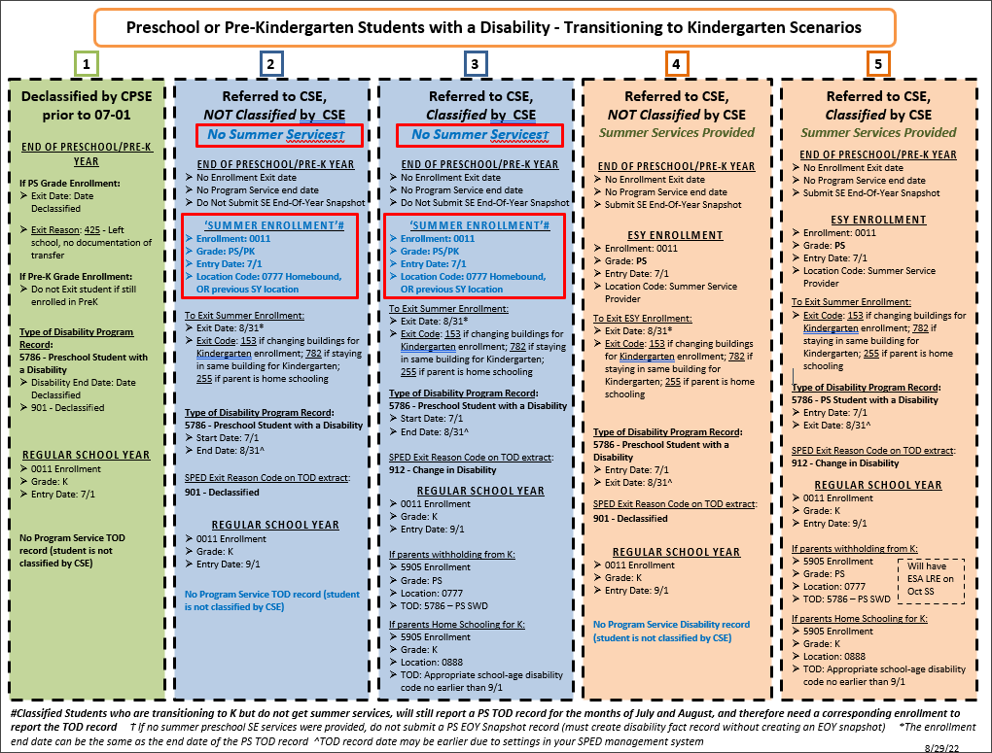
Notes:
Sample of CPSE to K Transition table available as a handout

Slide 35
PD Reporting: Enrollment Reminder
Report Home Schooled Students with a 5905 ‘CSE Responsibility Only’ Enrollment under the following circumstances:
NEW! Home schooled students classified as a SWD, even if they are NOT receiving services
Classified home schooled students will report with a TOD record
Only those classified and receiving services on BEDS day will report to the October Snapshot for VR2, VR3, VR5, VR8
Home schooled students referred to CSE for evaluation
End enrollment with 140 when determination is made
Notes:
You will receive an error upon import for your TOD if you do not also have a 5905 enrollment for all Home Schooled students who are classified – ASK your PPS Office for a list of all students who are home schooled but not receiving services.
Must also report 5905 enrollment for home schooled who are being evaluated for CSE

Slide 36
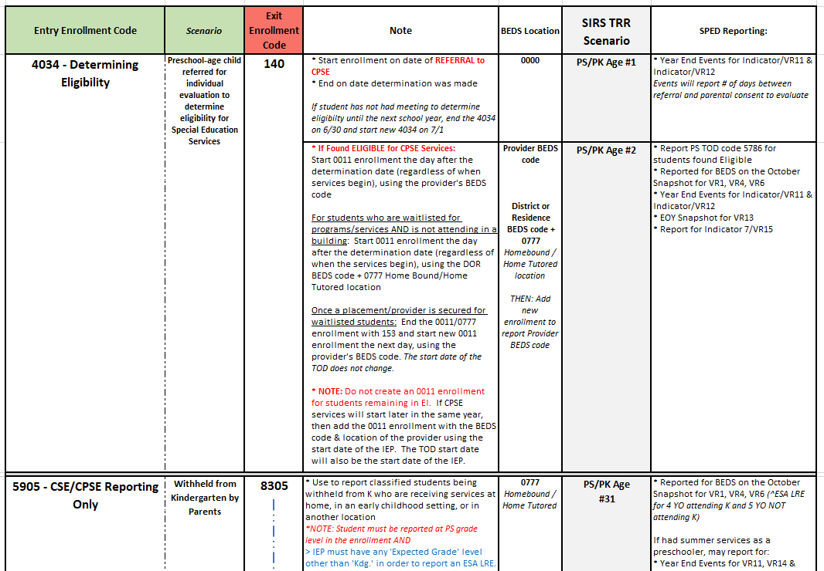
PD Reporting: Enrollment Reminders
4034 and 5905 Enrollment Quick Look for Students with Disabilities Reporting
Notes:
See Quick Look handout for details on 4034 and 5905 enrollments for SWD
Including:
Withheld from K
Parentally Placed
Home Schooled

Slide 37
PD Reporting: Enrollment Note
Approved Provider Locations Not Found in Level 0
CHECK SEDDAS site to see if the entity has a BEDS/Institution code
https://www.p12.nysed.gov/sedcar/locationcodes.html
If it is a preschool provider that does not have a BEDS code, then use the County location
If you can’t find the BEDS code of the school in which the SWD is enrolled, or by whom the student is provided special education services, contact the SEDCAR unit by email at datasupport@nysed.gov. The district may need to apply for an institution code for a ‘noncompliant Religious or independent (nonpublic) school’ (see TRR #11)
Run a SEDREF Query to find specific institution information
https://portal.nysed.gov/pls/sedrefpublic/SED.sed_inst_qry_vw$.startup
Copy the web address of the query result and email to Matt Fredericks – the location will be added to your Level 0 tables
Notes:
With providers being in flux, some service provider locations have closed, while others have opened or changed locations.
If you encounter a location that is not found in Level 0, this is what you need to do:

Slide 38
PD Reporting: MAARS Contacts for Data Reporting
PD Reporting through SIRS:
Kerri Baxendell 349-9077 kbaxende@bocesmaars.org
Level 0:
Matt Fredericks 349-9064 mfrederi@bocesmaars.org
SIRS Data:
Laurie Hazard 349-9051 lhazard@bocesmaars.org
SMS Specifics: Contact your SMS Liaison
Notes:
Watch the MAARS Weekly for any PD reporting updates or supplemental help sheets

Slide 39
Level 1
COGNOS Upgrade Preview
Tentative date Level 1 will shut down on Nov. 2-3
Upgrade will be live on Nov. 4
eDoctrina Imports

Slide 41
District Dashboard Shows at a Glance What You Might Want to Dig Into

Slide 42
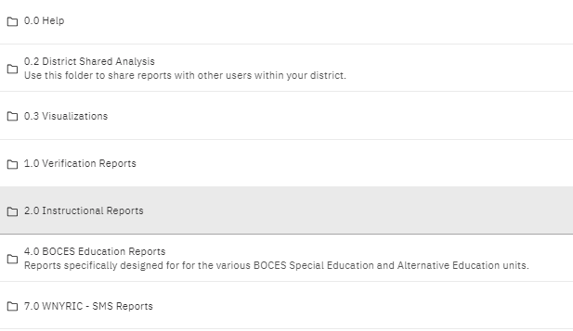
You Can Still Go to the Team Content Tab to find old favorites…

Slide 43
Double Click on District Enrollment

Slide 44
Takes You to the Enrollment Dashboard Defaults to BEDS Day #s Defaults to BEDS Day #s

Slide 45
Back to the District Dashboard, click on Assessment Overview

Slide 46
Assessment Overview

Slide 47
Lorena will be Offering Several Trainings
Recorded Videos (available by Nov. 4th)
DDC Zoom Trainings (Nov. 6, 9, 13)
Beginners: Navigation of Team Content - first hour
Experienced: Exploration of new features - second hour
School Administrators
Scheduled individually after Nov. 13th
Beginner and Veteran users of Level 1
Zoom or in-person options

Slide 49
Set up a call with Ryan to get a quick overview of eDoctrina and how to import into it
Book a meeting with Ryan
PDF with directions for 3-8 & Regents

Slide 50
SED Testing Updates

Slide 51
SEDREF – Keep Up-to-date
Please keep SEDREF updated.
Test Coordinators (3-8 & NYSAA), Principals, Superintendent, ASI… etc.
These data are used by NYSED for …
Sending information to all schools such as NYS Exam ordering memos and other important information.
CBT (computer-based testing) user access to Nextera Admin
(ELA, Math and Science)
CBT (computer-based testing) user access to Kite Educator Portal (NYSAA)

Slide 52
3-8 Assessments – ELA, Math & Science Ordering Memo
NYSED ELA, Math & Science Assessment Ordering Memo:
Memo(email) went out October 3rd from EXAMREQUEST(NYSED) to Principals and school leaders.
Memo includes important information concerning
Operational CBT required grade 5 & 8 ELA, Math, Science participation.
Selecting a Lead Scoring Entity in your exam orders for CBT
Participation in Statewide CBT Simulation as well as Stand-alone Field Tests.
CBT Simulation is required for all schools participating in Operational CBT.
Please make sure to carefully review all information in this memo.
The ordering window will close end of day NOVEMBER 10th.

Slide 53
Paper Based Testing (PBT)

Slide 54
Changes to Exams and Answer Sheets
NYSESLAT grade band 1-2.
This grade band will be separated into 2 separate exams...
One NEW test & answer sheet for grade band 1 and one NEW test & answer sheet for grade band 2
NEW Science 5 exam & answer sheet for PBT.
More details to come...

Slide 55
Computer Based Testing (CBT)

Slide 56
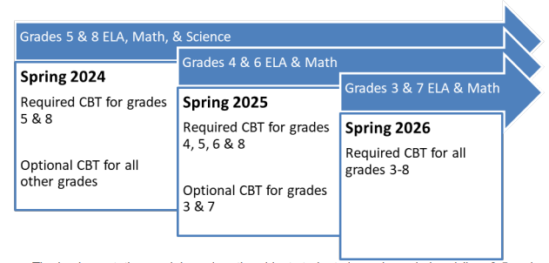
NYSED Role-Out Of Computer Based Testing (ELA, Math & Science)
For additional information – refer to the NYSED June 16th memo located on the NYSED State Assessment Webpage...
http://www.nysed.gov/state-assessment/computer-based-testing-cbt

Slide 57
3-8 Assessments – New Schools starting CBT
KEY ITEMS TO BE IN PLACE BEFORE A SCHOOL ATTEMPT TO MOVE INTO OPERATIONAL CBT:
Nextera Admin Roles & Responsibilities (understand the different types of users and their role in CBT)(updated October 2023)
Classroom practice for the students and teachers using the secure browser CBT practice tests and question sampler.
Participate in at least ONE CBT Simulation or CBT Field Test.
Review your technology:
You MUST have a tech person within your school/district
Student computer devices (good idea to have extra devises... Important security steps to be in place... etc.)
School internet servers
Carefully reviews the Tech Standard manual (and the Technology Readiness Checklist)
Each year schools need to verify “Tech Readiness”.
This occurs every year for all CBT schools, CBT veteran schools as well as new schools to CBT (required by NYSED)
Your tech person MUST be available during the CBT testing windows!!
When a school grade/content area moves to operational CBT. That grade level/content area student(s) would need an IEP or 504 to take the paper version of that test, instead of taking it via CBT. Not doing so could equate to an Administrator Error.
A student cannot be given certain accommodations in CBT without having an IEP or 504 for that accommodation. You should become familiar with the CBT accommodations.
CBT RESOURCES (SECTION ON CBT SUPPORT) << LINK

Slide 58
CBT Technology Readiness
(found on CBTsupport Website)
Technology Readiness opened in Nextera Admin October 3rd
(Please Note: Tech Readiness is required by all CBT schools … every year)
DEADLINE to complete TECH-READNESS This Year: December 29th
Below are a few links to CBT support articles that will help your school with the Tech Readiness process
Do I need to verify Technology Readiness if my school has ordered Grades 3-8 operational CBT ELA or Math? (this article also has a CBT Technology Readiness - Quick Reference Guide document available via a link at the bottom of this article)
How can I test my school's internet network for supporting the operational CBT administration?
Best Practices: Computer-Based Testing "Tech Tips"
There are many more resources the NYSED CBTsupport.

Slide 59
Nextera Set-Up and Clean-Up High Level Overview for Computer Based Testing.

Slide 60
Accessing Questar Secure Browser Practice Tests AND Question Sampler
It is important that all NEW CBT schools have their students use these practice tests before they sit for the "live" tests. This will help them get used to using the features and tools in each of these tests.
NYSED strongly recommend that ALL schools, (including Veteran CBT schools) have their students work with the Science 5 & 8 Practice tests. This will give the students a chance to practice with the different tools and features that will be used in these tests.
SECURE BROWSER PRACTICE TESTS:
The link below will take you to the ELA, Math and Science practice tests
Questar Secure Browser Practice Test Logins
QUESTION SAMPLER:
New York Question Sampler

Slide 61
Computer Based (CBT) version of Field Testing
From the NYSED Assessment Order Memo:
All schools are strongly encouraged, especially those that have not yet administered CBT, to participate in computer-based field testing in Spring 2024 as field testing offers the opportunity for schools to assess their technology readiness for CBT and provides administrators, teachers, and students an opportunity to become familiar with CBT in a low-stakes testing environment.
Important Note:
When entering your order(s) for your Field Test choices please keep in mind that grades 5 & 8 Field Tests will be given via computer (CBT) format only.

Slide 62
CBT - Some Encouraging Words
We have had 9 districts and both our BOCES in our area that have been 100% CBT over the last couple of years! 100% CBT both in ELA and Math … ALL grade levels… and have been doing very well with it!
There are lots of resources and support available to you.
Which includes us. We are here to help!
You know where to find us!!

Slide 63
CBT Simulation
Same as last year... All schools that will be participating in Operational CBT are also required to participate in the CBT Simulation.
Science will be part of the Simulation this year.
Important Dates:
Coming soon … waiting to hear back from NYSED on the deadline dates for student data to be setup in Level 2.
CBT Simulation testing window: January 16 – January 26

Slide 64
Math & Science Alt. Languages PBT & CBT
Important Change Starting this year … Alternate Languages
There will be NO alternate languages available for CBT (Computer Based Tests)
Alternate languages will be available as paper-based tests (PBT) only.
An ELL student who wants to take the test in English on the computer and have paper copy of the alternate language editions can still do that.
The alternate languages for this year's Math and Science are … Arabic, Bengali, Chinese(Simplified), Chinese(Traditional), Haitian-Creole, Korean, Russian, and Spanish.

Slide 65
Nextera Admin Update – Local ID Number
Local ID numbers are no longer required in Nextera Admin.
Users will see the field in Nextera Admin, but do not have to complete it when adding a student.

Slide 66
Scoring Materials ELA, Math and Science (CBT & PBT)
Scoring materials for ELA, Math and possibly Science(this year) will need to be accessed via Nextera Admin's "Help" tab drop-down menu this year.
All schools (superintendents, principals and test coordinators) should have received their "Welcome to Nextera" (Nextera Login) emails by now.
Please contact us if these folks, at you school, had not received their Nextera Login.
If you any have questions, please do contact me.

Slide 67
What's New in 2023-24 – From NYSED
NYSED has made some updates pertaining to CBT & PBT. They created a small manual that details each of these updates. The manual will be posted with the power point and other materials from this meeting on our Website. A snap-shot of the document cover is displayed below (along with the name of the document when saved on our website). Once the materials from this DDC meeting have been posted to our Website, please take a moment to review these updates.
What's New in-2023-24-CBT-PBT-NYSED.pdf

Slide 68
NWEA vs. Questar -- Updates
NWEA Rebranding
The team and platform are the same and some things this year will stay Questar, but you will start to see NWEA more...
What will remain with the Questar branding?...
Nextera Admin
Questar Secure Browser on your desktop
Questar Tech Readiness website
Question Sampler URL
Test Delivery System (TDS)
Where will you see NWEA?...
2023-24 manuals and support materials will reflect NWEA
Customer Support will now be contacted through NYTesting@nwea.org

Slide 69
3-8 Testing - Questions

Slide 70
Regents
August Regents – Demographic (Student Lite) and Enrollment (School Entry/Exit) must be in Level 1 before we can report your August Regents scores
2024 Regents Exam Dates
January 2024 Regents Examination Schedule (nysed.gov)
June 2024 Regents Examination Schedule (nysed.gov)
August 2024 Regents Examination Schedule (nysed.gov)

Slide 71
NYSITELL
M.A.A.R.S. High Level Process
Forms have not changed since May 2018
M.A.A.R.S. will load NYSITELL results to Level 1, on the last Wednesday of each month starting in October, for all schools.
Verification reports:
L1: Accountability: Assessment Scores, Levels, Trends & Grad>NYSITELL&NYSESLAT>NYSITELL Student Scores
L2: L2RPT Reports-SEDDAS>Tested/Not Tested>SIRS-104 NYSITELL Summary Report
NYSED is not providing the conversion charts for NYSITELL exams.

Slide 72
Digital Resources Survey
MAARS Student Digital Resources Survey Service
MAARS offers pre-printed survey sheets and processing for the Student Digital Resources Survey
If your school plans on using MAARS for preprinting/scanning please reach out to Michelle Ryan and Patty Zeiner.
High Level Process
Digital Surveys are printed using student data in Level 0
Demographic (student lite) and enrollment (school entry/exit) data must be in Level 0 before we can preprint surveys
PROCESS
The process is modeled after our Regents process using Teleform software. The survey is available in English and Spanish.
There are two sort options for pre-print survey sheets
BLDG, GRADE, LAST NAME
GRADE, LAST NAME
MAARS will pre-print survey sheets with 20 blanks for each school. If needed, schools can request additional blanks. Please contact Patty Zeiner 349-9053 or pzeiner@bocesmaars.org
MAARS will notify schools when pre-printed sheets are ready for pickup.
PROCESSING
Districts will use Teleform to scan and verify survey sheets
Charters will deliver completed surveys to MAARS for processing.
A CSV file will be generated with the survey responses.
MAARS will post the file for Charter Schools on the FTP under 2023-2024/Digital Equity Survey
Districts and Charters are responsible for importing this data to Level 0 for State Reporting by Thursday, January 26

Slide 73
MAARS Professional Development Opportunities

Slide 74
MAARS Professional Development Opportunities
New District Data Coordinator Trainings
Level 0
State Reporting Basics
MAARS Spotlight Series
Short (approx. 1 hr), focused trainings that providing a deep dive into one or two topics
Look for announcements, dates, and sign ups in our MAARS Weekly Digest
Lorena and Ryan post their PD to the MAARS homepage!
Data Warehouse, Assessment Best Practice

Slide 75
Next Meetings:
December 4th
10-11:30
March 4th
10-11:30
May 6th
10-11:30
Same zoom link as today!

