Slide 1


MAARS – Regional DDC Meeting
December 2, 2025
10 am

Slide 2
Agenda
    Level 1 – What you should be checking out right now!
    State Reporting
    24-25 BEDS Day Reporting
    24-25 Student Digital Resources Survey
    24-25 CIA/SCEE
    NYSESLAT Pre-ID
    Monthly Data
  Level 0 Updates
  PD Reporting
    Jan Reporting
    Special Ed. Events Reporting Update
  SED Testing Updates
    3-8 Testing
    January Regents
    Student Digital Resource Survey
Notes:
Bridget

Slide 3

Introduction to our new SchoolTool Liaison!
Chris Lally
Email: Christopher_Lally@boces.monroe.edu

Slide 4

Timely Level 1 Updates
3-8 Data by Subgroups
Reviewing for January Regents

Slide 5
Districts ESSA Results
Creates a Need to Dig into Subgroups of Students and
view the Intersectionality of Student Subgroups
(students belong to more than one subgroup)
EDUCATION Type
Economic Status
ELL Eligible
Ethnicity
Gender

Slide 6
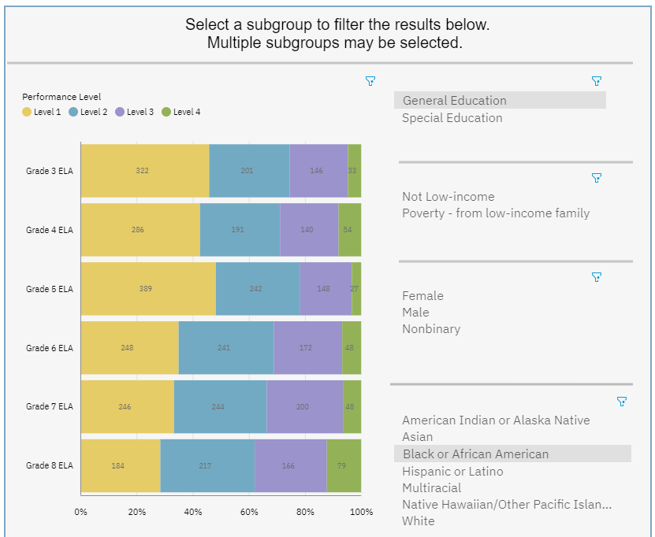
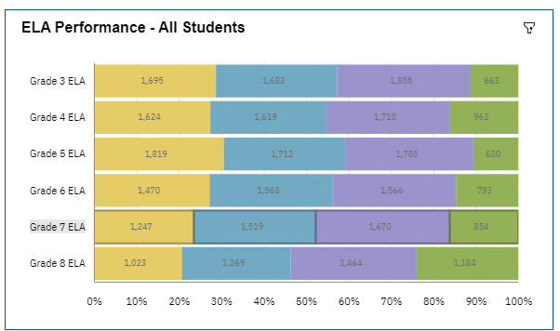
Generate Performance Data for Subgroups
Path to Follow: Team Content > Visualizations > 3-8 Assessments > 3-8 ELA, Math & Science Performance Visualization and then select…

Slide 7
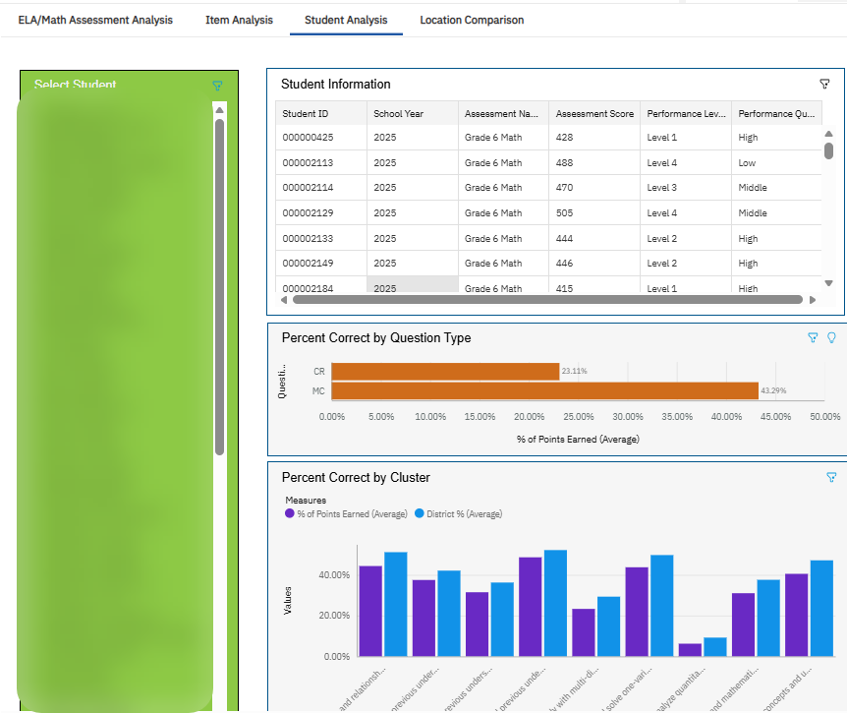


By Standards – By Subgroups
Filters for: Education Type, Poverty, ELL Eligibility, Ethnicity
Path to Follow: Team Content < Visualizations < 3-8 Assessments < 3-8 ELA/Math Item & Student Analysis Visualization

Slide 8

Reviewing for
January Regents Exams
Many students who take a Regents exam in January did not pass the exam previously.
What reports can help teachers who work with students or students themselves?

Slide 9
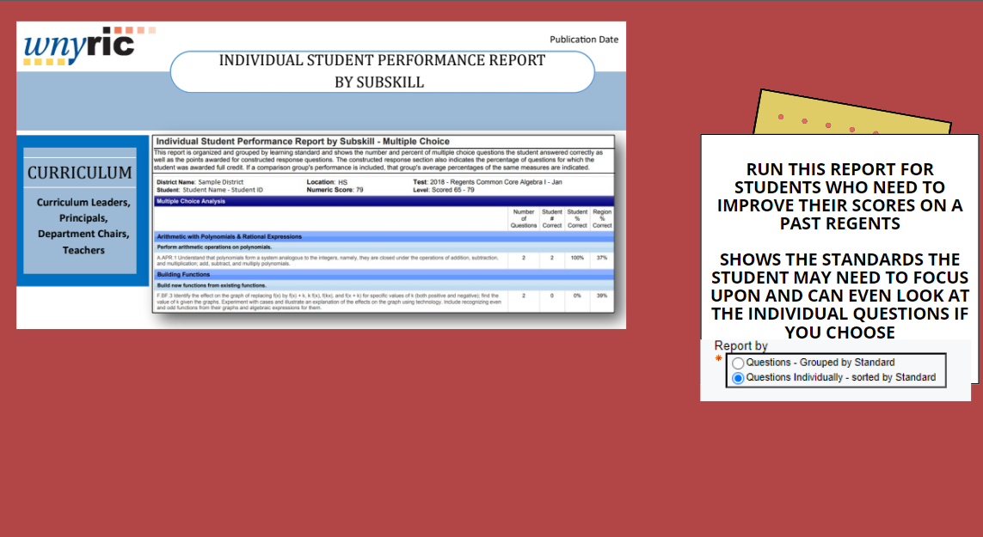
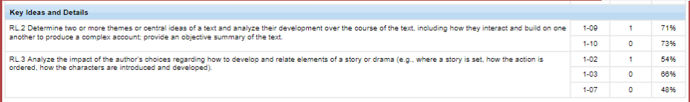

Slide 10
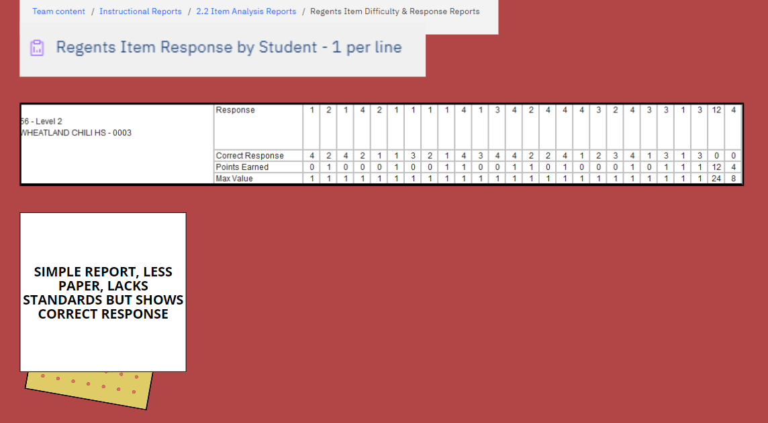
Student A

Slide 11
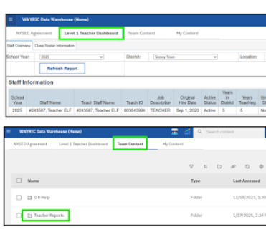
Teacher Reports in Level 1
WNYRIC Created a Teacher Reports folder in Level 1
New Level 1 Accounts will be created by a district user
  MAARS recommends that user be the District Data Coordinator
  ability to ‘designate’ the power to create accounts to others
A MAARS security form for the DDC will be required
  districts can create additional security forms for teachers or other users
Trainings for Account Creation will be announced in the MAARS Weekly shortly
Notes:
At our last DDC Meeting, we announced that WNYRIC has created a Teacher Reports folder in Level 1.
New Level 1 Accounts will be created by a district user at no extra charge.
MAARS recommends that user be the District Data Coordinator
This user will be able to ‘designate’ the power to create accounts to other staff members within district (ie Principals or Assistant Principals)
A MAARS security form for the DDC will be required
It will be up to the district to create any additional security forms for their teachers or other users.
Trainings for Account Creation will be announced in the MAARS Weekly shortly

Slide 12
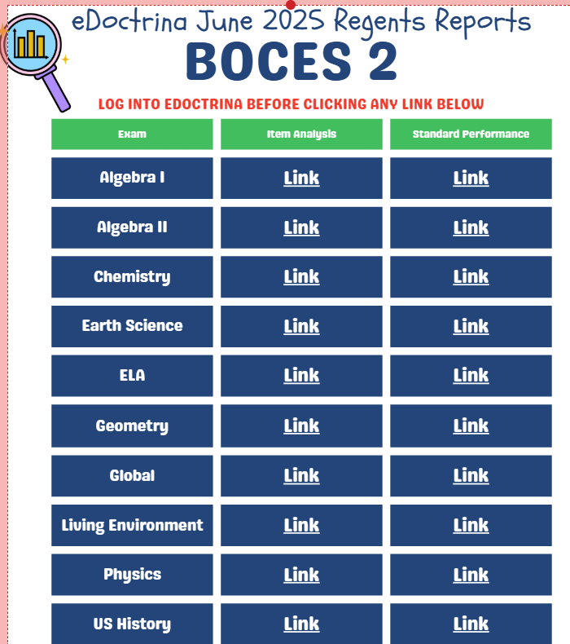
Attn:
*Brockport
Churchville-Chili
*Gates Chili
Greece
*Fairport
Hilton
*Holley
HFL
Penfield
*Rush Henrietta
*Spencerport
West Irondequoit
*ASIs have already been sent a copy
Contact rmaier@bocesmaars.org or dlubbert@monroe2boces.org for help!
Notes:
Deb: Contact Ryan or me if your district would like help importing your Regents results into eDoctrina this year. We are still waiting to get some of the science exams to get in the system, but once we do, we can make the standards match Level 1 so you get great Standards Reports right in eDoctrina.

Slide 13
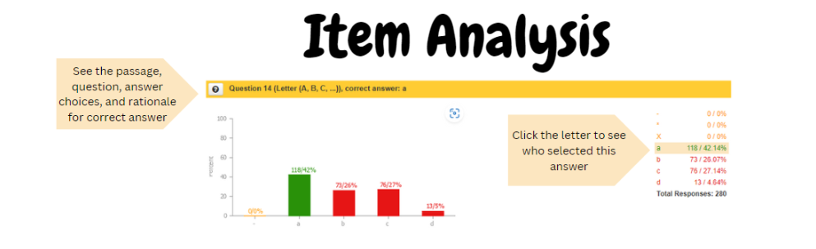
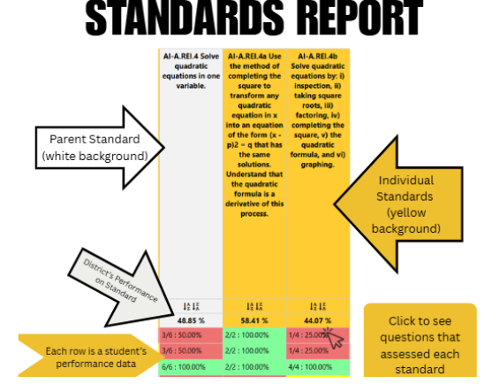

Slide 14
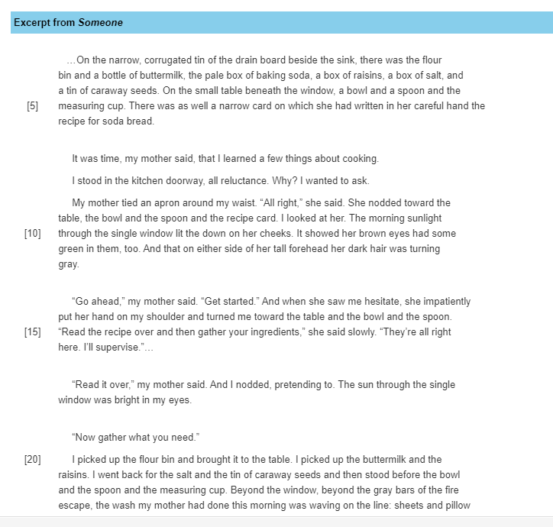
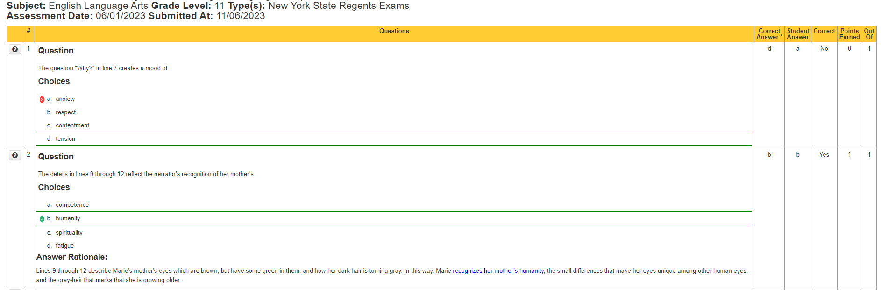
An example of an individual student report that could help them review for January! Show them what they got right and wrong!

Slide 15


Slide 16
State Reporting

Slide 17
2025-2026 Student BEDS Day
Applies to Districts and Charter Schools
BEDS Day Enrollment Extract (L2RPT: SIRS 312, 313, 314, 316, 319, 350)
  Enrollment by grade, district of residence, and supplemental enrollment counts are collected for calculating preliminary State Aid allocations
BEDS Day Free and Reduced Priced Lunch Extract (L2RPT: SIRS-323 and SIRS-327)
  Eligible students must be reported with
    5817 – Free Lunch Program or
    5806 – Reduced-Price Lunch Program
    All must have 0198 – Poverty-from low-income family
Data due: Wednesday, December 31
Notes:
Laurie

Slide 18
2025-2026 Student Digital Resources Survey
Applies to Districts, BOCES, and Charter Schools
Survey must be completed each school year
All students should be surveyed as well as any new students who enroll during the school year
Data will be used to identify specific needs and target resources and funding opportunities when they become available
L2RPT Verification: SIRS-336 Annual Digital Resources Survey Report
Data due: Thursday, January 22
Notes:
Laurie

Slide 19
2025-2026 CIA/SCEE
Applies to Districts, BOCES, and Charter Schools
Staff Snapshot, Course Instructor Assignment and Student Class Entry/Exit data
Data will be used by Office of State Assessment for determining counts of students enrolled in courses leading to state assessments
L2RPT Verification:
  SIRS-330 Student Class/Course Instructor Summary Report
  Begin reviewing SIRS-328 Out of Certification and SIRS-329 Certification reports
Data due: Thursday, January 22
Notes:
Laurie

Slide 20
Implementation Schedule for New Regents Exams
Exam | State Course Code | June 2025 | January 2026 | June 2026 | January 2027 | June 2027
Earth & Space Sciences | 03008 | X First Administration | X | X | X | X
Life Science/Biology | 03050 | X First Administration | X | X | X | X
Earth Science | 03001 |  | X | X Last Administration
Living Environment | 03051 |  | X | X Last Administration
English | 01003 |  |  | X First Administration | X | X
Common Core English | 01003CC |  | X Last Administration
Algebra II | 02056 |  |  | X First Administration | X | X
Common Core Algebra II | 02056CC |  | X Last Administration
Chemistry | 03120 |  |  | X First Administration | X | X
Regents Phy Set/Chemistry | 03101 |  | X | X | X | X Last Administration
Physics | 03170 |  |  | X First Administration | X | X
Regents Phys Set/Physics | 03151 |  | X | X | X | X Last Administration
Other Course Code Changes
US History | 04101
Global History | 04052

Slide 21
NYSESLAT SAFT Pre-ID Data
Applies to Districts, Charters, and Non-Public Schools
English Language Learner data for NYSESLAT Stand Alone Field Test exam
Must report all 0231 – ELL Eligible and ELL Programs
Data used for administration of NYSESLAT SAFT
Data due: Thursday, January 29
Notes:
Laurie

Slide 22
Operational ELA, Math & Science Pre-ID Data
Applies to Districts, Charters, and Non-Public Schools
Grades 3- 8 data for ELA, Math & Science CBT testing
Current Demographic, Enrollment and Program Fact
Data used for loading students into Nextera Admin
Data due: Thursday, February 19
Notes:
Laurie

Slide 23
NYSESLAT Pre-ID Data
Applies to Districts, Charters, and Non-Public Schools
English Language Learner data for NYSESLAT exam
Must report all 0231 – ELL Eligible and ELL Programs
Data used for pre-printed labels for NYSESLAT answer sheets
Data due: Thursday, February 26
Notes:
Laurie

Slide 24
2025-2026 Preliminary Summer EBT
Applies to Districts and Charter Schools
Demographic, Enrollment, FRPL, Homeless, Foster Child, Migrant data
Data will be used for preliminary Summer EBT Benefits
L2RPT Verification:
  SIRS-651 Annual Enrollment Summary
  SIRS-401 Reasonableness Report
    Homeless
    Foster Child
    Migrant
    Free & Reduced Lunch
Data due: Thursday, February 26
Notes:
Laurie

Slide 25


Level 0 Updates: release 20.0b
Level 0: version 21.0a
Updated last on 10/2/25 to 21.0a
No update since the last DDC meeting

Slide 26
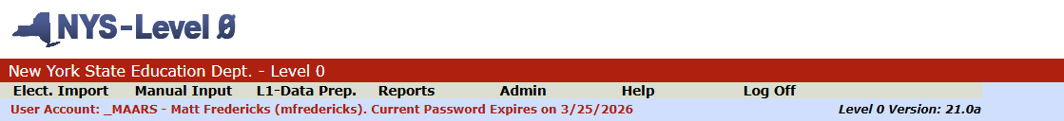
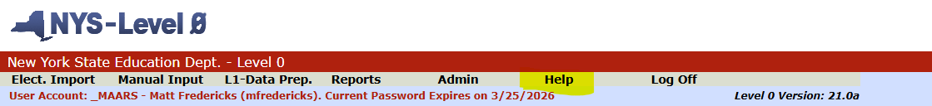
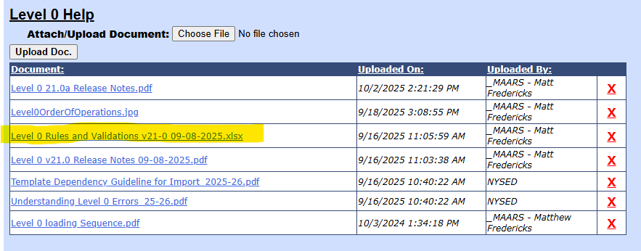
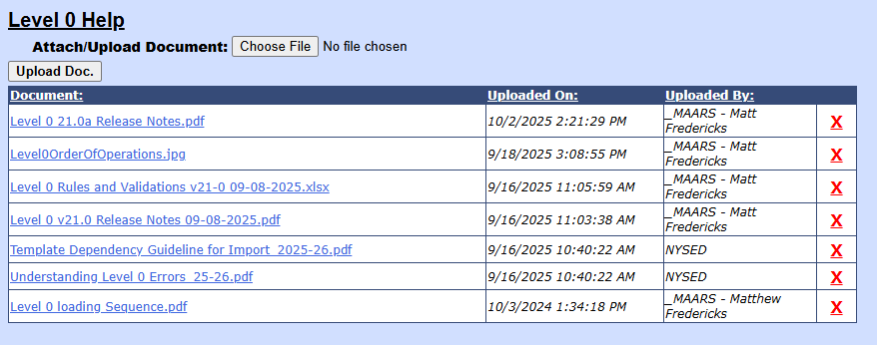
Level 0 Updates: release 20.0b
Level 0: version 21.0a

Slide 27
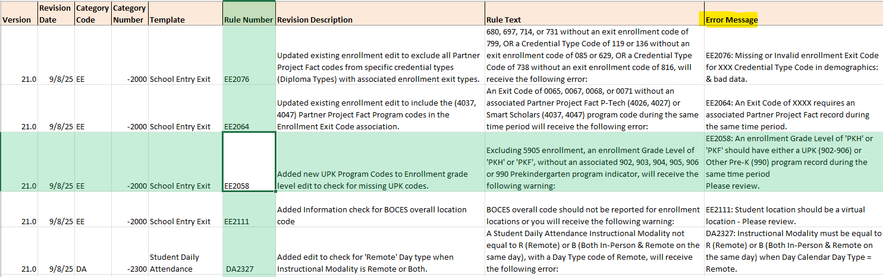
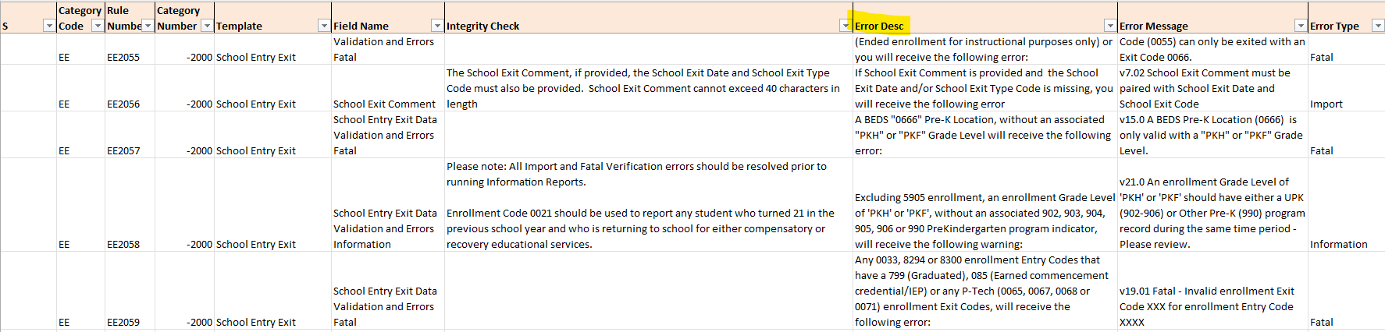
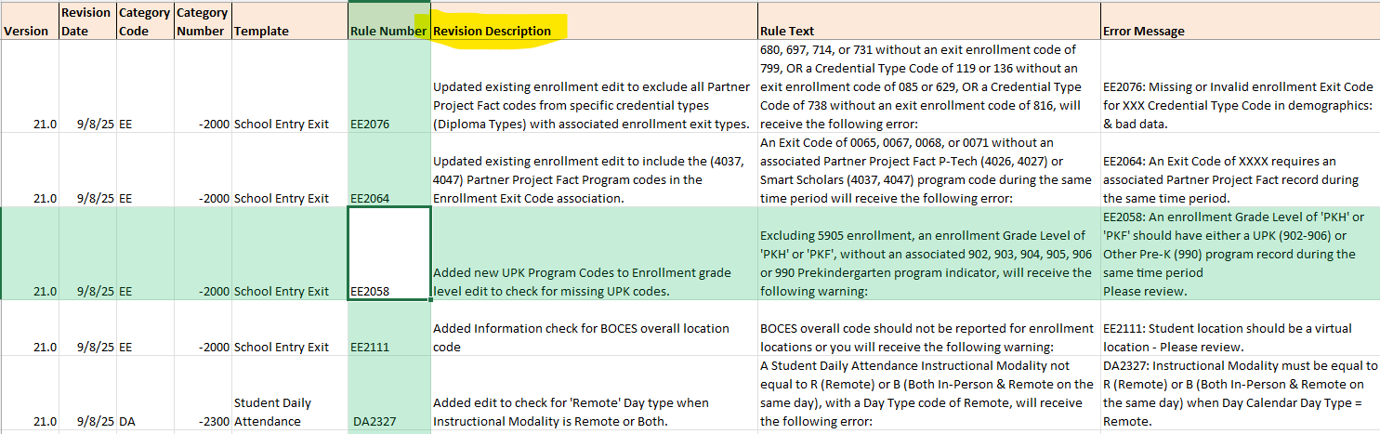
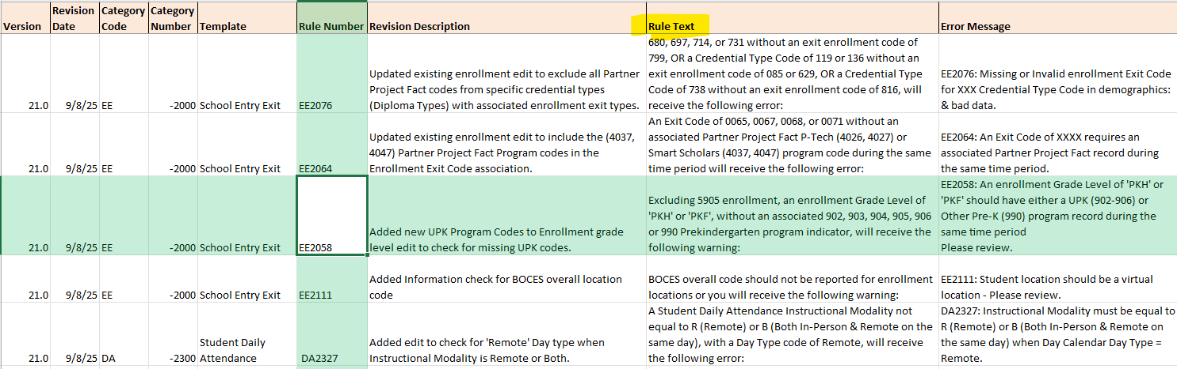
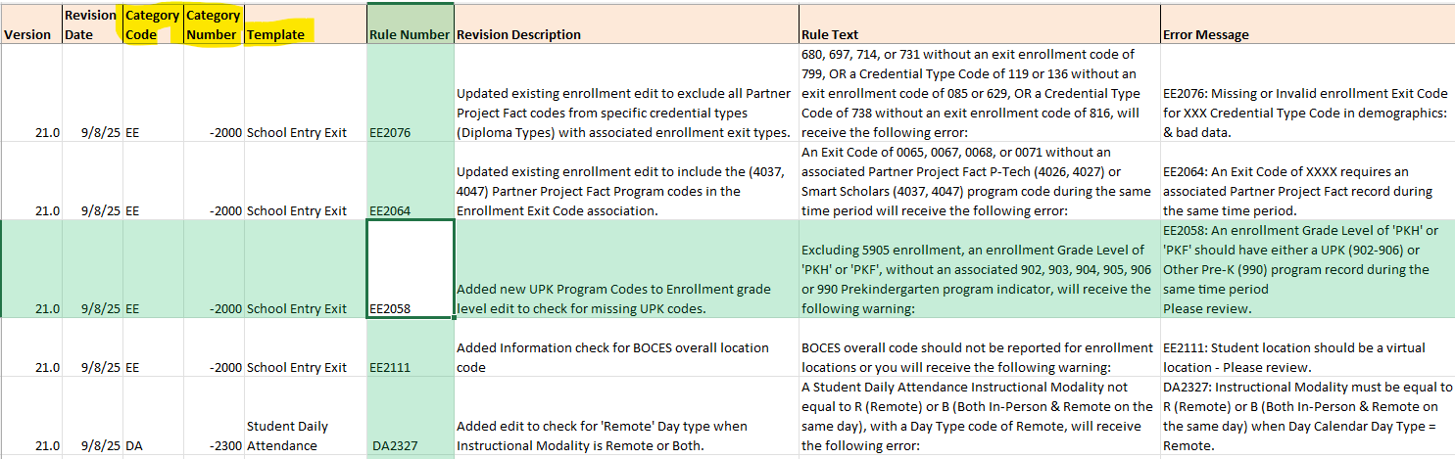
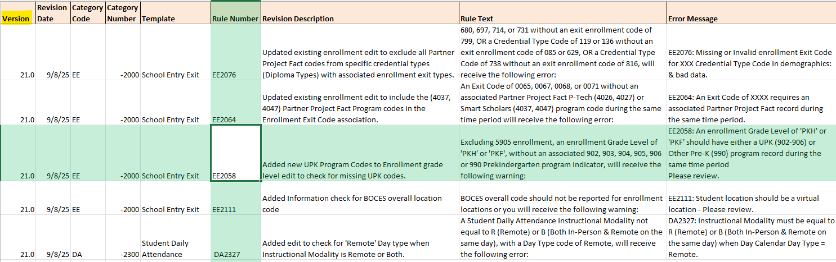
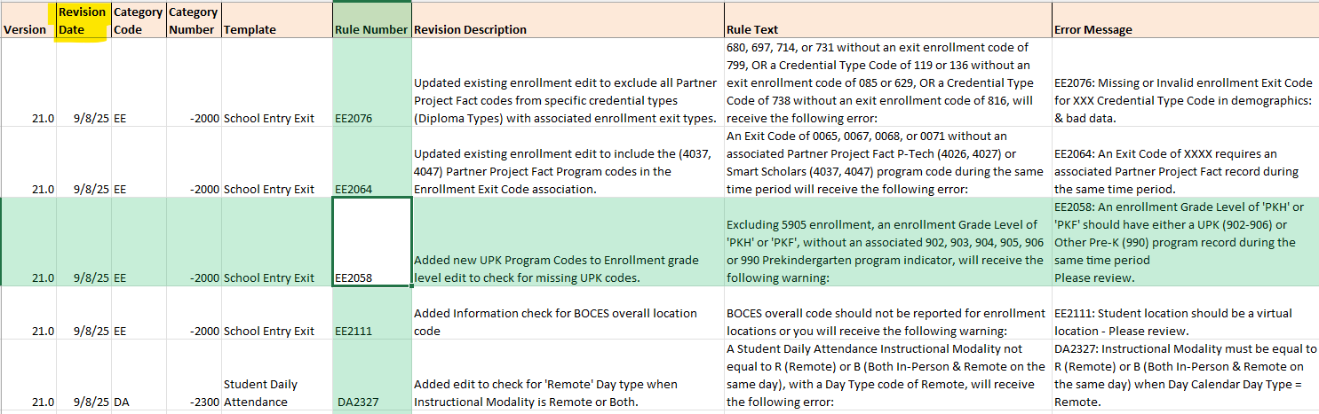
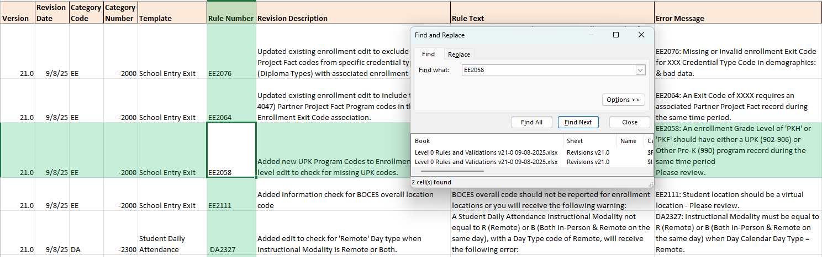
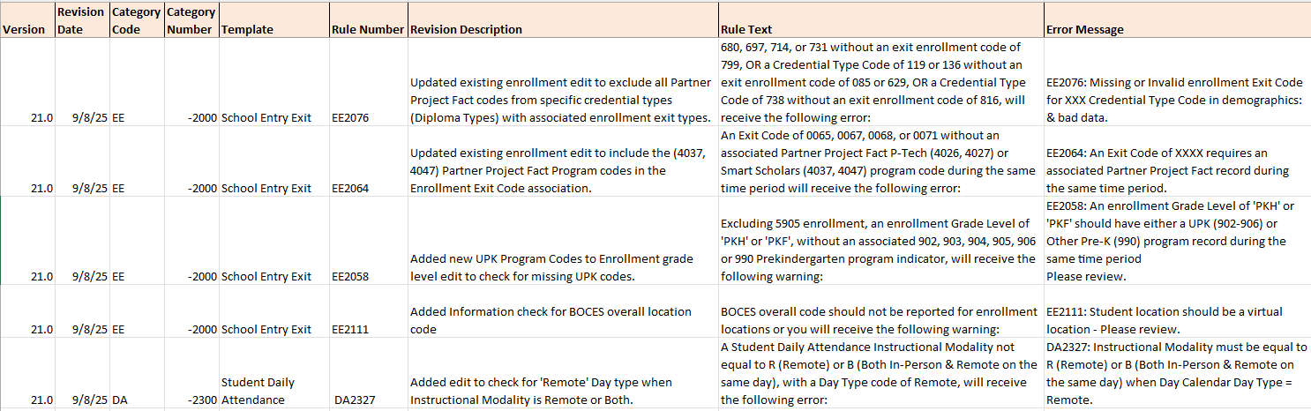
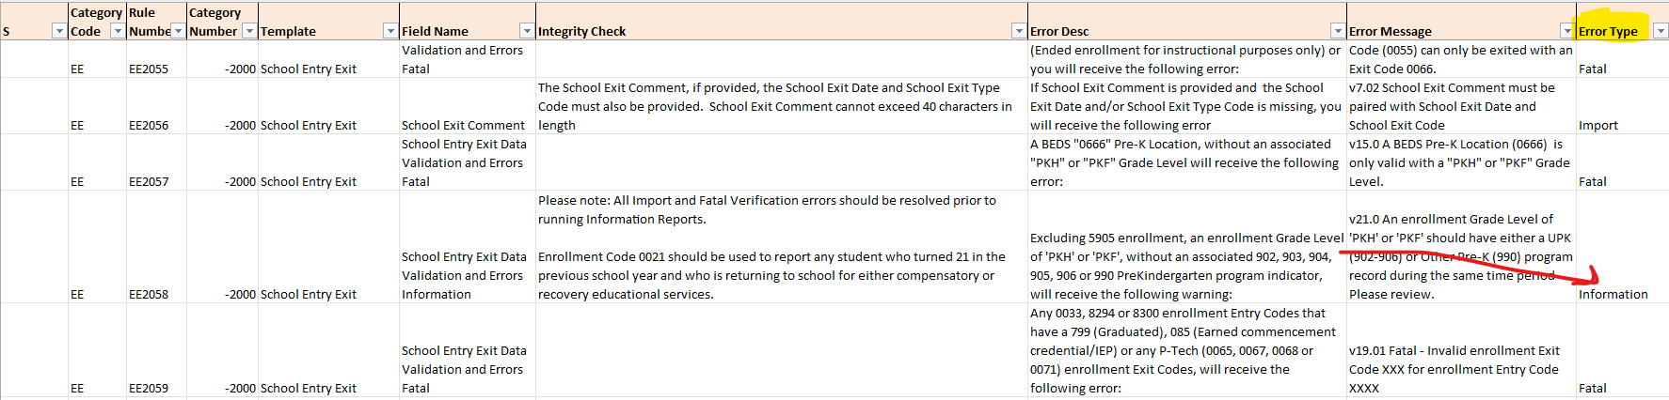

Level 0 Updates: release 20.0b
Level 0: version 21.0a

Slide 28


Slide 29

Pupils with Disabilities Reporting

Slide 30

PD BEDS Reporting
October Snapshot Reporting:
Requires Certification of VR’s 1-6, and VR 8
Certification in the PD Data System is DUE January 20th, 2026
LAST upload to Level 0 to make PD System in time: Thursday, January 15th by NOON
Required Data:
      Demographics/Enrollment
      Type of Disability
      October Snapshot
        Included: Students with an IEP in effect on BEDS day, and with programs or related services that span BEDS day 10/1/25
    VR7/VR9 Do not need certification but should be checked for accuracy

Slide 31


Zoom Registration Link

Slide 32
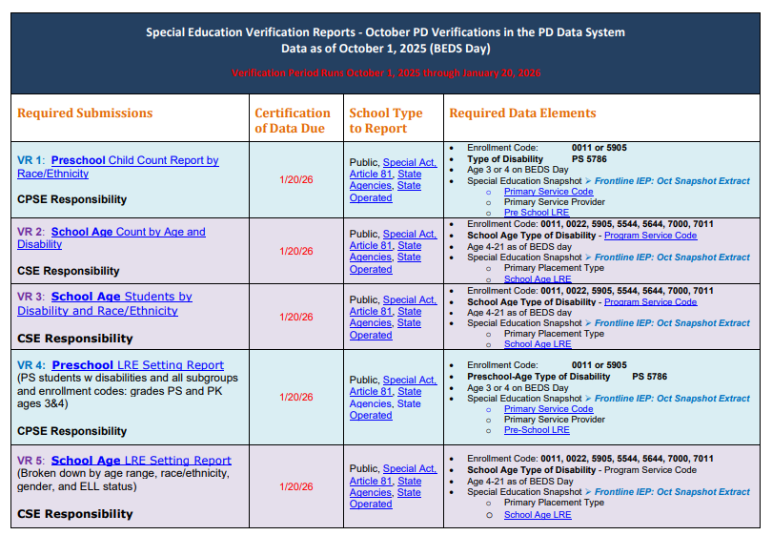
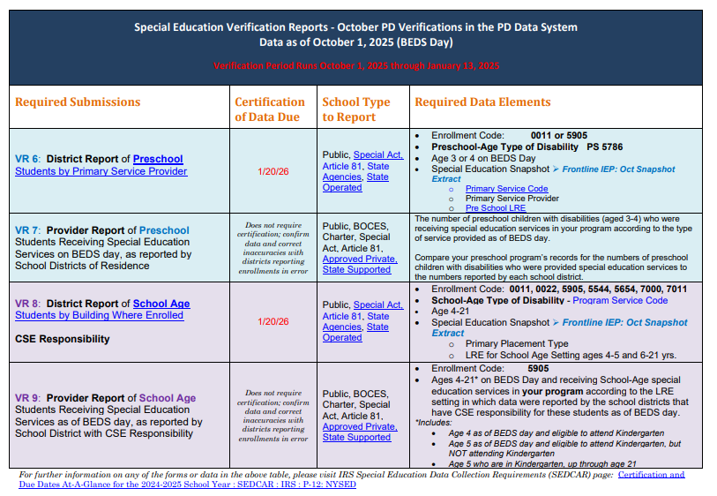

BEDS Day Verification Dates

Slide 33
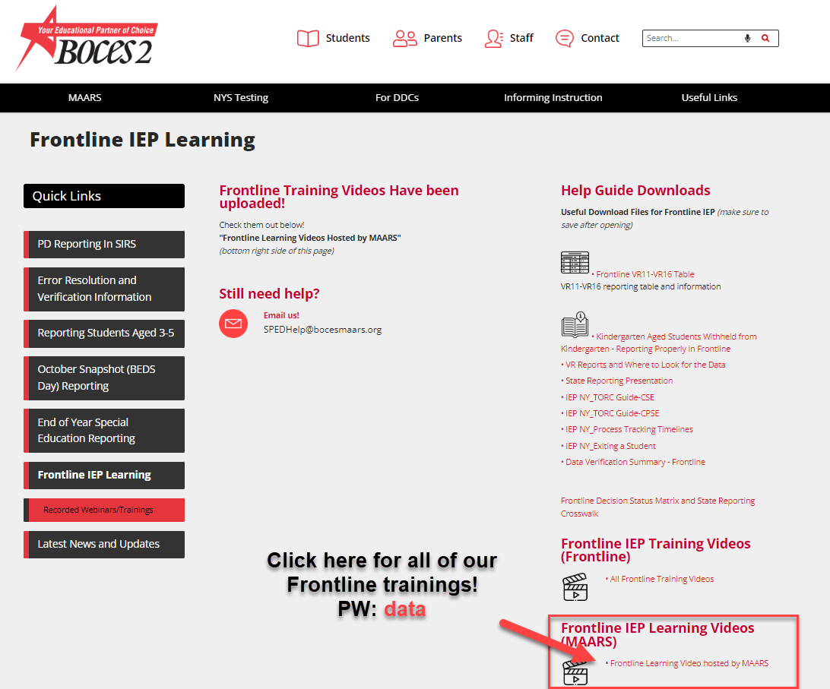

PD BEDS Reporting
PD Reporting In SIRS- Website
SPEDHelp@bocesmaars.org- Shared Mailbox
Keep checking the MAARS Weekly for upcoming trainings and valuable information!

Slide 34

PD Reporting:
MAARS Contacts for Data Reporting
PD Reporting and Frontline IEP:
Jim Saintours 349-9052 jsaintou@bocesmaars.org
SPEDHelp@bocesmaars.org
Level 0:
Matt Fredericks 249-9064 mfrederi@bocesmaars.org
SIRS Data:
Laurie Hazard 349-9051 lhazard@bocesmaars.org
SMS Specifics:
Contact your SMS Liaison
Notes:
Call or email if you need help!

Slide 35

3-8 Computer Based Testing

Slide 36

2025-26 CBT Milestones
October and November
Create user accounts in Nextera
Place orders in Online Request System: window opened first week of October
Complete Tech Readiness: window opens 10/2/25
Finalize Lead Scoring Entity and exam requests prior to the closing of the system on 11/14/25
Download Secure Browser
Verify Student Enrollment/Program Service/ Demographic Data
December and January
Simulation Pre-ID File enrollment, program service, and demographic data due to L2: 12/12/25
Proctor & Best Practices Training: TBD
Schedule date for participation in Statewide Simulation
Students, Classes, Tests Tabs open for Simulation January 2, 2026
Statewide Simulation:
•• ⁰E^{1/26/26- 02/06/26}nsure completion of Tech Readiness; Window closes 12/26/25
February and March
LSE will be loaded to Nextera Admin for ELA and Math
ScorePoint Training: TBD
Student Data loaded to Nextera Admin for Operational Testing
Prepare for Testing
April and May
Testing window for ELA, Math & Science: 4/6- 5/15/25
Scoring Window: 4/7- 5/22/25
Last day to set NTC: 5/22/26

Slide 37
CBT Simulation
Participation
Required for all districts and schools in Grades 3-8 CBT
Schools can choose which grades and students will participate in the simulation
Data Preparation
Ensure Level 0 student data is accurate and up-to-date by end of day Thursday, December 11th
NYSED will pull student data on December 12th for loading to Nextera Admin
Setup
Nextera opens for CBT Simulation setup on Friday, January 2nd.
Testing Window
January 26th – February 6th
Simulation Overview
Evaluate readiness of internal systems, hardware, and testing procedures
Practice for teachers and students to familiarize with the testing platform
Identify adjustments to streamline operational testing

Slide 38
Premier Scoring Services for 2025-2026
Computer-Based Scoring
Managed using ScorePoint (Questar/NWEA)
CR scores sent to Questar/NWEA
Final scores by NWEA/NYSED
Paper-Based Scoring (IEP/504)
For paper tests
Test booklets and answer sheets sent to Premier
CR scores recorded on answer sheets
Processed by MAARS, final scores by NYSED
Important Notes
Follow Premier's packing instructions
Return answer sheets to MAARS by communicated deadline

Slide 39
Scoring the 2025 Science Tests
Who Scores the Tests?
NWEA scores the computer-based Science tests for Grades 5 and 8.
Schools are responsible for paper Science tests.
Schools/Vendor score all ELA and Math tests, both computer-based and paper-based.
Open-Ended Questions
Teachers/Vendor rate the open-ended questions.
At least two teachers must rate each test.
Teachers can't score their own students' tests.
Rating Guide
Follow the Rating Guide for detailed instructions.
Keep copies of the Rating Guides for at least one year.

Slide 40
Nextera Setup for CBT 2025-2026
Nextera Platform
Nextera is used to set up students for their testing
Steps Before Testing Window Opens
Review Students: Ensure all students are reviewed and put into "classes"
Add Students: Include any students not pulled during NYSED's CBT student data pull
Connect Teachers: Assign teachers to the classes created for their use
Apply Accommodations: Add student accommodations in Nextera for those who need them

Slide 41
Optional Nextera Live Session for DTCs & Principals
Join us on Microsoft Teams!
These sessions are designed to help District Test Coordinators and Principals become more familiar with the Nextera Admin platform.
What You’ll Learn:
Basic overview of Nextera Admin
How to navigate the system
Key functions for test administration
Why Attend?
Build confidence using Nextera Admin
Be prepared before testing begins
Session Dates:
December 3, 2025
Early January (TBD)

Slide 42
CBT Support and Resources
Computer-Based Testing Simulation Guide
NYSED Quick Reference Guide
Other Helpful Articles
Can be found on the CBT Support Web Page
Search on key words to find helpful how-to articles where needed
Weekly Digest
Our weekly Digest is a great resource for more up-to-date information
SAM (School Administrators Manual)
Can be found at: 2025 ELA, Mathematics, and Science School Administrator's Manual
Contains information and how-to's for setting up Nextera for testing
Includes step-by-step directions in the appendix section
MAARS Contact
Ian Buchanan – 585-349-9069 – ibuchanan@bocesmaars.org
General Test Help Email -

Slide 43
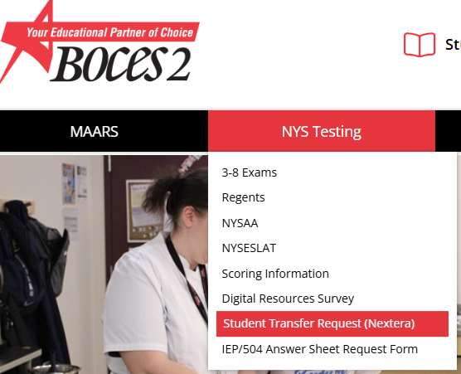
Where to Find Our Form to Complete Transfer Requests
Navigation Menu:
  Go to the MAARS website
  Click on the "NYS Testing" tab
  Select "Student Transfer Request (Nextera)" from the dropdown menu
Student move directions and information will be sent out to districts and schools in the coming weeks

Slide 44
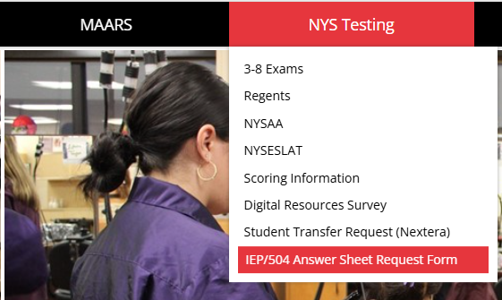
For now or later: Start requesting Paper-based answer sheets!
Navigation Menu:
  Go to the MAARS website
  Click on the "NYS Testing" tab
  Select “IEP/504 Answer Sheet Request Form" from the dropdown menu
This will open a spreadsheet. Download a copy. Directions on spreadsheet.
You will need access to files.monroe.edu for this

Slide 45
Regents
Patty Zeiner- 349-9053 pzeiner@bocesmaars.org

Slide 46
JANUARY 2026 REGENTS
January 2026 Regents:
Pertinent information (including the highlights below) have been updated in the MAARS website
2026 January Regents
M.A.A.R.S. Pre-printed answer sheets:
MAARS order form for preprinted answer sheets are due 12/5
  Files of student demographic information is due 12/12 to MAARS through the secure Monroe FTP site. Please do not email files of student information!
  Any needed additional walk-in files are due 1/15 and will continue to be accepted by MAARS up to exam time. Last minute answer sheets will be printed to a PDF file and sent to the school for printing.
  Do not make copies of pre-printed or blank answer sheets for students to use.
  MAARS will start preprinting answer sheets in the last week of December. They will be shipped to Districts/BOCES starting the first week of January. We will notify the other schools when their answer sheets are ready to be picked up at MAARS.
  Reminder: The Physical Setting/Physics exam, (course code: 03151) offered in January, is a Restricted Test which means each test is numbered and sealed with an answer sheet in its own envelope. You will NOT receive preprinted answer sheets from MAARS for this exam.

Slide 47
Course Codes for Level 0
Exam | State Course Code
Earth & Space Sciences | 03008
Life Science/Biology | 03050
Earth Science | 03001
Living Environment | 03051
English | 01003
Algebra II | 02056
Chemistry | 03120
Regents Phy Set/Chemistry | 03101
Physics | 03170
Regents Phys Set/Physics | 03151
Other Course Code Changes
US History | 04101
Global History | 04052
Please make sure Level 0 is updated to show the correct course codes.

Slide 48
STUDENT DIGITAL RESOURCE SURVEY
If using MAARS for Preprinted Survey Sheets please reach to Patty Zeiner at pzeiner@bocesmaars.org or 349-9053
Deadline to have data uploaded to Level 0 and pushed to Level 1 is Thursday, January 22nd

Slide 49

Next Meeting: March 3 at 10am
Notes:
Bridget

