Slide 1
DUAL ENROLLMENT INFORMATION FOR Broome High School Students and Parents 2021-2022

Slide 2
DUAL ENROLLMENT: a sMART CHOICE!
Through participation in the SCC Early College program as a student dually enrolled at Broome High School and Spartanburg Community College, you can earn college credit.

Slide 3
BENEFITS OF SCC Dual Enrollment
Earn college credit while you are still in high school
Gain experience in navigating college classes
Affordable tuition
**Research indicates that dual enrollment gives students
momentum and is positively related to going to college,
persisting in college, and earning a college degree.

Slide 4
How Do I Apply for DUAL ENROLLMENT CLASSES?
TALK WITH your high school or career center guidance counselor during your IGP meetings/registration to make sure you are eligible to apply.
COMPLETE your 2021-2022 SCC Early College application packet: Please review the first two pages and keep those for your records. Return the application to BHS Guidance.
ASK BHS Guidance to submit your high school transcript if you have a 3.0 weighted GPA or higher or take the Accuplacer placement test free of charge at SCC in order to establish your eligibility for the course(s). Qualifying ACT (19 or higher on English and 22 or higher on Math) and SAT (510 or higher Evidence Based Reading and Writing; Math 580 or higher) scores may be used instead of ACCUPLACER. Students must meet any required prerequisites for individual courses.

Slide 5
Class meeting times at SCC-Giles (central) campus
8:00 a.m. – 9:20 a.m.
9:30 a.m. - 10:50 a.m.
11:00 a.m. - 12:20 p.m.
12:30 p.m. - 1:50 p.m.
2:00 p.m. - 3:20 p.m.

Slide 6
Class meeting times at SCC- Downtown Campus
8:30 a.m. – 9:50 a.m.
10:00 a.m. – 11:20 a.m.
11:30 a.m. – 12:50 p.m.
1:00 p.m. – 2:20 p.m.
2:30 p.m. – 3:50 p.m.
4:30 p.m. –5:50 p.m.

Slide 7
Examples of University Transfer Courses (additional classes are available.)
English Composition I-ENG 101
English Composition II-ENG 102
Public Speaking-SPC 205
Art Appreciation, Music Appreciation, Introduction to Theatre-ART 101, MUS 105, THE 101
General Psychology-PSY 201
Introduction to Sociology-SOC 101
College Algebra-MAT 110
Probability and Statistics-MAT 120

Slide 8
Dual enrollment classes at Daniel Morgan Technology Center
AHS 102- Medical Terminology
AHS 104- Medical Vocabulary/Anatomy
EGT 152- Fundamentals of CAD
EGT 245- Principles of Parametric CAD

Slide 9
Class Registration
If you are interested in registration for fall 2021 classes that meet on one of the SCC Campuses or online, this registration begins on April 12! You can search for classes on April 5, 2021.
Summer 2021 registration begins on March 15.
Please contact Mr. Brian Tucker, Early College Counselor at tuckerb@sccsc.edu or 864-592-4256 to schedule an advisement appointment for summer or fall classes.

Slide 10
What happens after I register?
The SCC Early College office provides an orientation session tailored for dual enrollment students and their parents. During your orientation this summer, you will get logged in to your SCC Portal and hear other useful information to help get you prepared to start classes. We also provide orientations for students taking dual enrollment courses at Daniel Morgan Technology Center.

Slide 11
What is FERPA?
The Family Educational Rights and Privacy Act (FERPA) is a federal law that protects the privacy of the educational records of students. Students must have accountability for their enrollment in college courses. Parents should not attempt to contact college instructors regarding their student’s grades and academic progress.

Slide 12
How do I request accommodations?
SCC provides reasonable accommodations to qualified individuals who have, have a history of, or are regarded as having a disability. Early College students who wish to seek accommodations should contact Josh Holmes, the Coordinator of Student Disability Services. Mr. Holmes’ office phone is 864-592-4437; his e-mail address is holmesj@sccsc.edu.

Slide 13
What are the enrollment and tuition costs?
2020-2021 tuition for classes offered at the SCC campus or online: $65.00 per credit hour for students enrolled in fewer than 6 credit hours and $25.00 per credit hour for students enrolled in 6 or more credit hours per semester. **Tuition is subject to change for the 2021-2022 academic year.
Application Fee: Free
Enrollment Fee: $75.00--Waived

Slide 14
Grades
Please know that you are beginning to establish your college transcript and your college career. Poor grades can negatively impact future financial aid eligibility. Always do your best to take full advantage of your early start!
Your final letter and numeric grades will be included in the grade reports sent to the high schools from the Spartanburg Community College Registrar’s Office. Only letter grades appear on your college transcript. The SCC Registrar sends final grades in December 2021 and May 2022.

Slide 15
How will my DUAL ENROLLMENT course transfer to a four-year college or university?
Generally speaking, whether and how dual credit courses transfer depends on your college and major of choice.
It is the responsibility of students and parents to check to ensure whether and how Early College courses transfer to the student’s college or university of choice.
SCC has statewide articulation agreement with all state supported colleges and universities in South Carolina which supports acceptance of 86 university transfer courses. Seventeen independent South Carolina colleges signed a similar agreement with our SC Technical College System to accept the list of 86 courses from technical/community college graduates. Great tool to begin exploring transfer questions: www.SCTRAC.org
SCC has a Direct Connect agreement with USC-Upstate. Any SCC student who graduates with an Associate of Science, Associate of Arts, Associate in Applied Science in Nursing, or Associate in Applied Science in Electronic Engineering Technology is guaranteed admission to USC-Upstate through this agreement.

Slide 16
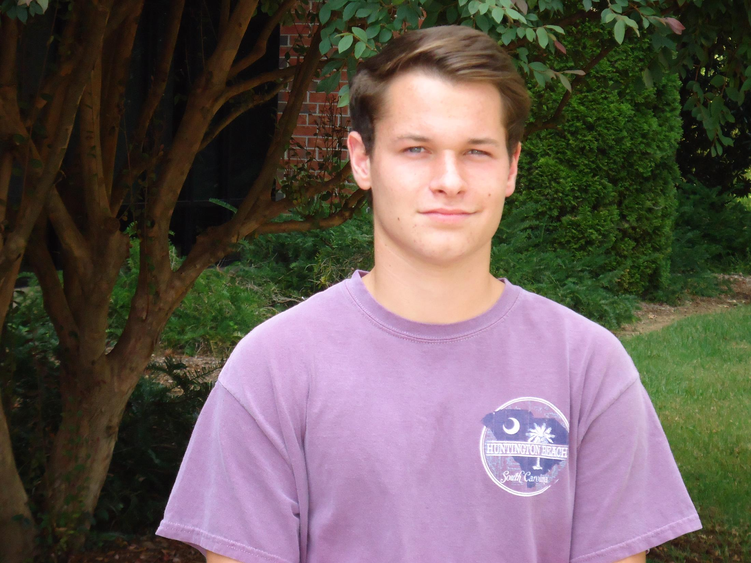
STUDENT TESTIMONIAL
“Go for it. Taking dual enrollment exposes you to different types of learning styles and cultures early. This is an excellent way to get ahead.”
-Jared Sanford
Former SCC Dual Enrollment Student
Broome High School Graduate

Slide 17
Spartanburg Community College—Early College Contact Information
Brian Tucker
Early College Counselor
tuckerb@sccsc.edu
Phone: 864-592-4256
Sherry Renshaw
Administrative Specialist, Early College
renshaws@sccsc.edu
Phone: 864-592-4758
Eugenia Hooker
Director, Early College
hookere@sccsc.edu
Phone: 864-592-4263

