Slide 1


IMAGE Summer Training
2026

Slide 2
MEP ACRONYMS
OMEC- Ohio Migrant Education Center
IPT- Idea Proficiency Test
COE- Certificate of eligibility
EOE- End of Eligibility
ID&R- Identification & Recruitment
LQM- Last Qualifying Move
OME- Office of Migrant Education
PFS – Priority for Services
MEP- Migrant Education Program
CNA- Comprehensive Needs Assessment
HEP- High School Equivalency Program
CAMP – College Assistance Program
COS- Continuation of Services
OMSIS II- Ohio Migrant Student Information System II
SEA- State Education Agency
LOA- Local Operating Agency
QC- Quality Control

Slide 3
OMEC Staff
José Salinas - OMEC Director
Malena Gutierrez - State ID&R Coordinator
Corina Barranco - Records & Data Coordinator
Page Warner - Education Coordinator
Lisa Flórez - Health Fair Coord. & Office Specialist
Mark Papenhausen - Developer (META Solutions)

Slide 4

Ohio Agricultural Trends

Slide 5


National Dropout Rate = 5.3%
[Migrant = 45%]
Child Labor Laws
[Migrant children can legally work at age 12]
High School students lose credit due to differing graduation requirements.

Slide 7
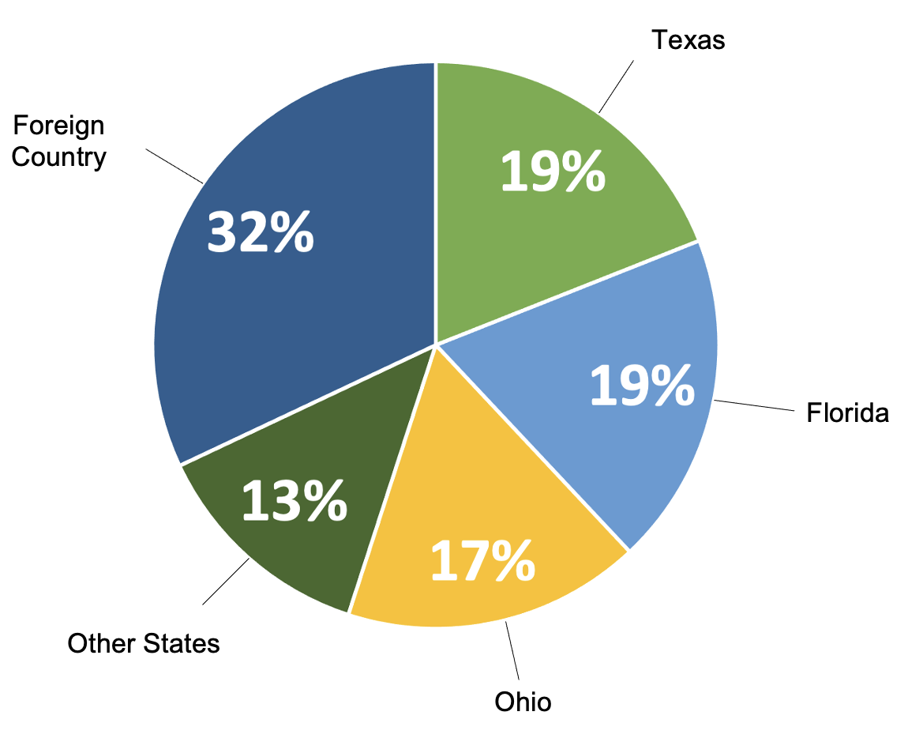
Previous Residence

Slide 8
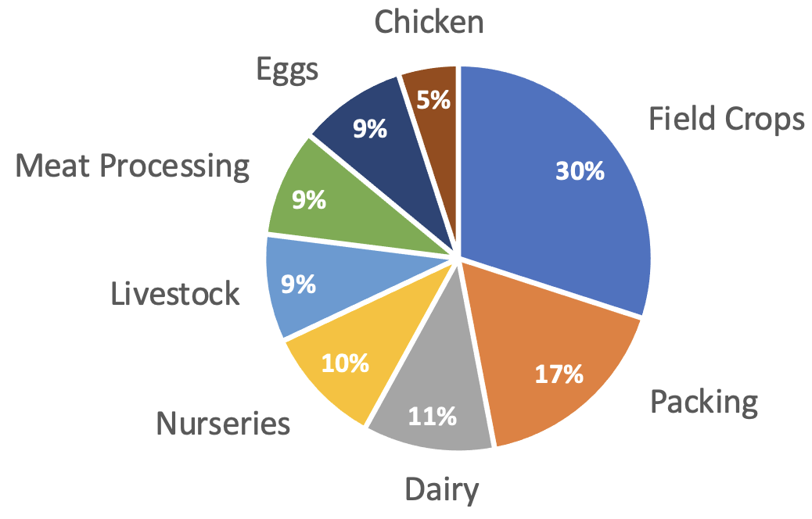
Types of Qualifying Work

Slide 9
624

Slide 10
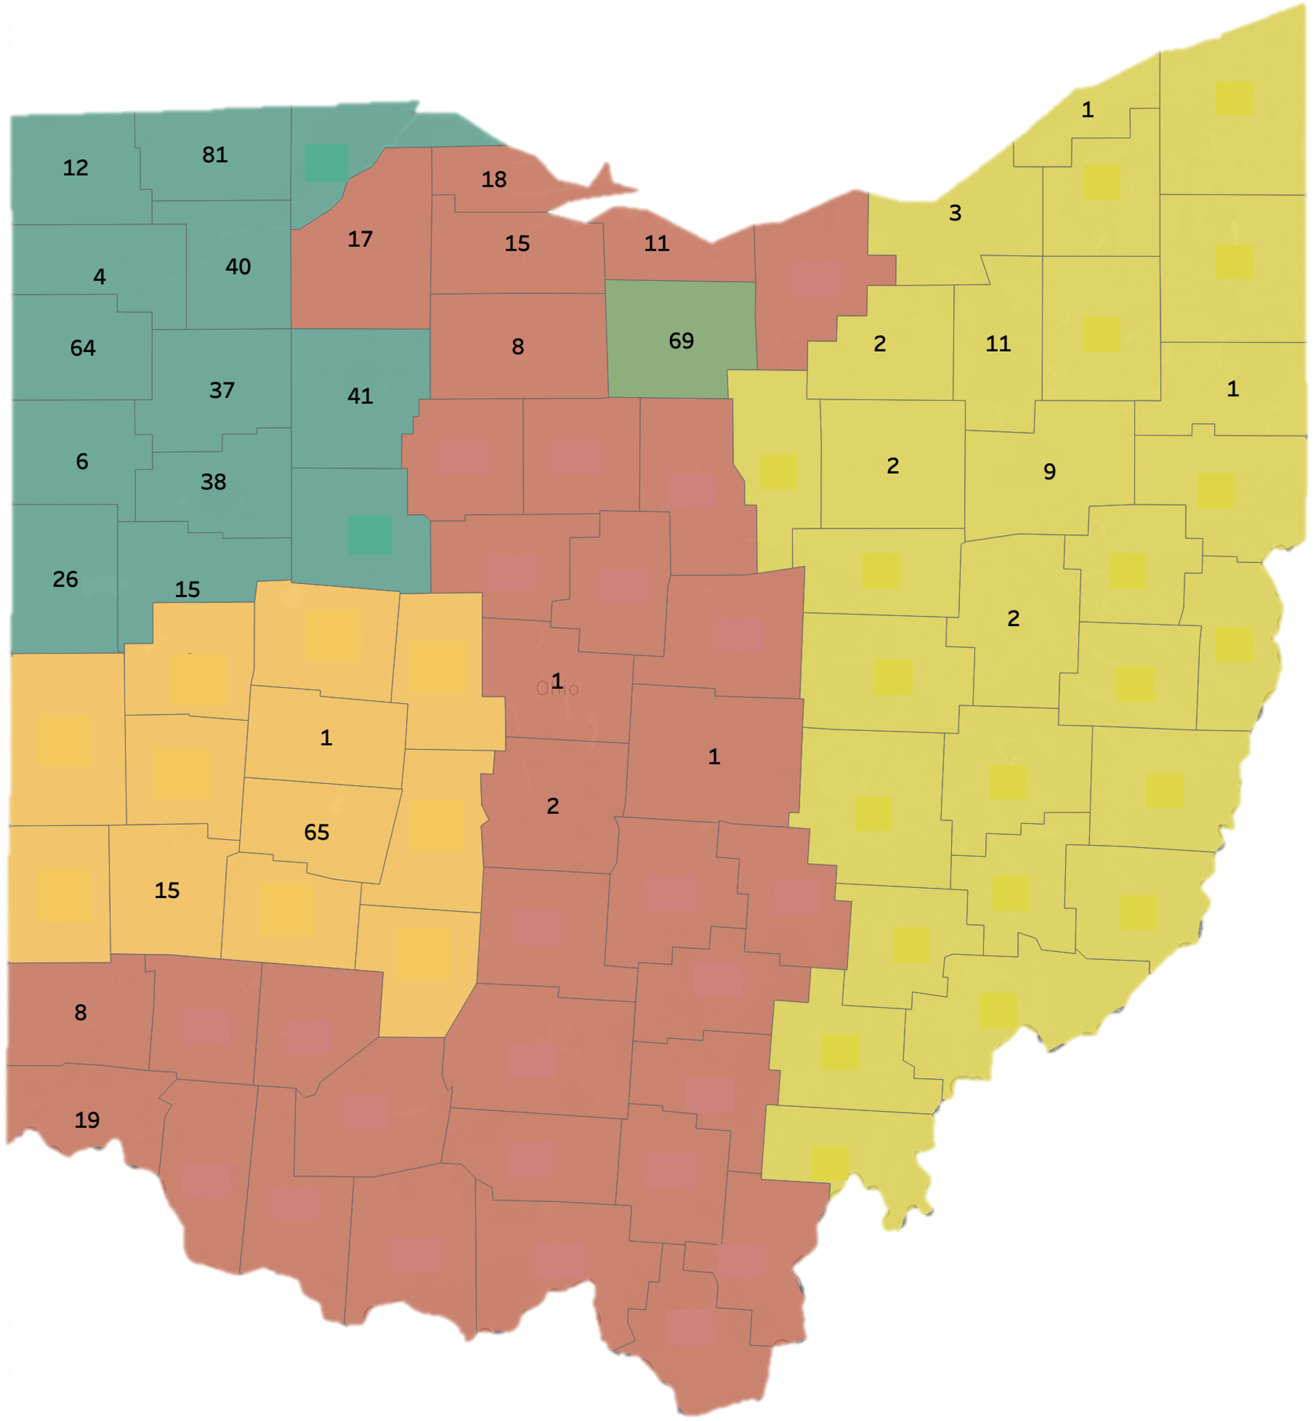
Eligible Migrant Students 2025
BY COUNTY

Slide 11
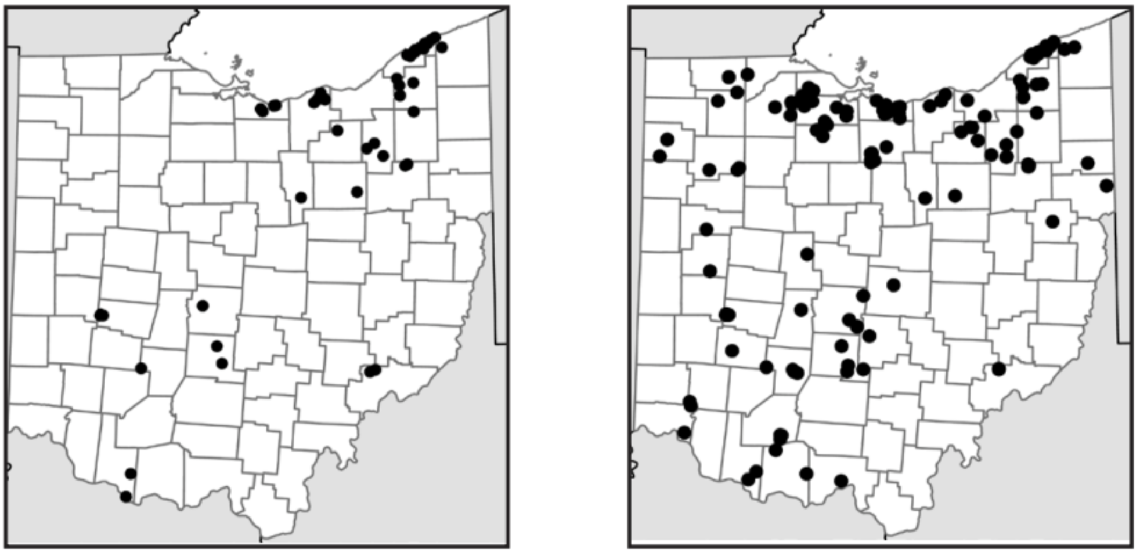
Ohio H-2A Licensed Camps Data
2013
2019

Slide 12

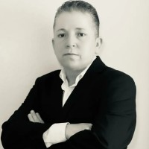
Agribusiness Recruitment Initiative

Slide 13

PHASE #1: March 16-20
Introduced ourselves to agribusinesses and labor contractors.
Disseminated Title I-C information to advertise our services and build connections.

Slide 14
PHASE #2: April 12-17
Revisited same agribusinesses for face-to-face eligibility interviews with their workers.
Shared free EL materials and PPE supplies to workers.

Slide 15
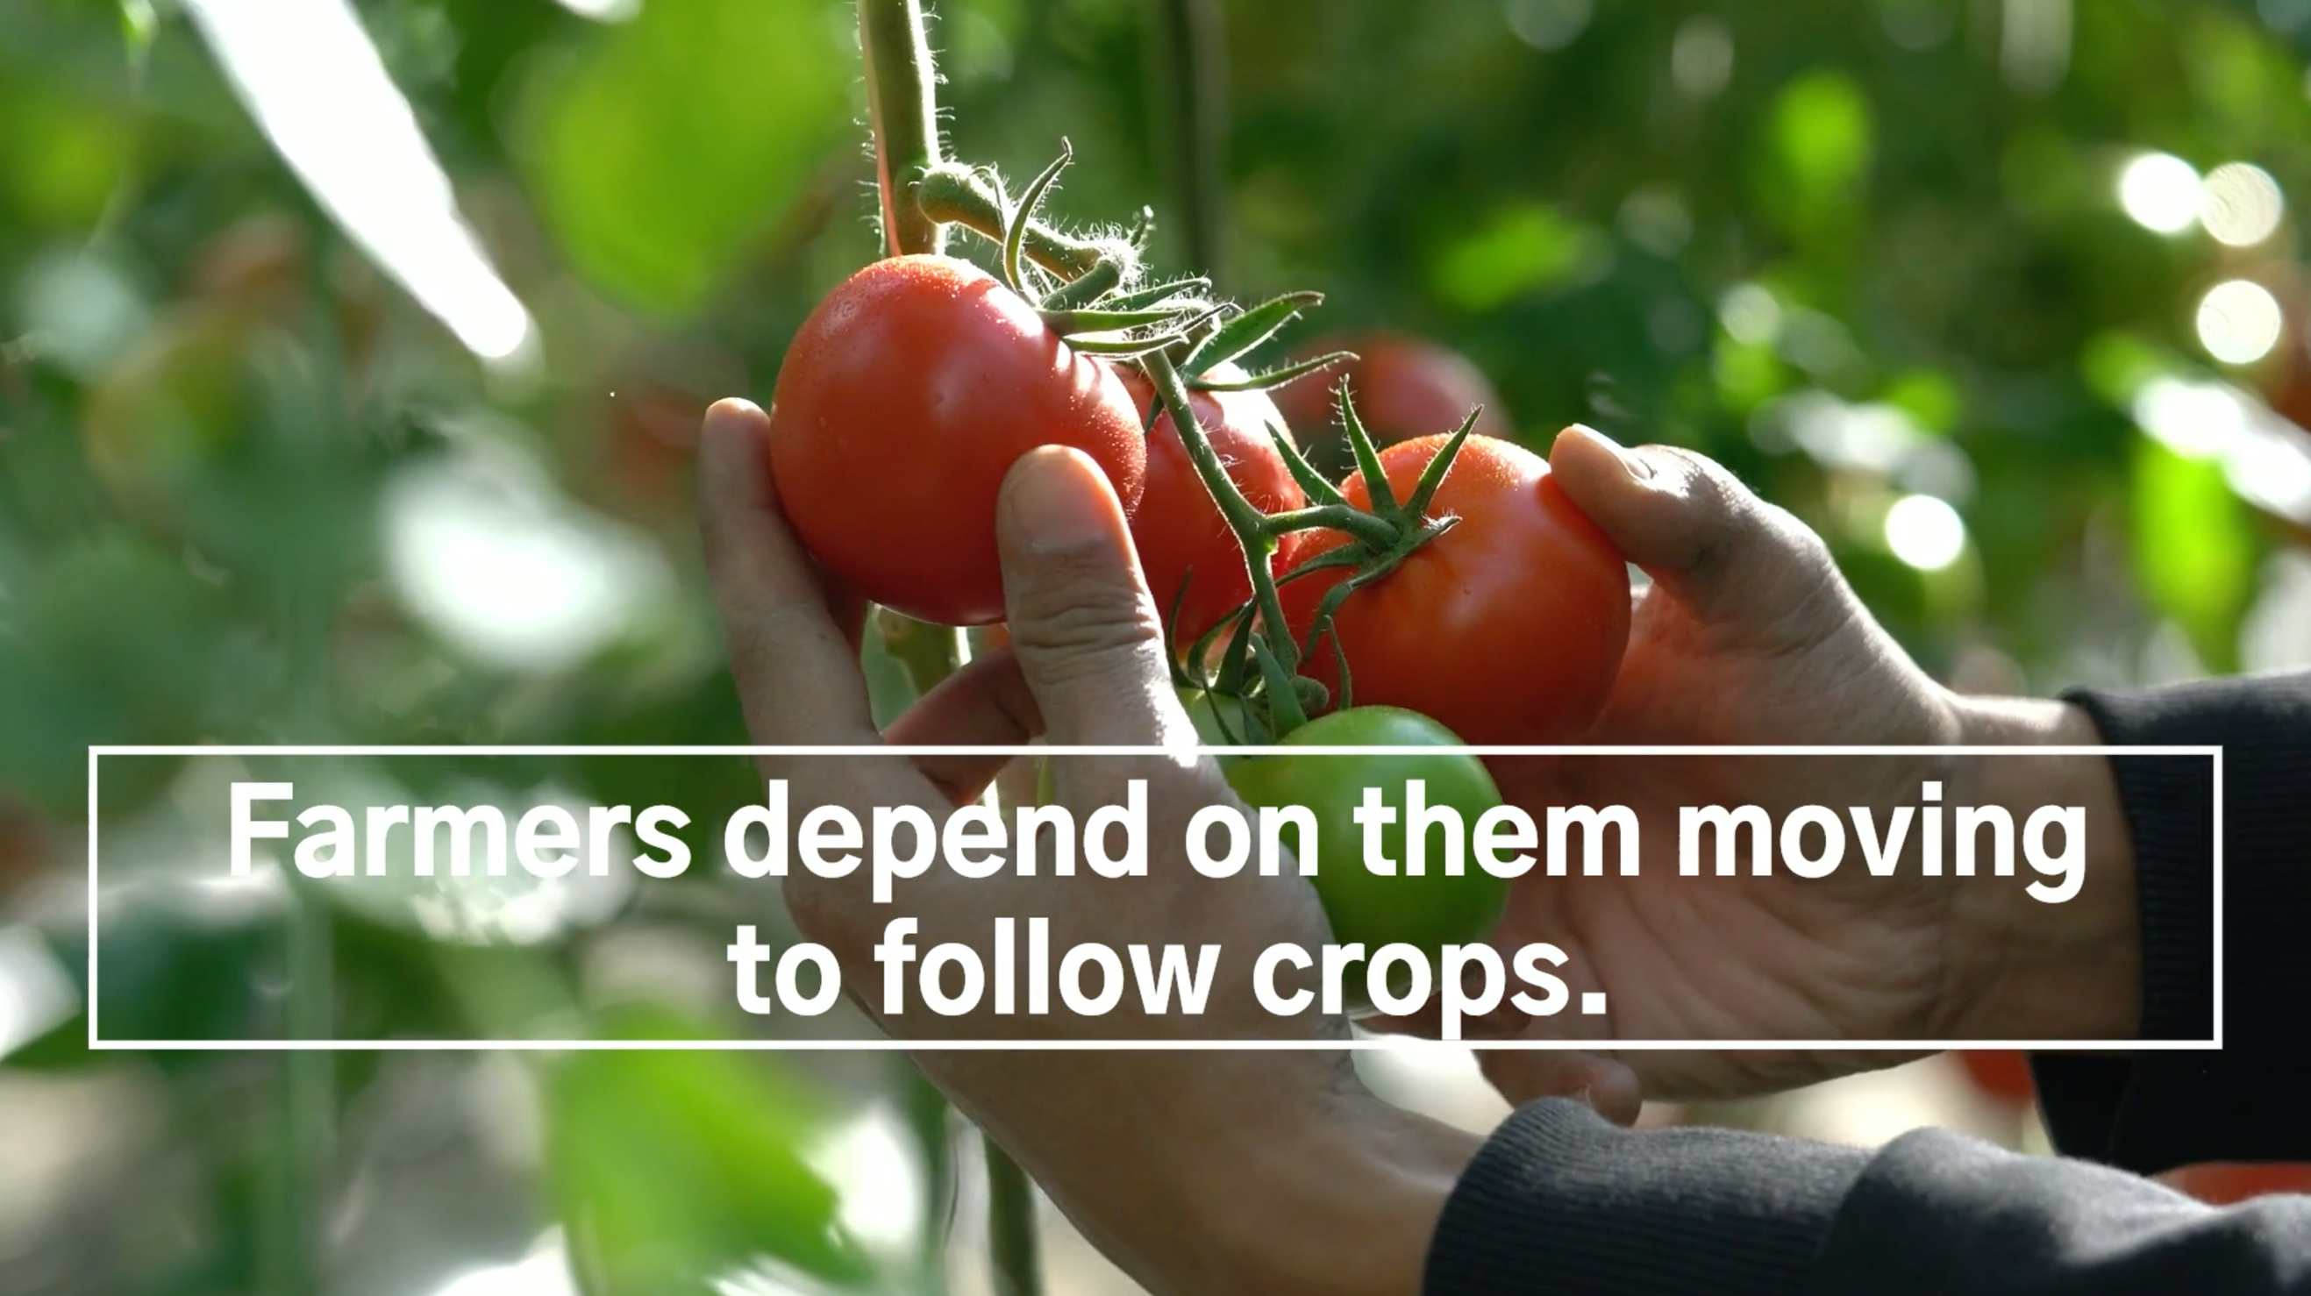
BASIC ELIGIBILITY CRITERIA

Slide 16
Purpose of Title I-C
Ensure that all migrant students have access to the same educational opportunities.
Help migrant students overcome barriers to education.
Help migrant students graduate from high school and be prepared for post secondary education or employment.

Slide 17
Migrant…not “Immigrant”
A migrant worker, or migratory agricultural worker is someone who:
1. Seeks agricultural employment of a seasonal or temporary nature.
2. Typically makes multiple interstate or intrastate residency changes to follow the qualifying work.
*A person’s citizenship status is not a factor for qualifying for the Title I-C program

Slide 18
“Migratory Child” Definition
For Title I-C eligibility, a migrant child must…
- be under the age of 22 years old.
- not have graduated from a U.S. high school.
- not have earned a GED.

Slide 19
Eligibility Criteria for Title I-C
1.) Family must have moved into the school district sometime in the past 36 months,
AND
      2.) ...someone in the family must have engaged in “Qualifying Work” sometime during those 36 months.

Slide 20

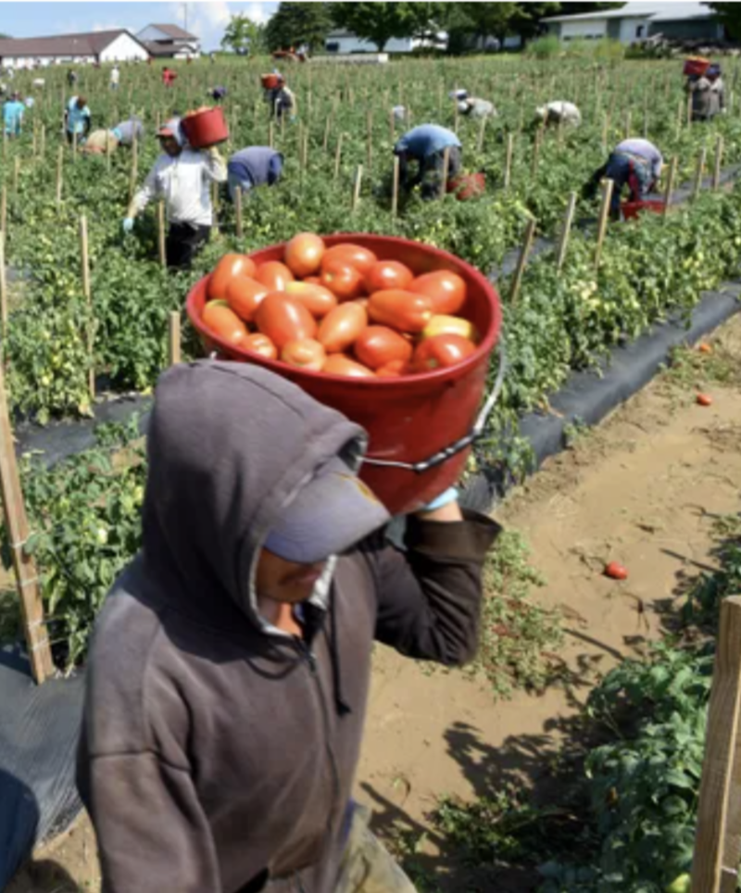

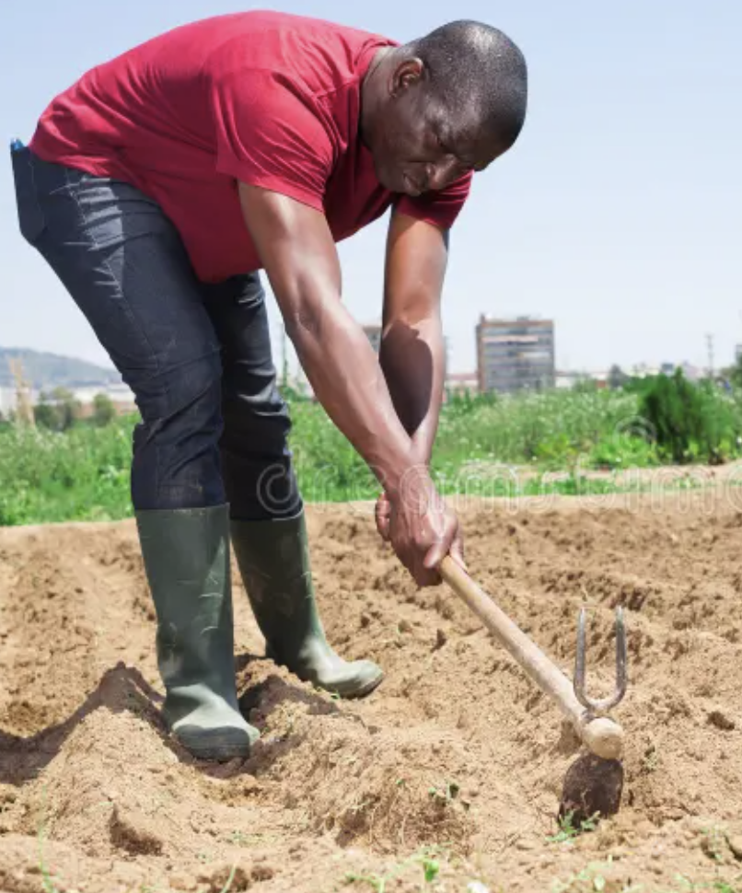
Examples of “Qualifying WORK”

Slide 21
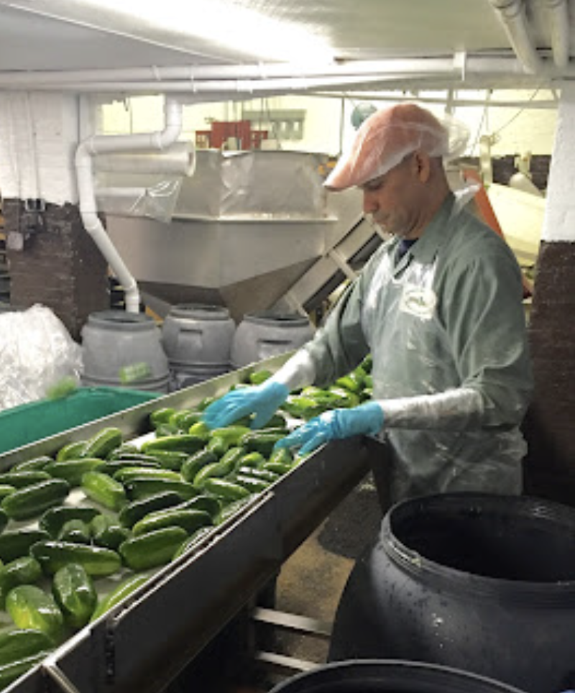

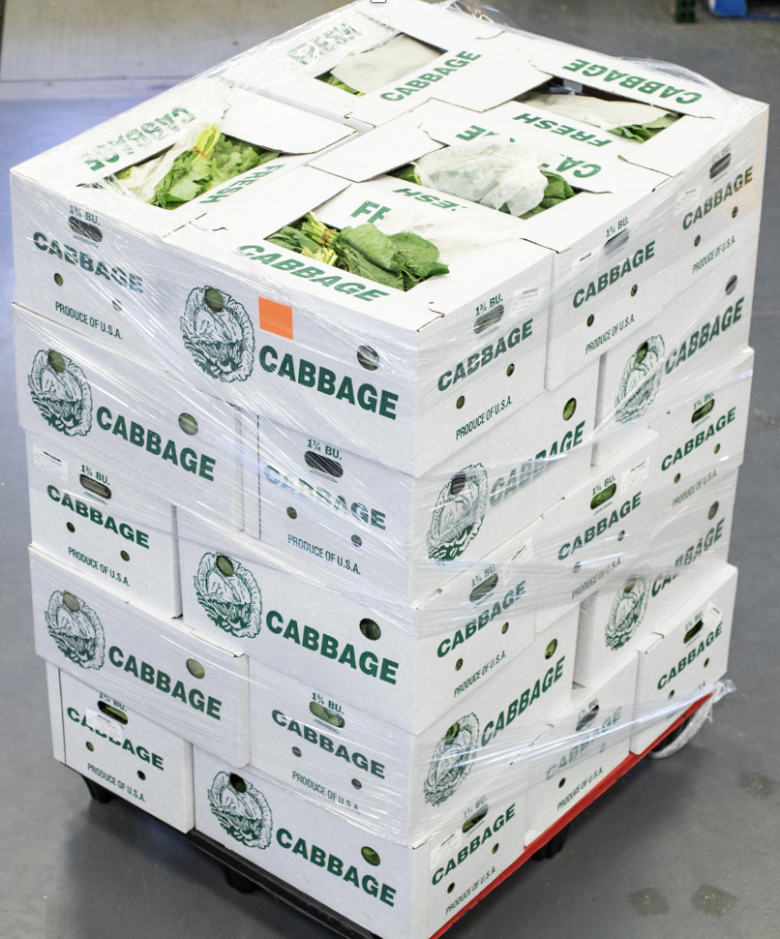
Examples of “Qualifying WORK”

Slide 22
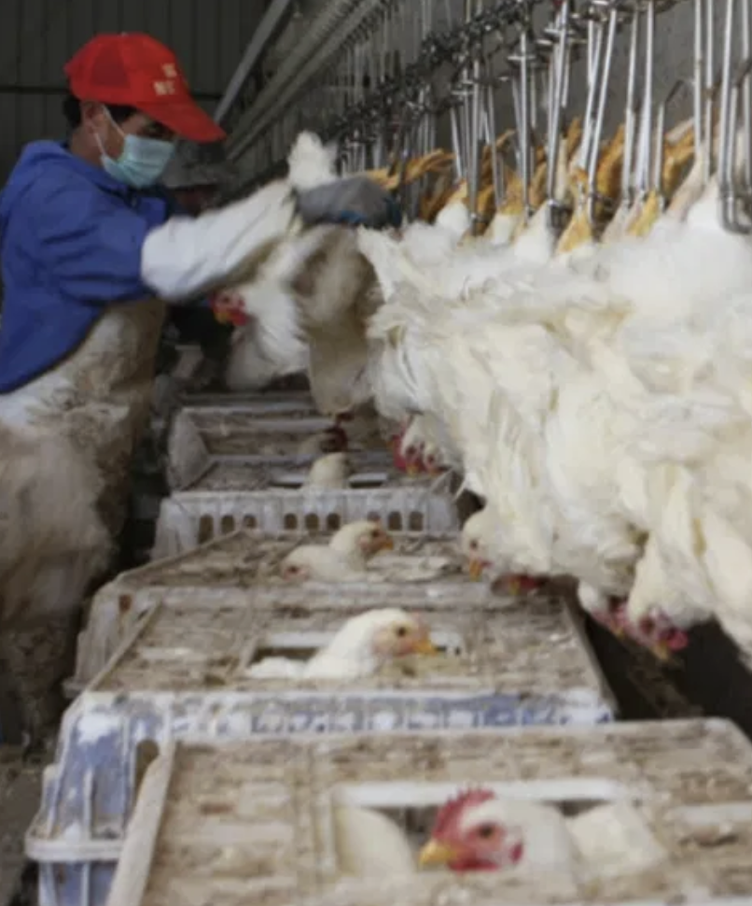
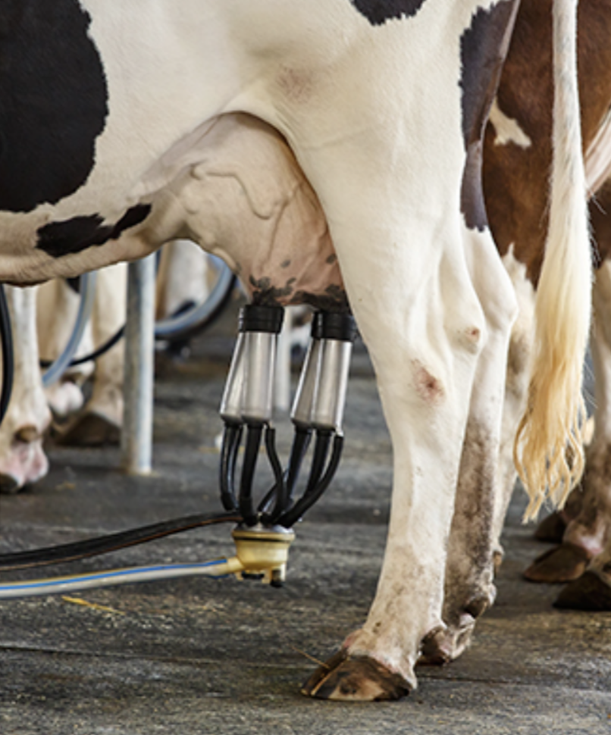

Examples of “Qualifying WORK”

Slide 23
What is IMAGE?
I.M.A.G.E.
  Improving Migrant Academic Gains Educationally
Traveling Teachers
Types of students that benefit most from IMAGE:
  Students who live too far from a building program
  High School Dropouts
  Students who work or babysit during the day
  Eligible H-2A workers

Slide 24
IMAGE Program
IMAGE is a more viable program than a summer building program:
  Less expensive to run.
  Most high school students & and all OSY served in the MEP are served through IMAGE.
  Much safer due to immigration uncertainties.

Slide 25
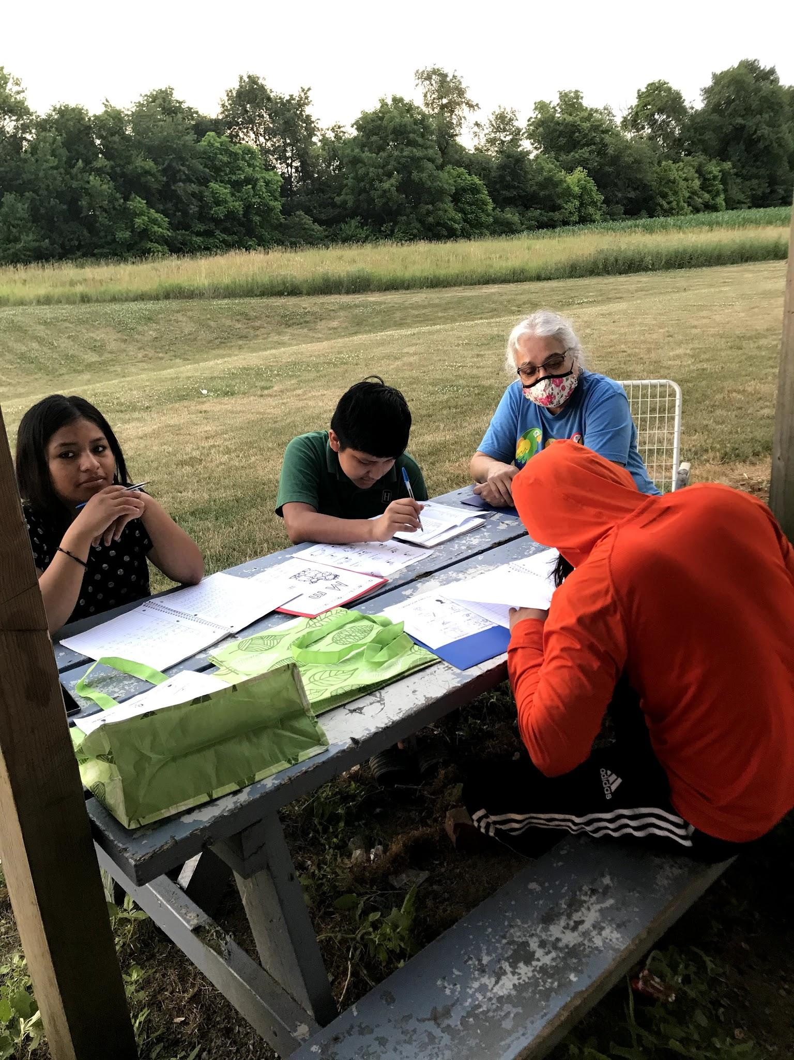
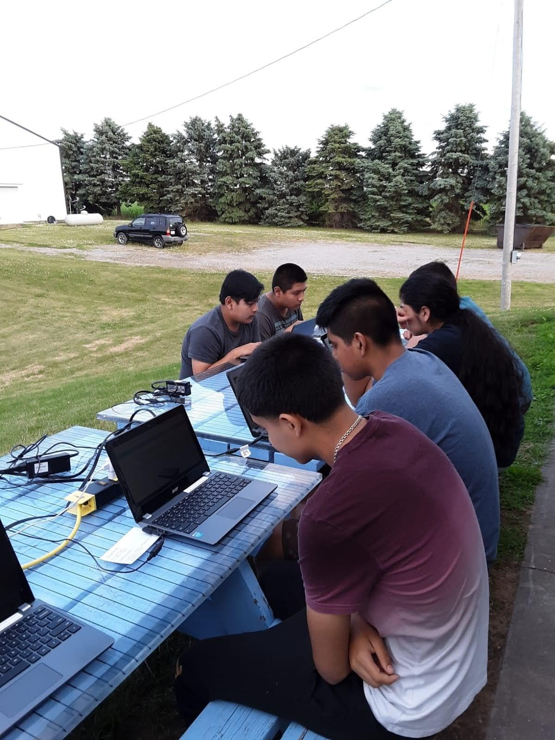
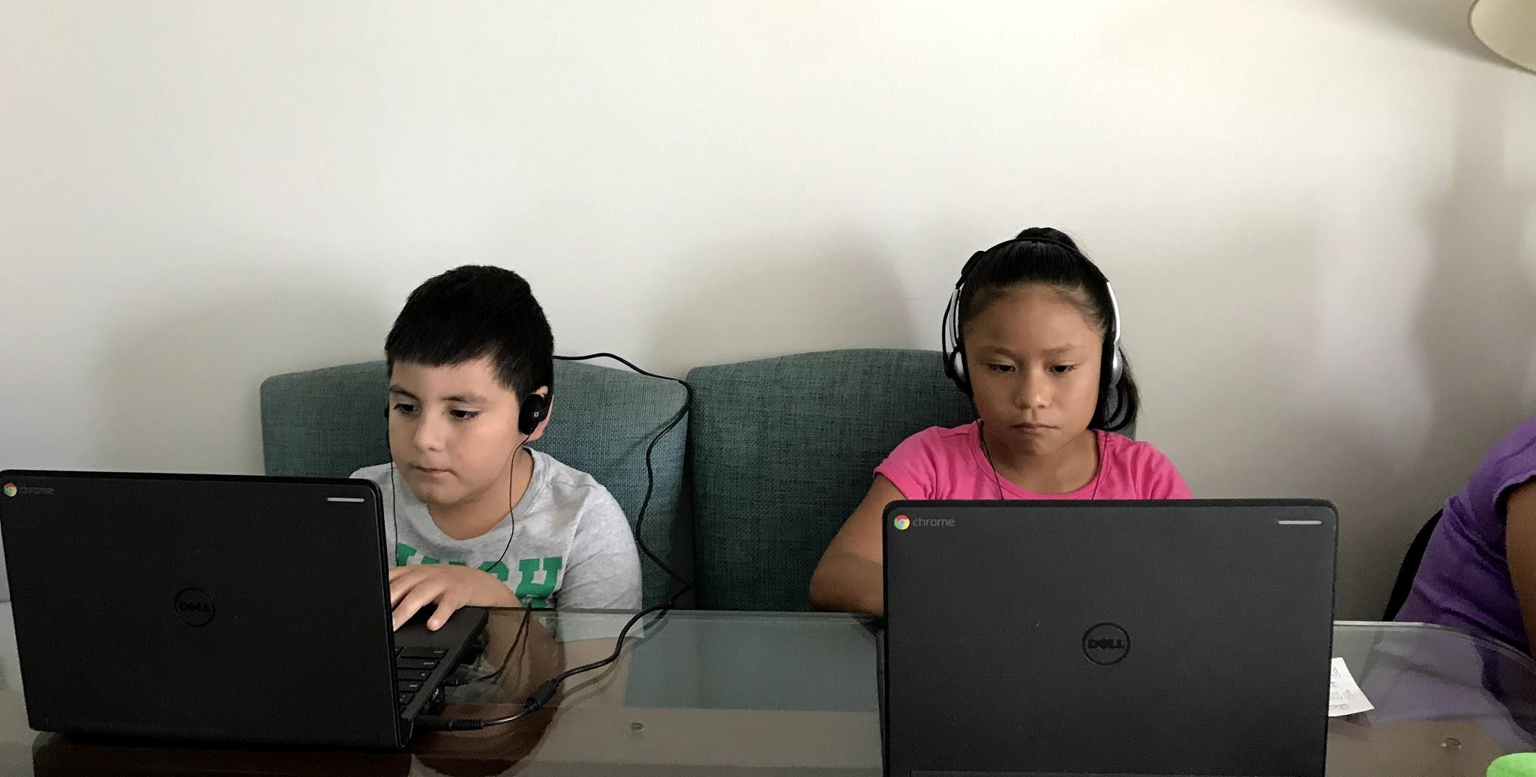
IMAGE Educational Options
EL Instruction
Secondary Credit Recovery & Career Exploration
Evidence-based Instruction
Notes:
30-day summer school program building run from a fully operational school building.
IMAGE services: designed to send qualified teachers to the homes of migrant students residing in non-project districts to deliver one-on-one instructional services.
I-ready: an evidence based adaptive assessment designed to provide teachers with actionable insight into student needs
Odysseyware: provides easy-to-access, user-friendly digital content and curriculum that includes over 300 standards-based core courses and electives.
Course options include enriching electives such as Career & Technical Education (CTE) courses, world languages, the arts, health, test readiness, life skills, and more.
Odysseyware is available anytime on any device. The course work is engaging, and students do well… many of our students graduate because of this program.

Slide 26
Building Program vs. IMAGE Services
Summer Building Program
  30 days of instructional services
  Students need only attend a building program for one day to be counted as “Served”
IMAGE Services
  IMAGE students must receive 10 hours of direct instruction to be counted as “Served”

Slide 27
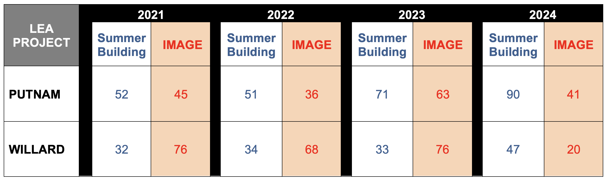
IMAGE vs. Building Program Numbers

Slide 28
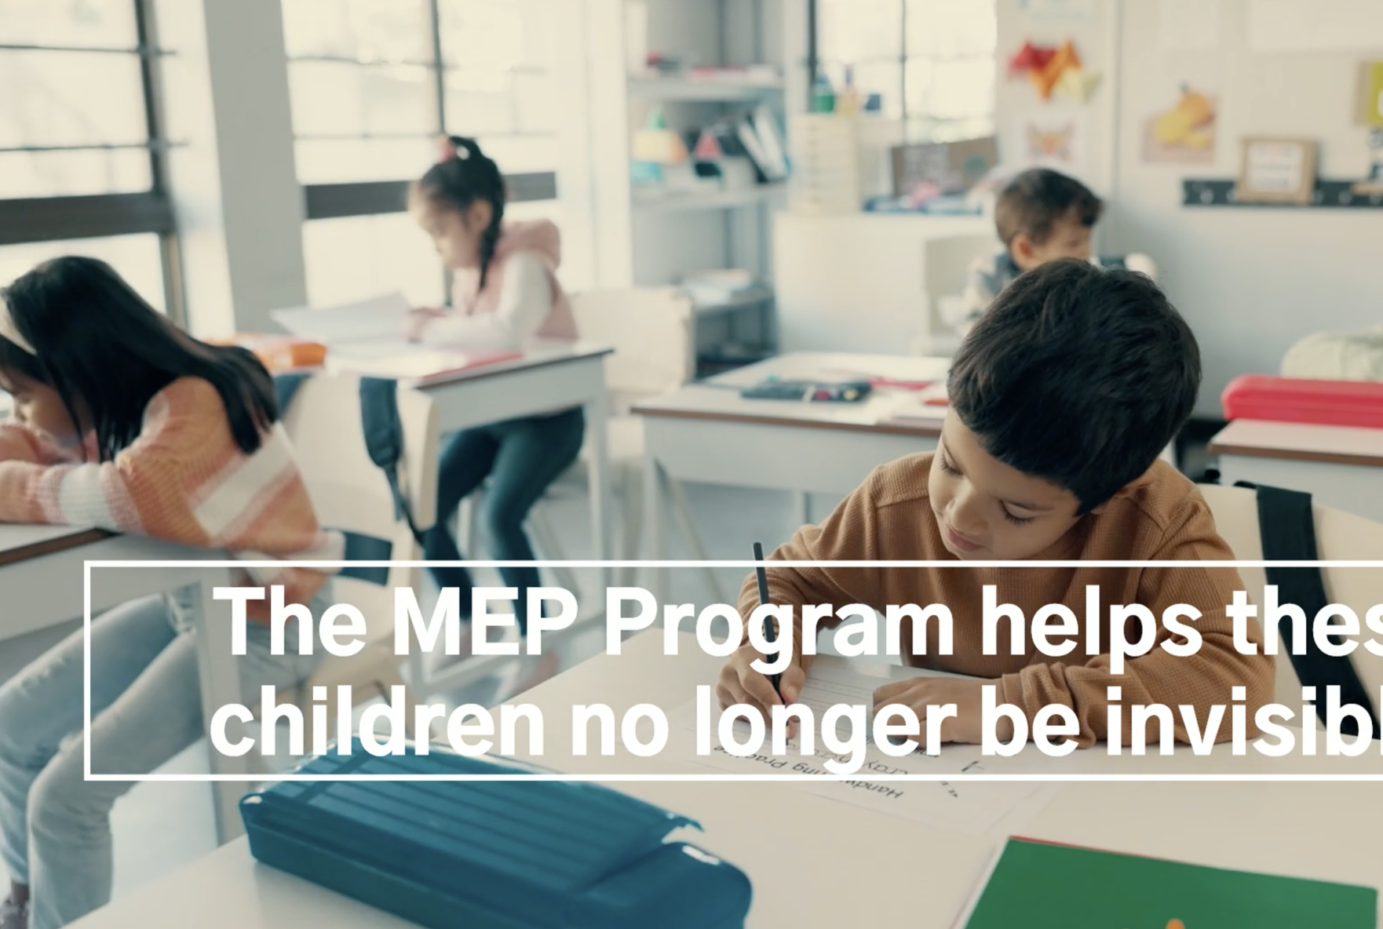
PreK (Ages 3-5)

Slide 29
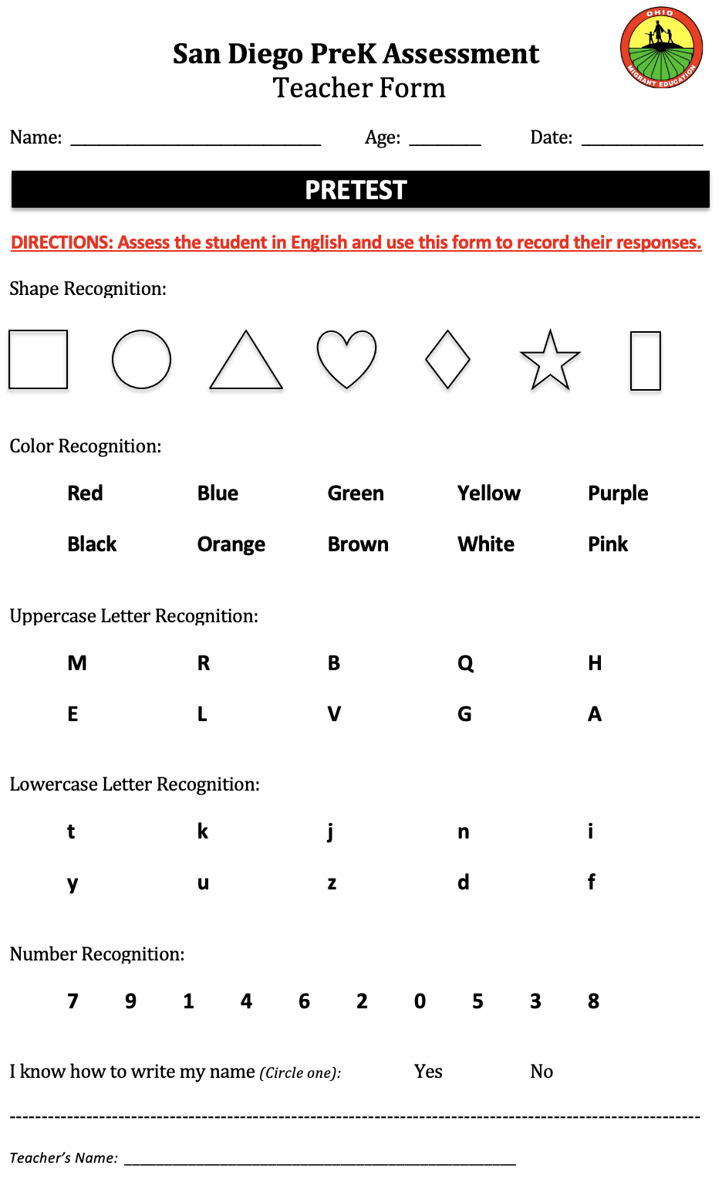
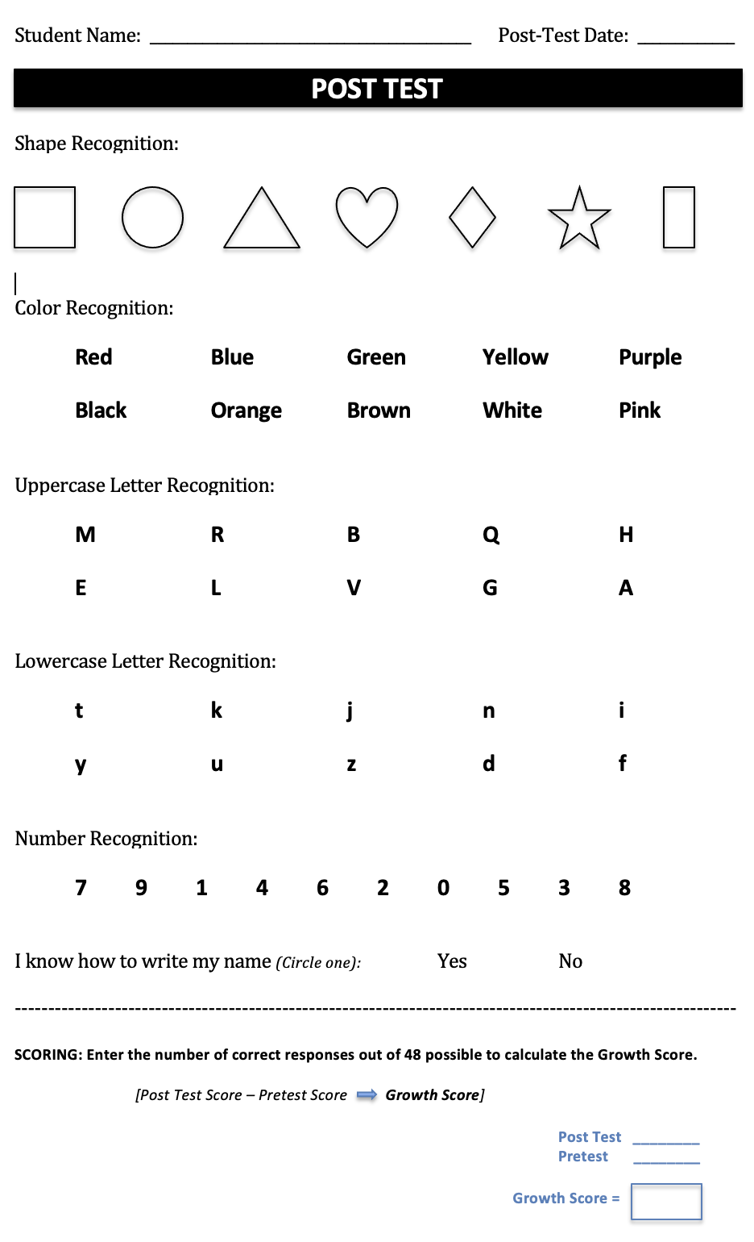

Slide 30

Pre-K Basket of Manipulatives

Slide 31
Grades K-8

Slide 32
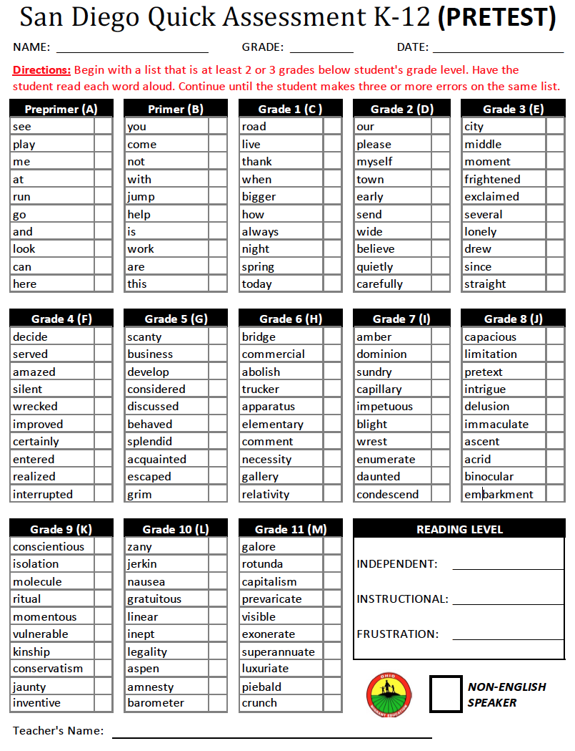
San Diego Quick Assessment
For K-12 Students

Slide 33
EL Requirement
Every effort must be made to identify which migrant students in the Title I-C program are Limited English Proficient!

Slide 34
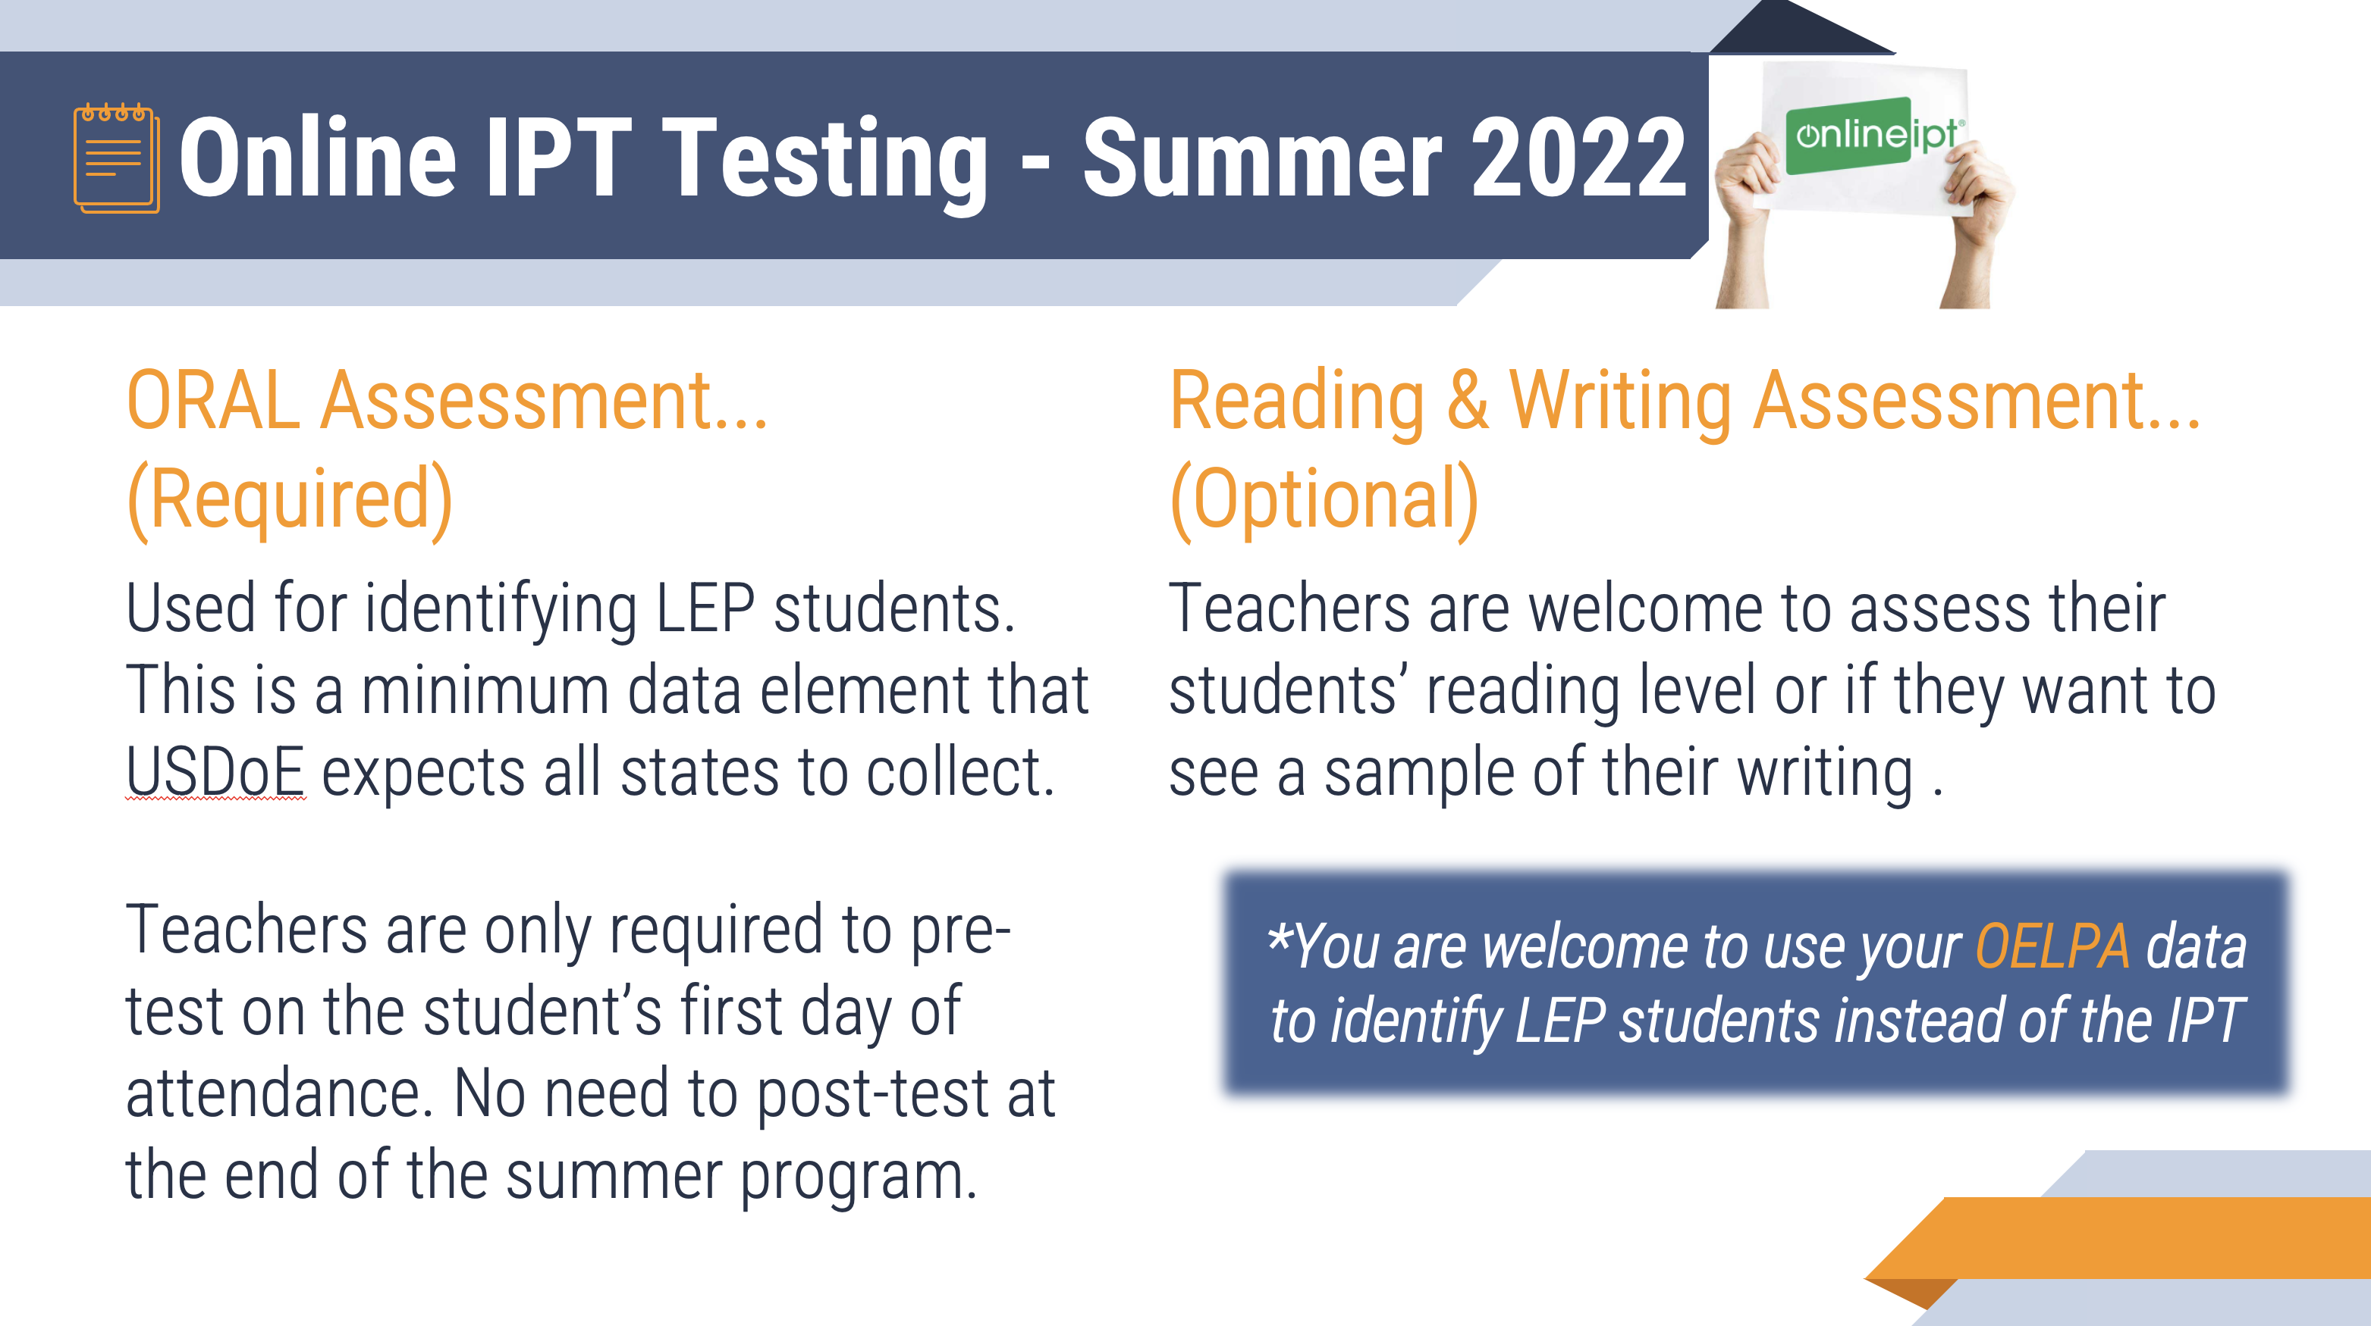
2026

Slide 35

https://www.onlineipt.com/
IPT Oral Assessment
To set up an IPT teacher account, contact: Page Warner
419-332-6007
Page.Warner@nwoesc.org

Slide 36

IPT Oral Assessment (K-8)
Ohio MEP’s Language Proficiency Assessment
Only 3 possible designation outcomes:
Non-English Speaker - (NES)
Limited English Speaker - (LES)
Fluent English Speaker - (FES)

Slide 37
Used for identifying LEP students. LEP is a minimum data element that USDoE expects all states to collect.
Teachers are only required to pre-test on the student’s first day of attendance.
Post-testing at the end of the summer program is NOT required.
*You are welcome to use OELPA data
to identify LEP students in place of the IPT

Slide 38
High School Students

Slide 39

Secondary Credit Recovery
Options/Information for Online Coursework through the Ohio Migrant Education Program
Gary Herman, APEX Coordinator
GaryHerman@PutnamCountyESC.org

Slide 40
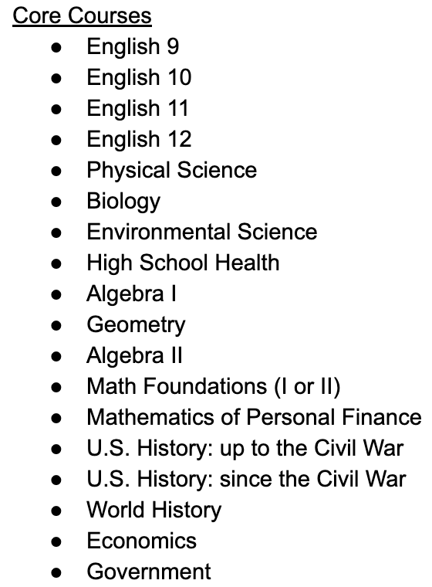
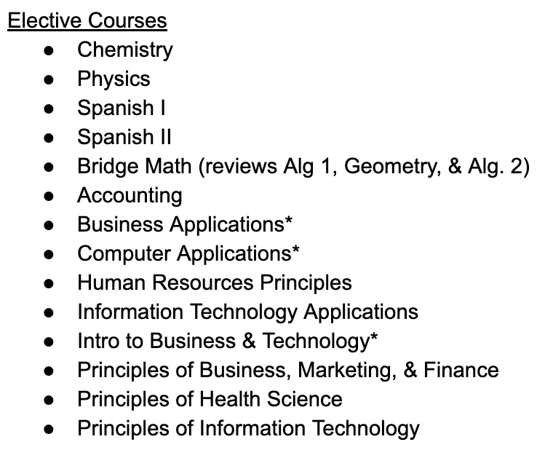

Slide 41
APEX Course Registration
Fill out online Registration Form at:
bit.ly/MigrantCourseRegistration
Teacher who submits request will receive confirmation, and a link will be emailed to the TR Clerk.

Slide 42
APEX Registration Process
1. Contact Corina for verification of course option at:
Corina.Barranco@nwoesc.org
2. Fill out online Registration Form: bit.ly/MigrantCourseRegistration
Person who submits request will receive confirmation of submission and a link will be emailed to the TR Clerk.
3. Contact Gary if you have any questions
Gary.Herman@putnamcountyesc.org

Slide 43
Out-of-School Youth (H-2A)

Slide 44

H-2A Instructional Offerings
English Tutoring
Life Skills
Workforce Training

Slide 45


Supports for Out-of-School Youth
https://www.osyconsortium.org/
https://www.idr-consortium.net/

Slide 46
GROUP ACTIVITY #1
What educational resources do you plan to use this summer:
PreK (ages 3-5)
Grades K-8
High School Students
Out-of-School Youth (OSY)… including H-2A workers

Slide 47
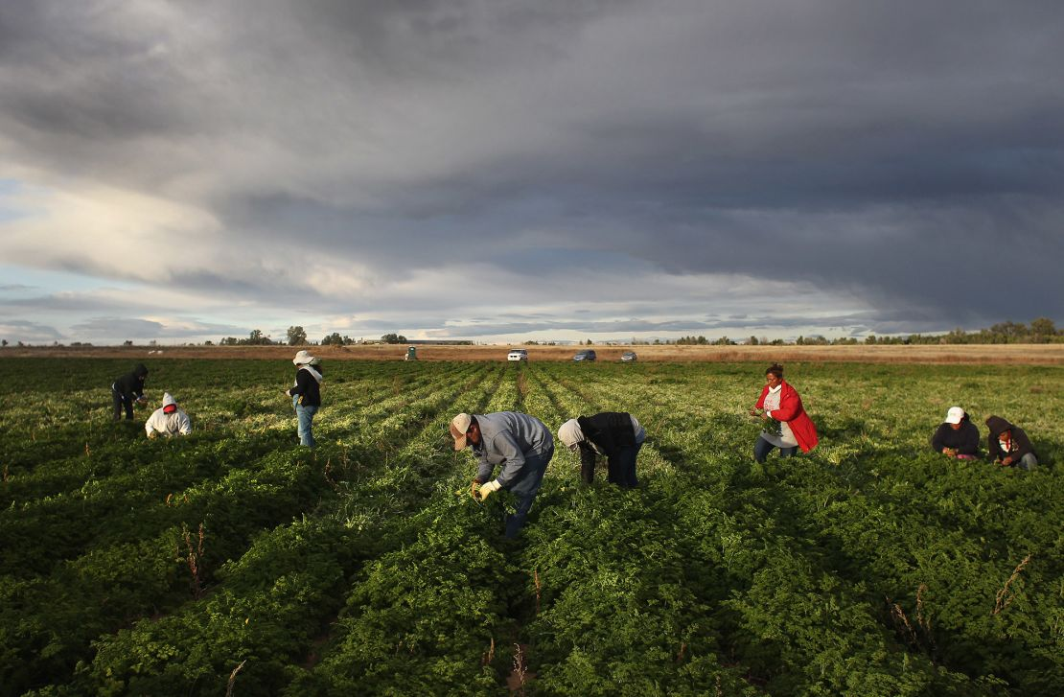
IMAGE Forms

Slide 48
Continuation Of Services (COS)
Eligibility for Title I-C is only good for 36 months.
COS allows the MEP to serve students who reach the end of their eligibility for a maximum of 12 months.
The MEP will not count students served through COS.
OMEC approval is required before COS can be offered.
The reporting process for COS students is completely different from migrant-eligible students.
Students must be “At Risk” of failing to qualify for COS.

Slide 49
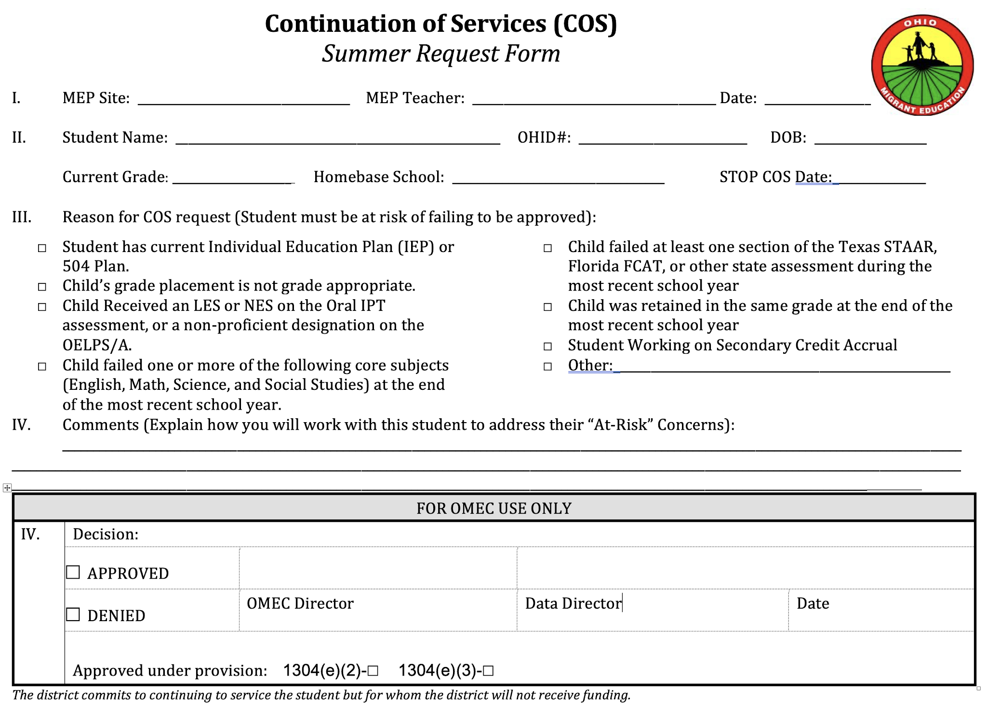

Slide 50
Priority For Services (PFS)
A PFS form must be completed on all students participating the the summer MEP.
Student must meet Criteria I & II for PFS status.
Teacher must explain the supplemental instruction that addresses Criteria II for those with PFS status.
This form needs to be completed ASAP.
Use MSIX to determine school interruption.
All teachers must maintain a list of their PFS students in their classroom.

Slide 51
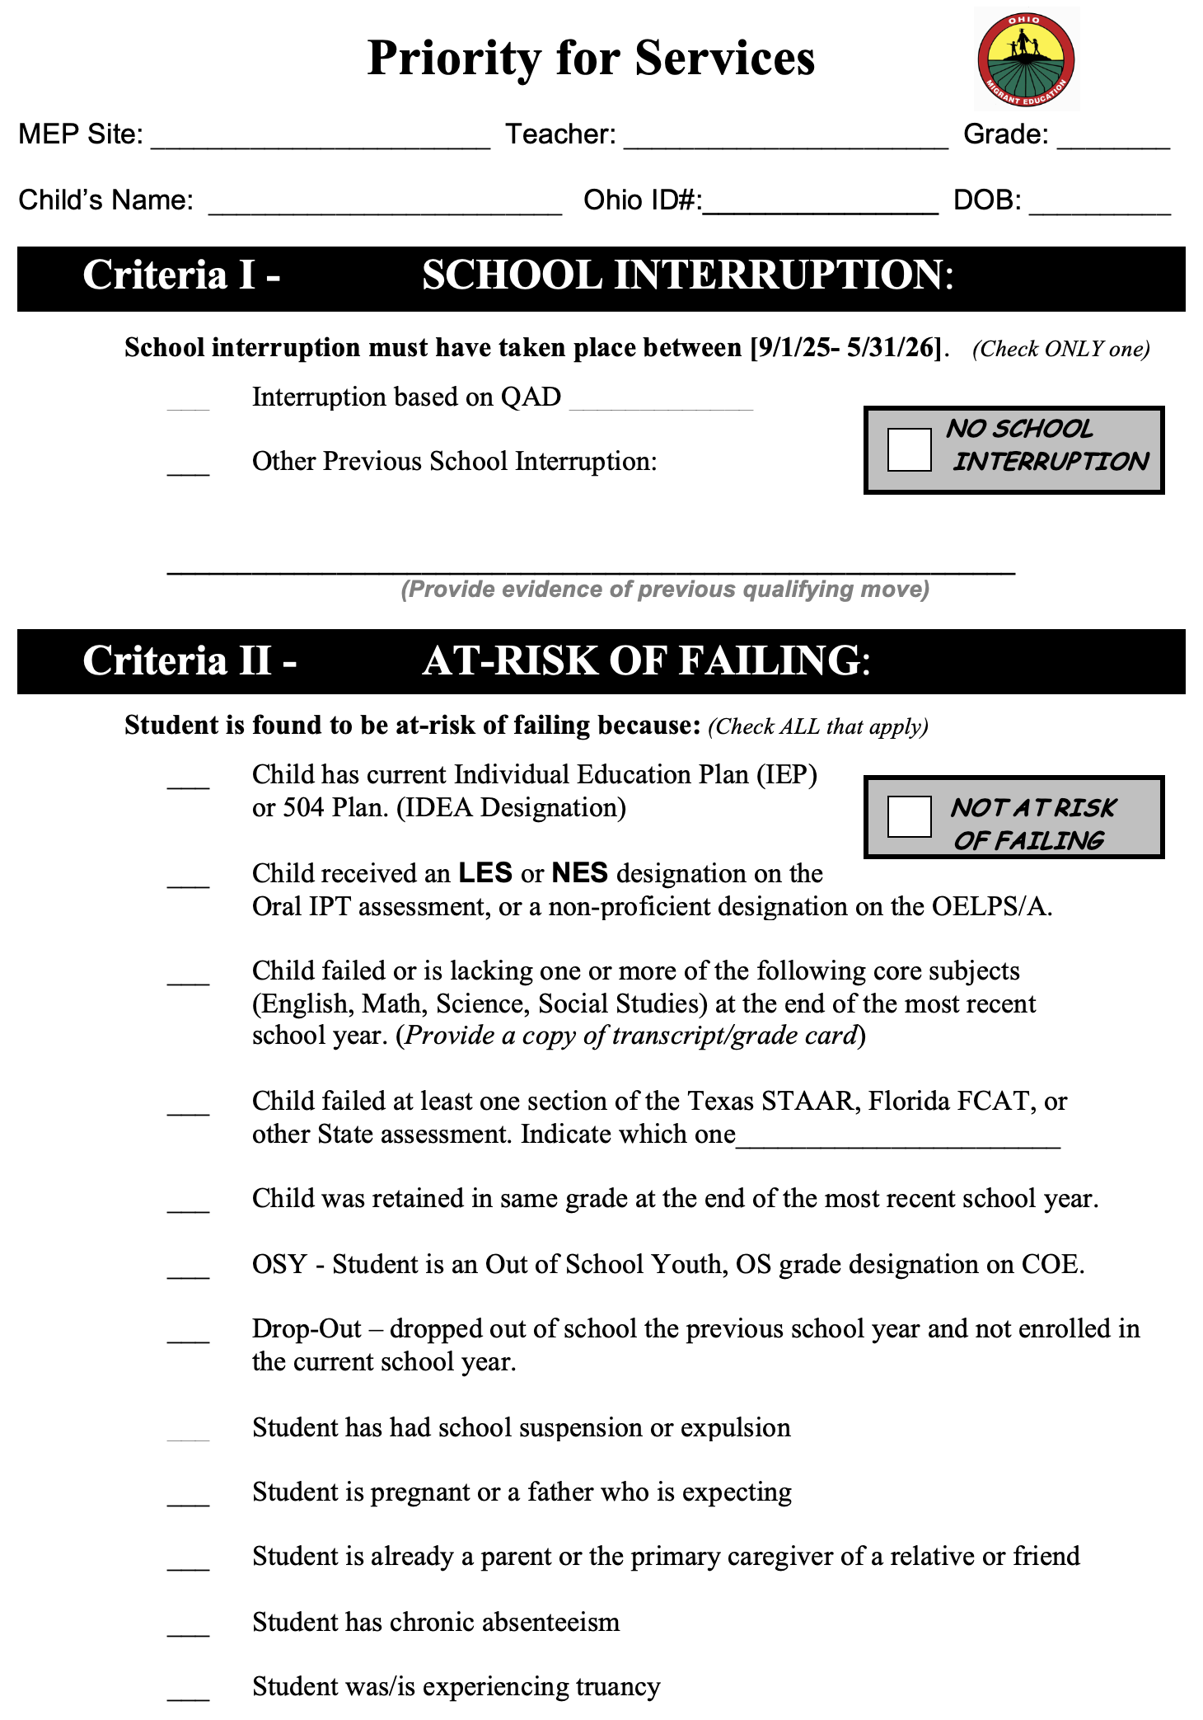
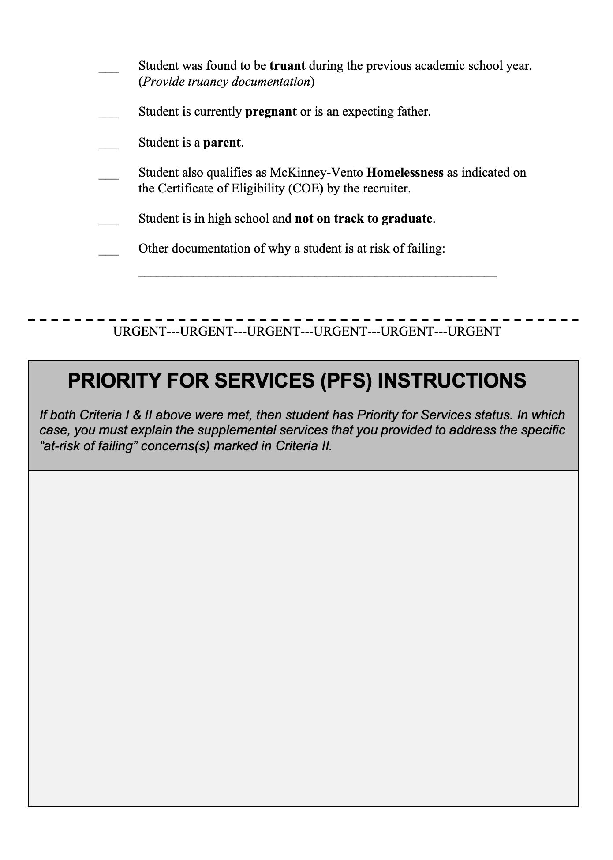

Slide 52
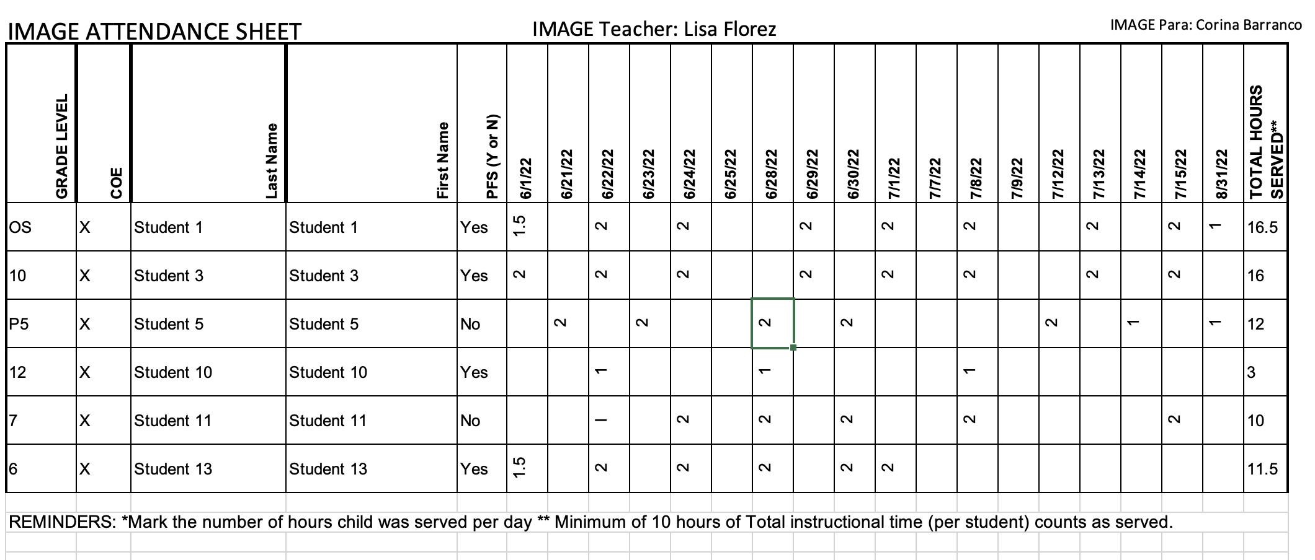
Sample IMAGE Attendance Sheet

Slide 53
1. One form per student.
2. Minimum of 10 instructional/contact hours.
3. If an IMAGE student decides to attend the summer migrant program for just one day, you are NOT required to continue serving that student through IMAGE.
4. You cannot leave a packet of work and count that towards the 10 hours of instructional/contact hours.
5. If you cannot complete the 10 hours due to student moving out of your area or the program ending within a week or so of qualified arrival date document that on the form. These will be decided on a case by case basis.

Slide 54
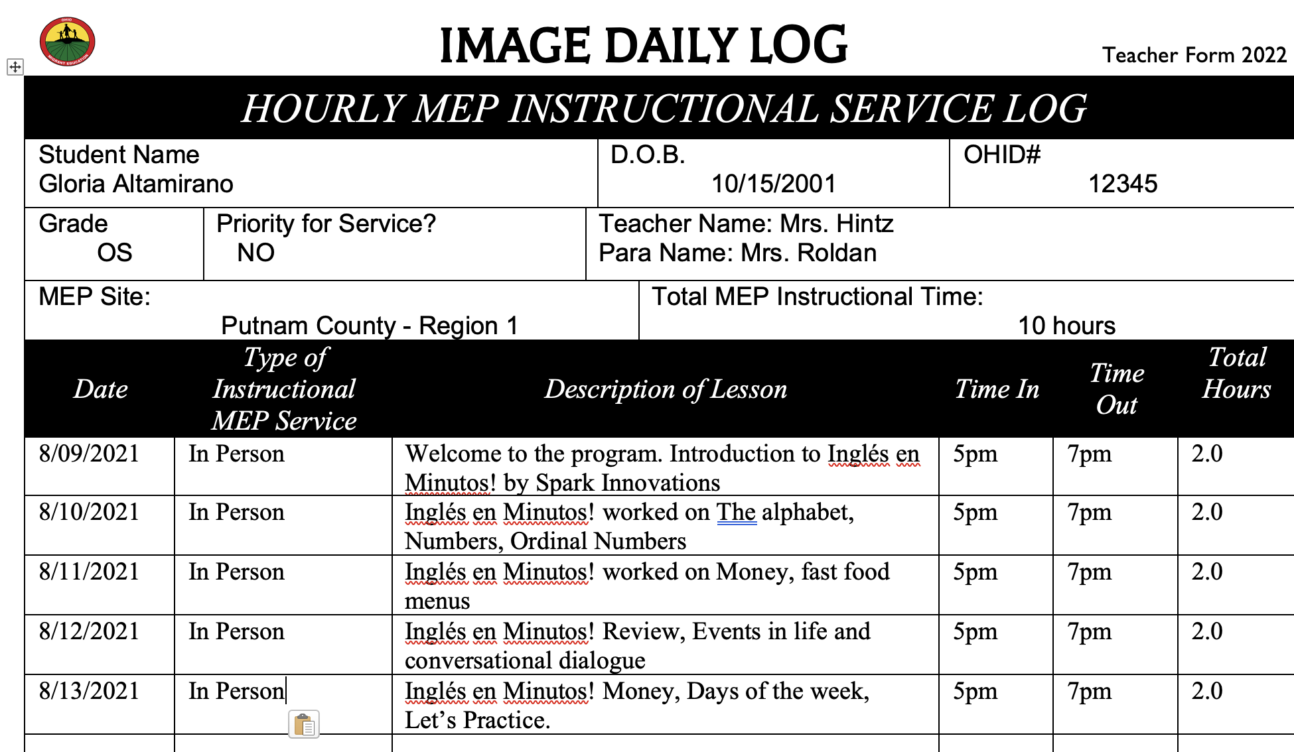
Teacher Form 2025
Gloria Maya

Slide 55
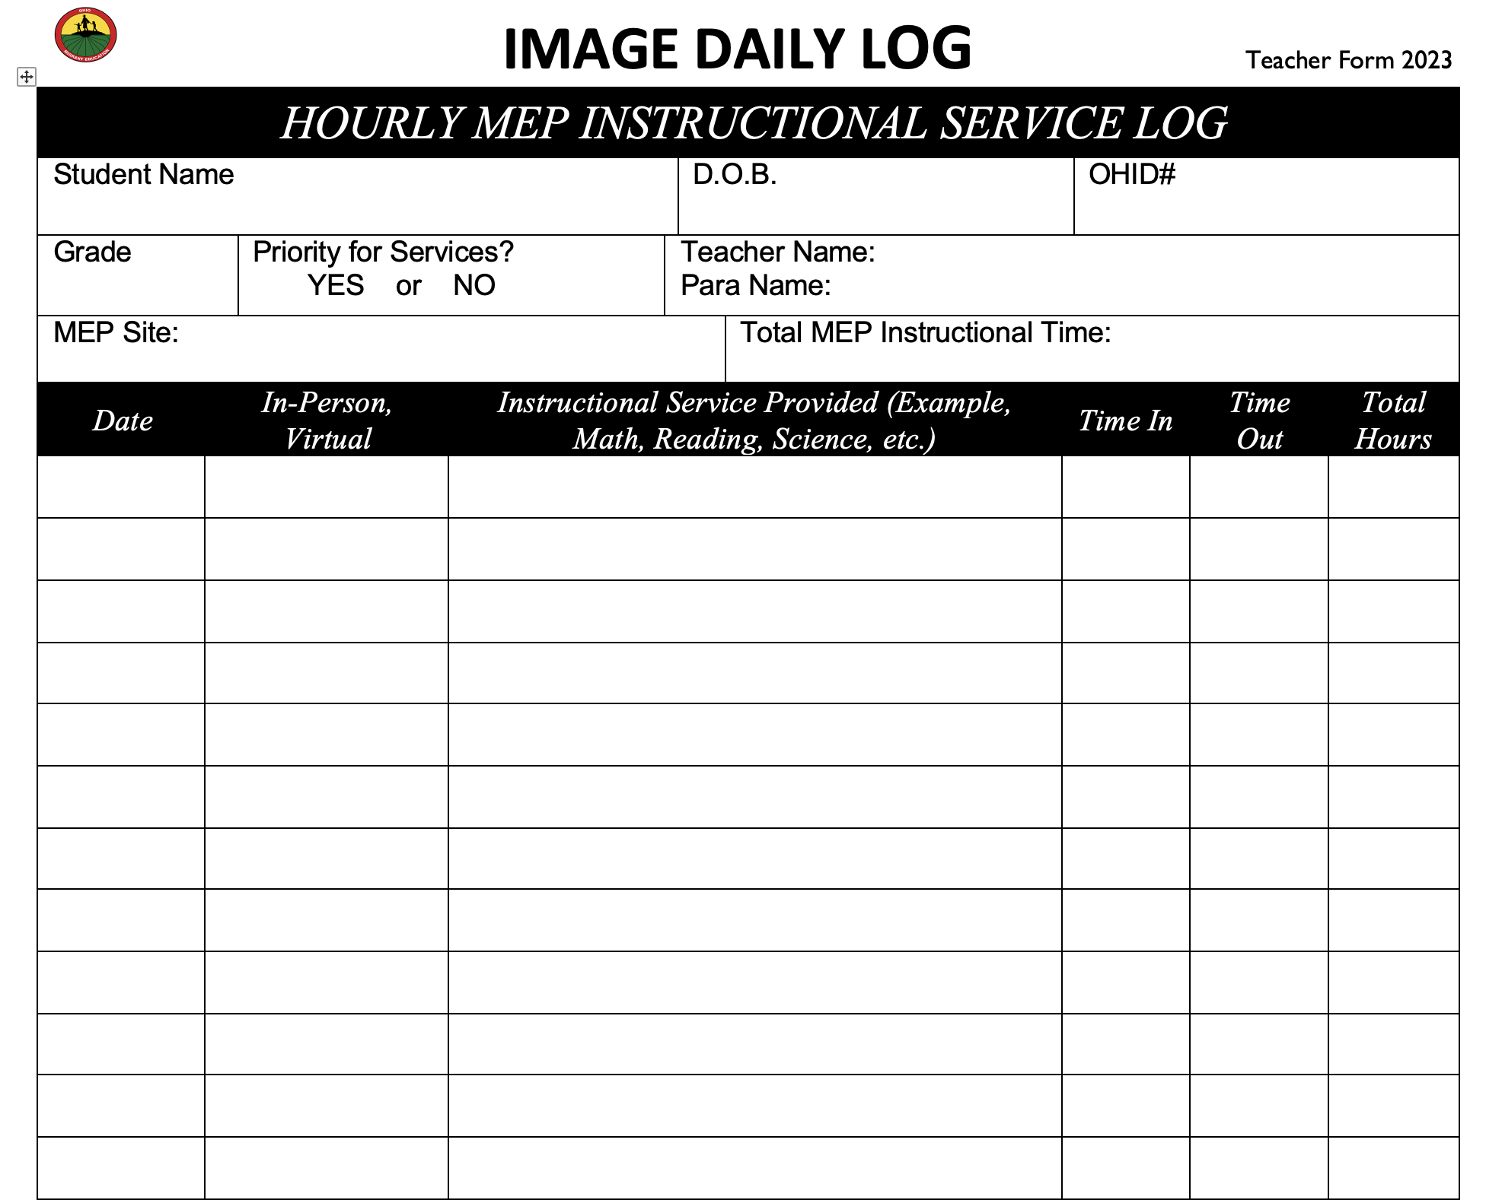
Student Name – no nicknames, use name on COE
DOB – data on coe.
OHID# - data on COE.
Grade – Should be the last grade the student completed.
PFS - Mark Yes or No if the student has been determined to be eligible for PFS.
Teacher Name – The teacher and aide providing the instructional service.
MEP Site – Your MEP name such as Putnam Co or Old fort, etc.
Instructional service – what educational service was provided to the student (math, reading, science, EL, etc.).
Date of Instruction – Each day you meet with a student.
In-Person or virtual – how the instruction is being provided.
Time in & Time out.
Total hours per day.
**Student has to have a total of 10 hours to be counted as served**
IMAGE Daily Log

Slide 56
MSIX Login
MSIX users are required to create an account via Login.gov
Anyone wanting to be an MSIX user must contact Corina Barranco.
Corina.Barranco@nwoesc.org

Slide 57
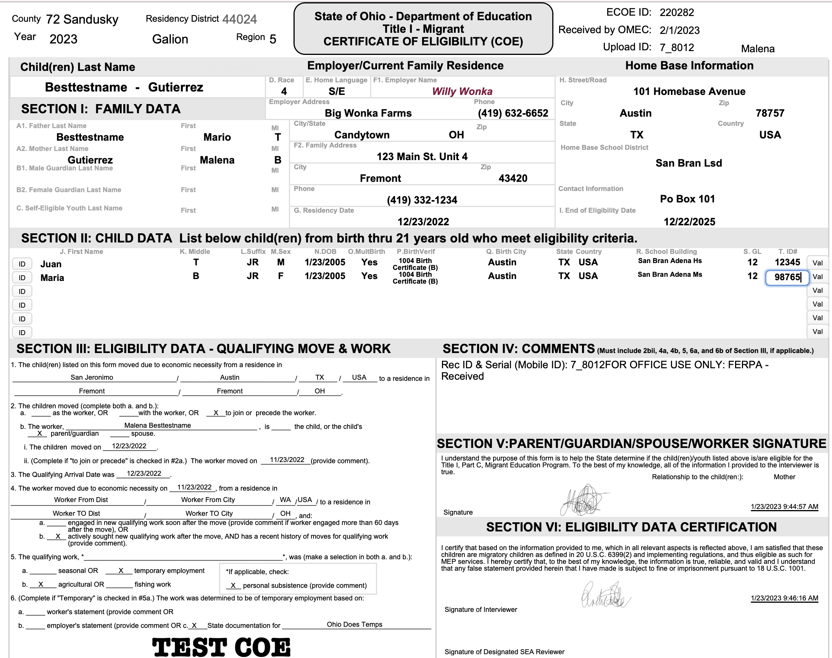

Slide 60
End of Eligibility (EOE)

Slide 62
OMEC Paperwork Support
1. Teachers & TR Clerks Should work together to complete paperwork requirements.
2. All paperwork is inputted into OMSIS II by the TR Clerk
3. If you do not have a TR Clerk, your teachers will fill out and input all paperwork into the drive and on OMSIS II.

Slide 63
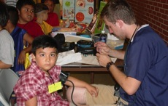
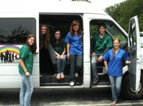

Summer Health Fairs
10% to 14% of migrant students screened each year receive a new pair of glasses.

Slide 64

Summer Health Fairs
Dental & Vision screenings.
Students can receive free dental work and prescription glasses.
10% to 14% of migrant students screened each year receive a new pair of glasses.

Slide 65
Migrant Health Fairs
Lisa Flórez, Health Fair Coordinator
  Barbara.Florez@nwoesc.org

Slide 66

Migrant Head Start

Slide 67
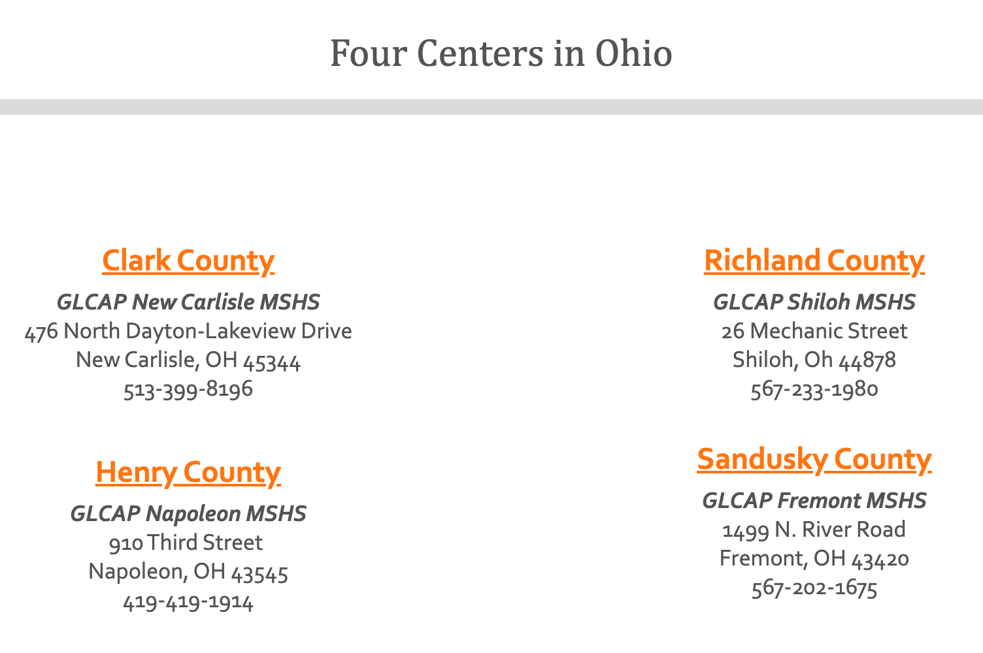


Slide 68
Details of 2025 Partnership
Help recruit for both programs
  Your IMAGE Pre-K children could also be receiving GLCAP services.
IMAGE teachers can serve eligible PreK students in the GLCAP centers.
  Last year, our teachers were invited to serve children enrolled in the Migrant Head Start centers that also met the eligibility criteria for the Title I-C program.

Slide 69
Migrant & Seasonal Head Start
Center Locations
Migrant Head Start Centers
Regional Migrant Programs
Napoleon Putnam County ESC
Fremont North Point ESC
Shiloh North Point ESC
New Carlisle Tecumseh

Slide 70

2025

