Slide 1
Corina Barranco, Records & Data Coordinator
2026 IMAGE Paperwork Training

Slide 2
Agenda
IMAGE Paperwork
Web Direct
Google Forms

Slide 3
WEB DIRECT – INSTRUCTIONS
Google Chrome Browser
https://ohiomigranteducationtest.com/fmi/webd
User Name: region #
Password: migrantprogram

Slide 4
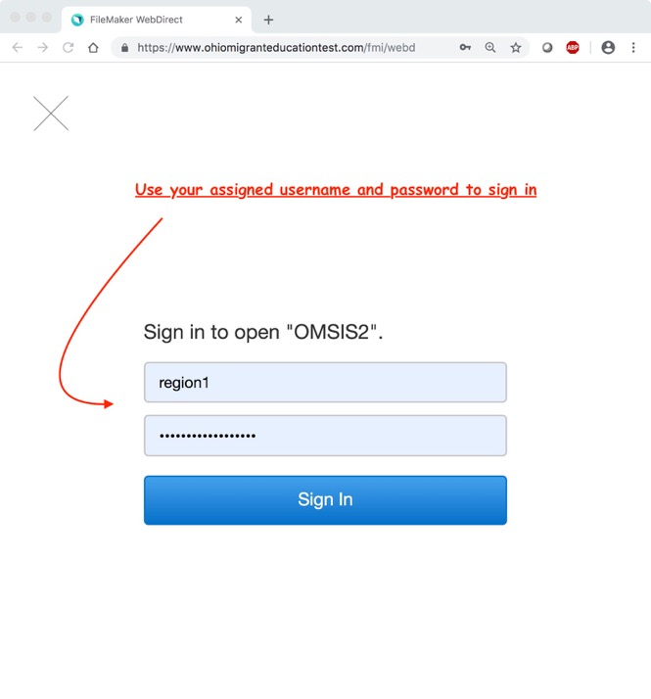

Slide 5
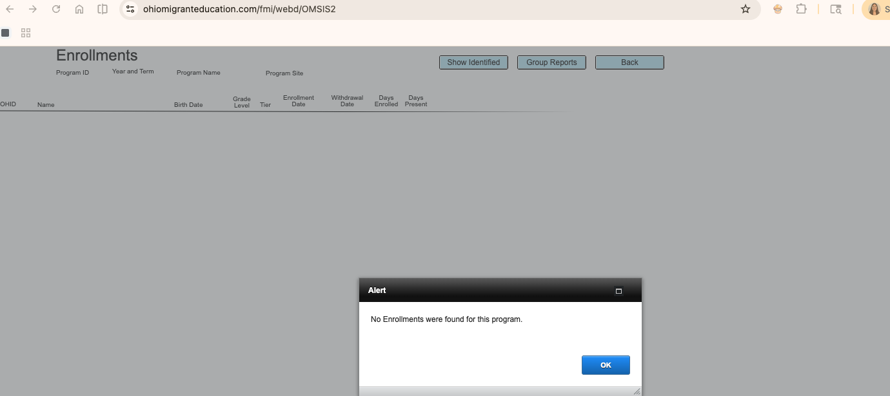

Slide 6
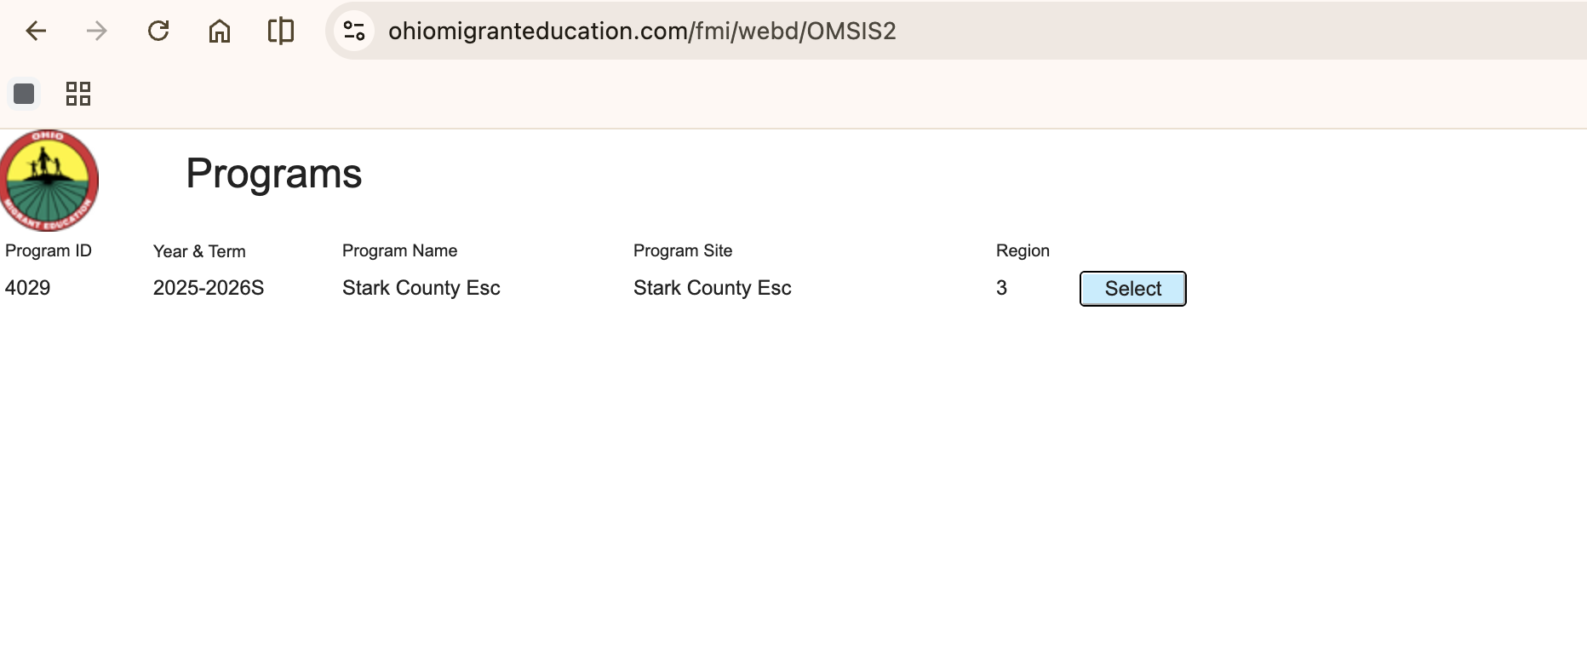
1. The starting screen will show the region program.
2. Start by clicking the “select” button next to the program.
This will display the list of all your enrolled students.

Slide 7
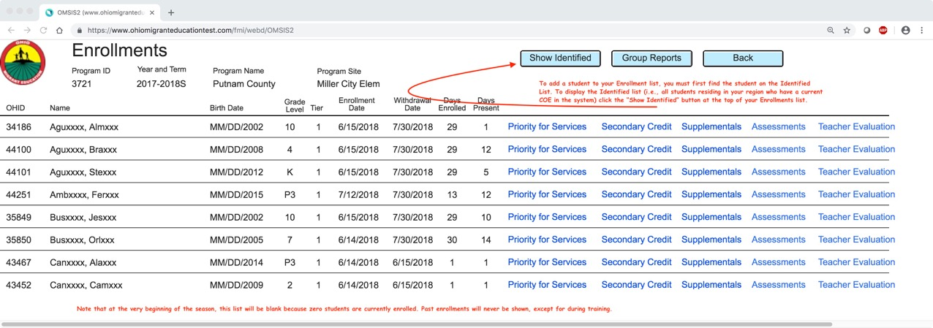
2023-24S
To add a student to your Enrollment list, you must first find the student on the Identified List. To display the Identified list (i.e., al students residing in your region who have a current COE in the system) click the “Show Identified” button at the top of your Enrollments list.)
Note that at the beginning of the season , this list will be blank because zero students are enrolled. Past enrollments will never be shown.

Slide 8
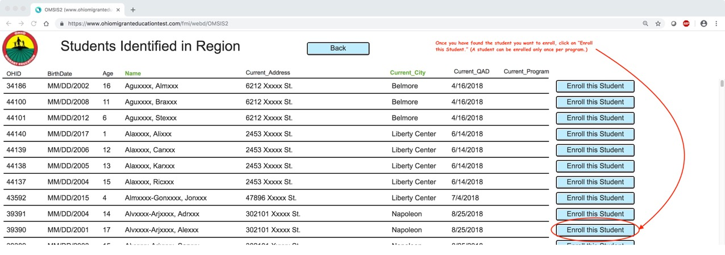
Once you have found the student you want to enroll, click on “Enroll this student.” A student can be enrolled only once per program. They will only show up in the Region’s list who has the most current COE.

Slide 9
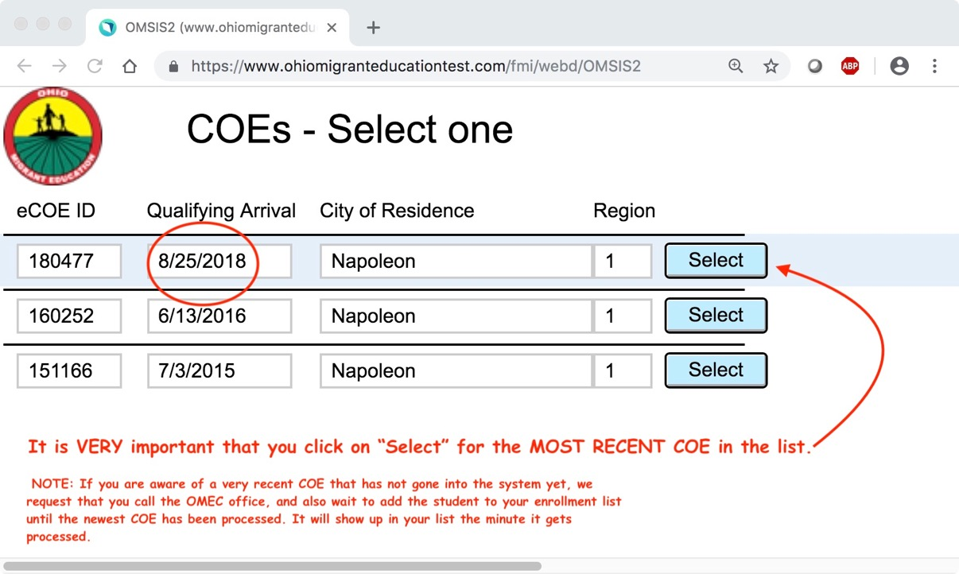
2
06/01/2024
06/05/2023
05/15/2022

Slide 10
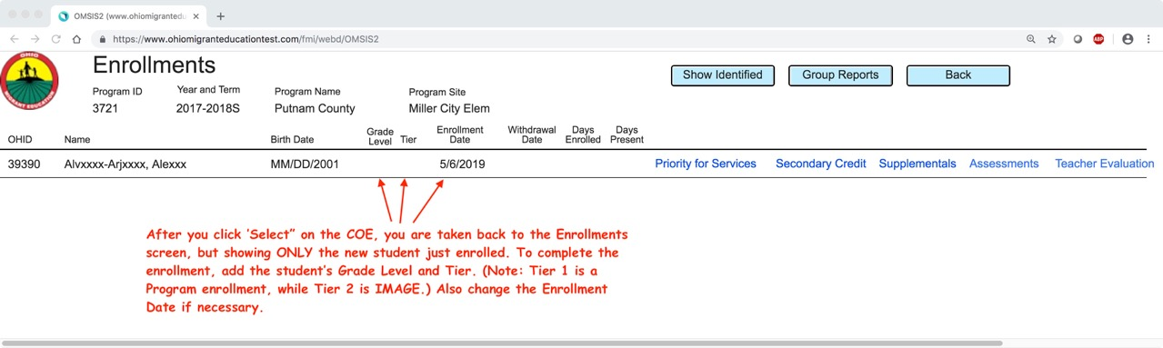
MM/DD/2010
3 1 6/25/24

Slide 11
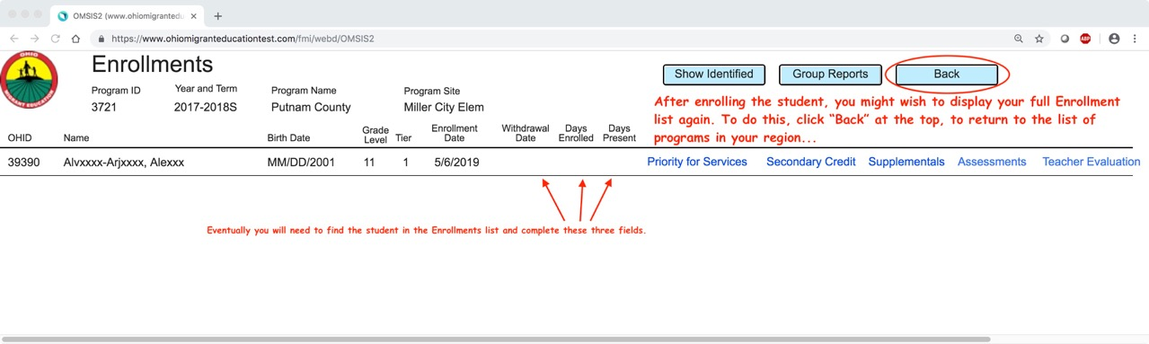
MM/DD/2010
3 1 6/25/24

Slide 12
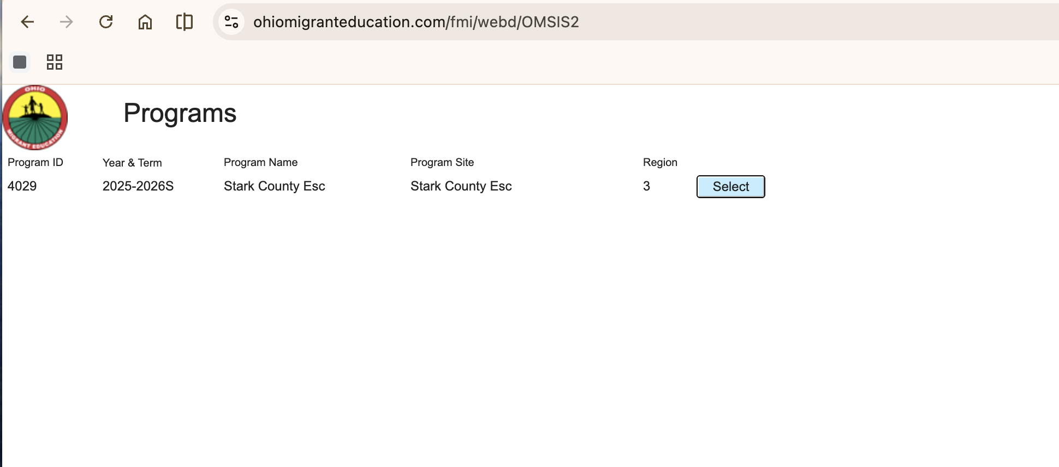
… and then click “select” on the program again

Slide 13
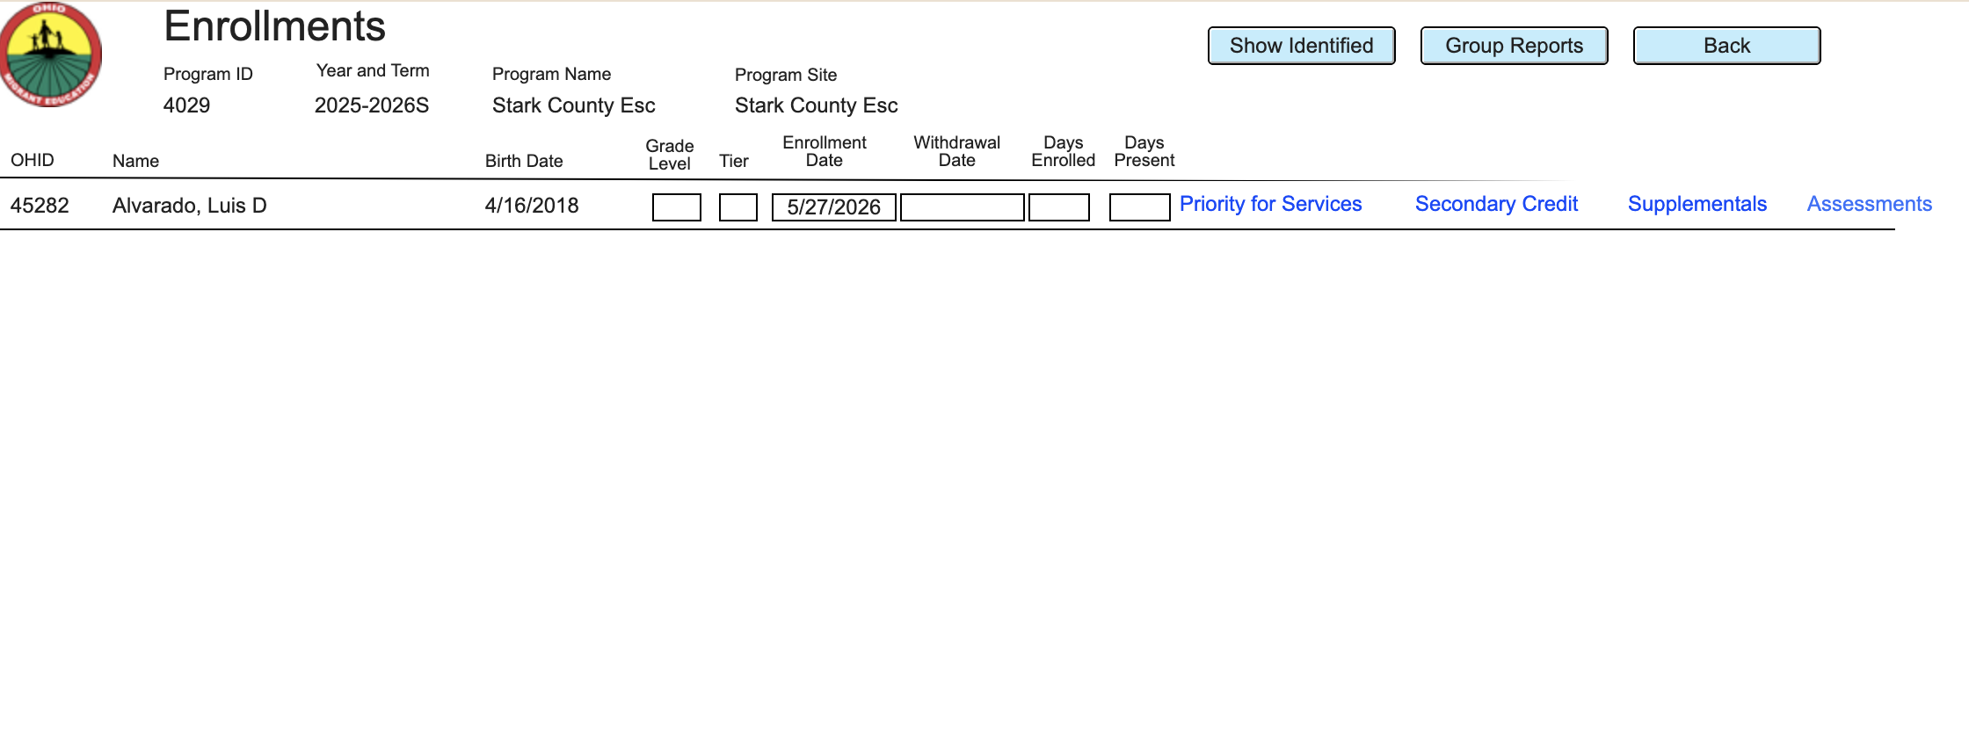
25416
Jane Doe
System will insert date once the student is selected, however the date can be changed if necessary
Make sure to also fill grade level and tier
Click here. This Creates a PFS form for the student as well as display the form.

Slide 14
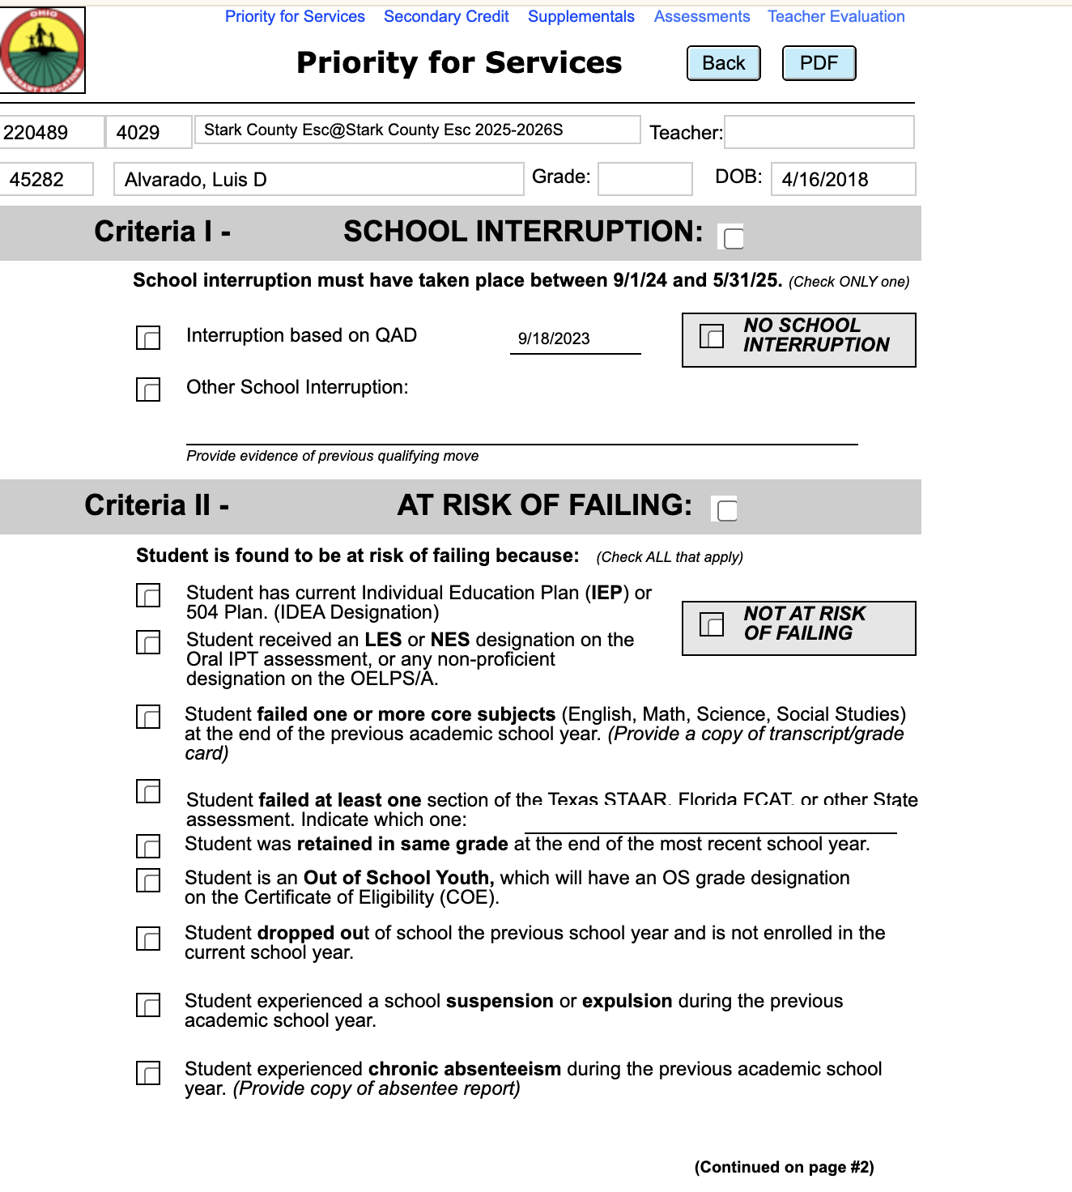
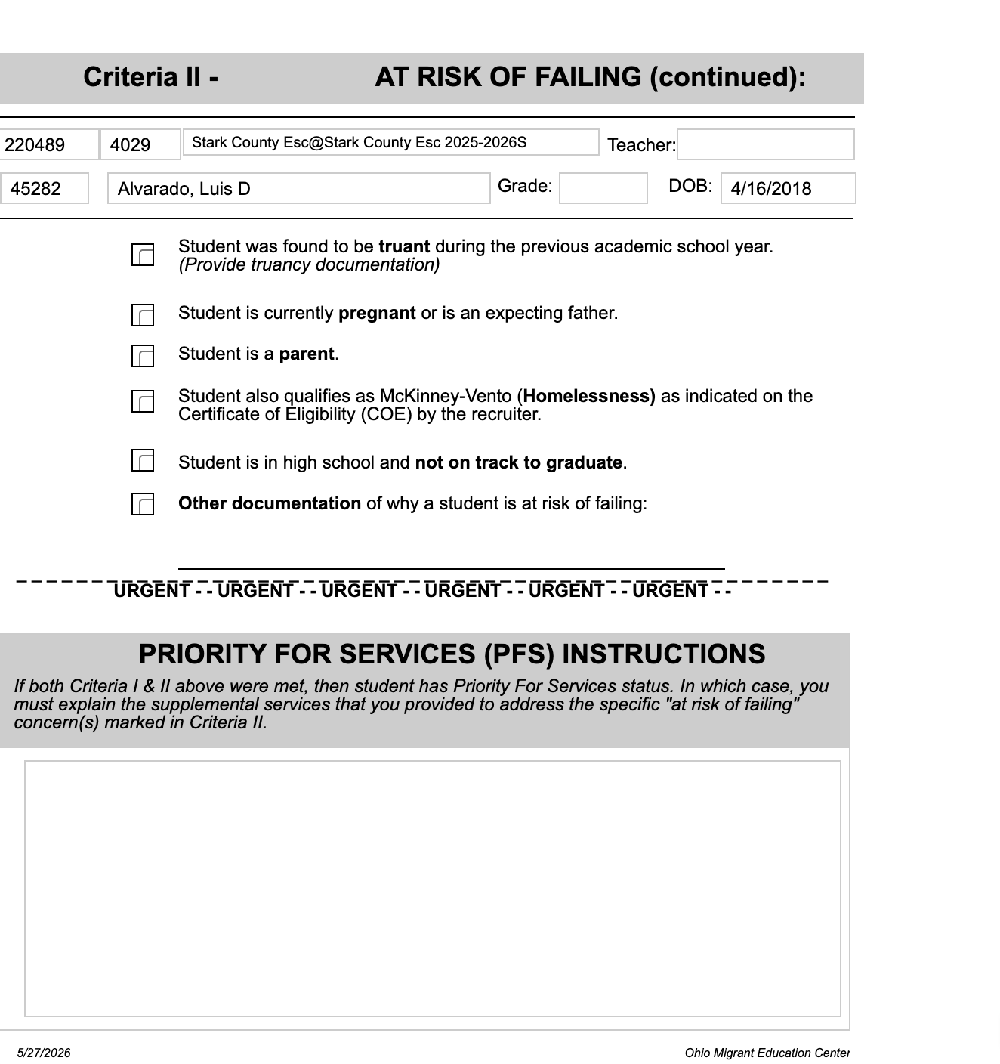
Use the form to complete the required entries using the checkboxes & fill in the teacher
2515
Jane Doe
Jane Doe
If the student qualifies as Priority for Services, fill in the box at the bottom as well.
Use the PDF button to save an encypted PDF form & click back when done.

Slide 15
Keep in Mind
Once Priority For Service form is completed save as PDF and transfer it into the google drive under your Folder and into the PFS folder
ALL students should have a PFS on file
Complete PFS as soon as possible

Slide 16
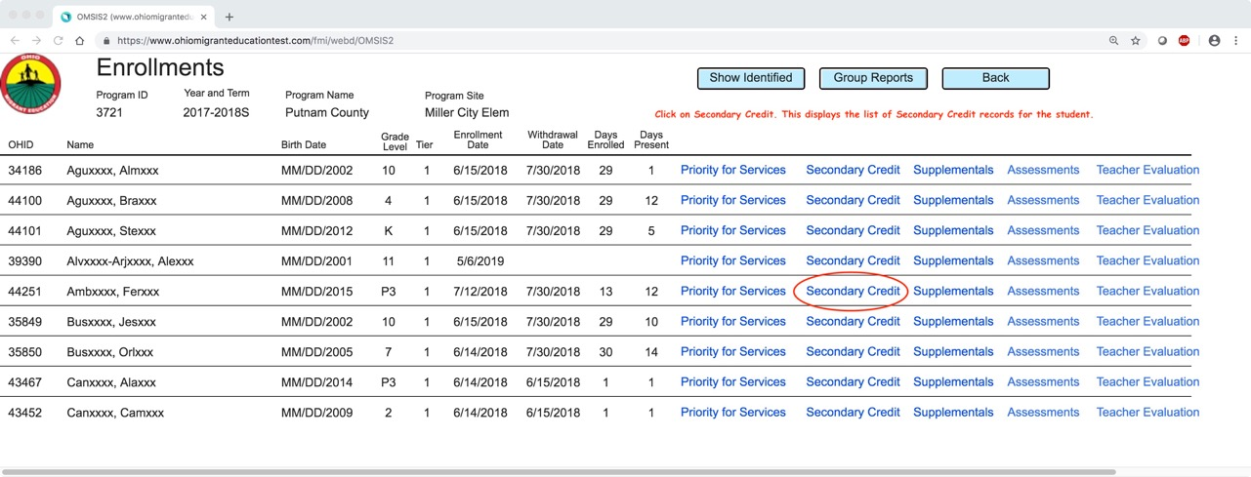
2023-24S
Click on Secondary Credit. This displays the list of Secondary Credit records for the student.

Slide 17
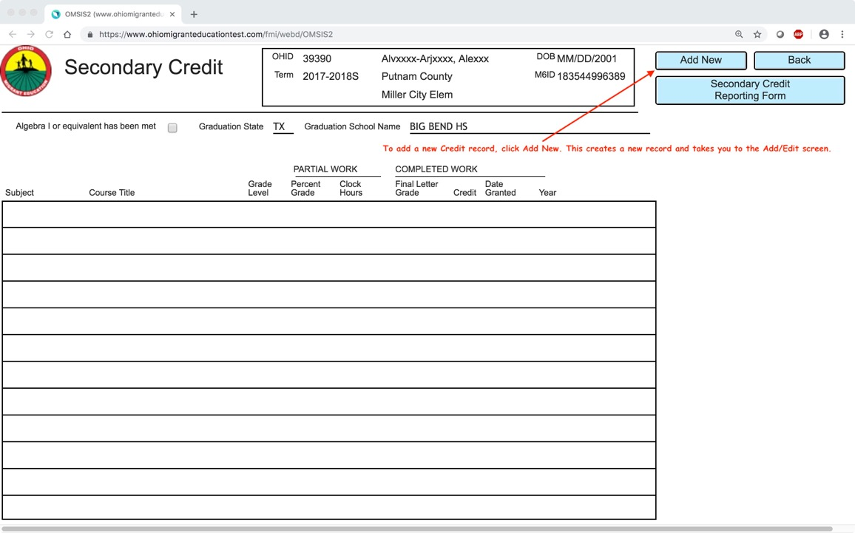
2023-24S
To add a new Credit record, click “Add New” button. This creates a new record and takes you to the Add/Edit screen.

Slide 18
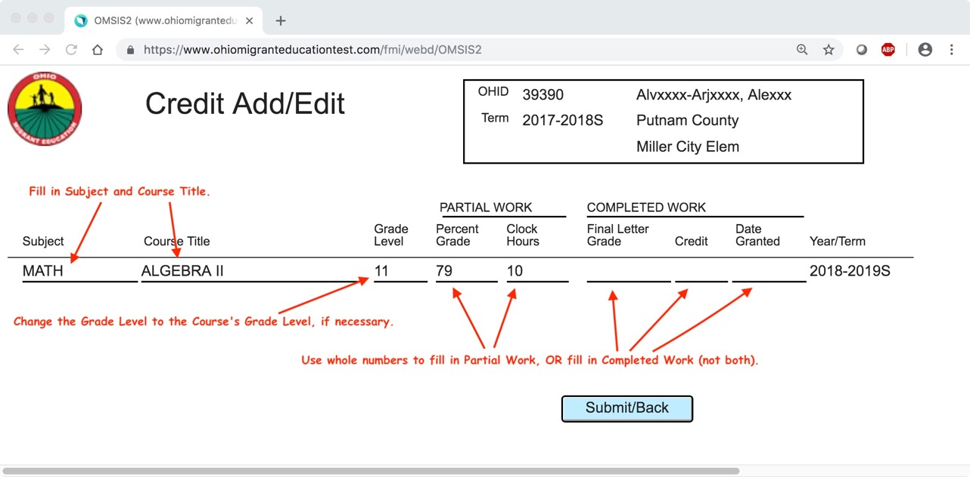
2023-2024S
2020-21S

Slide 19
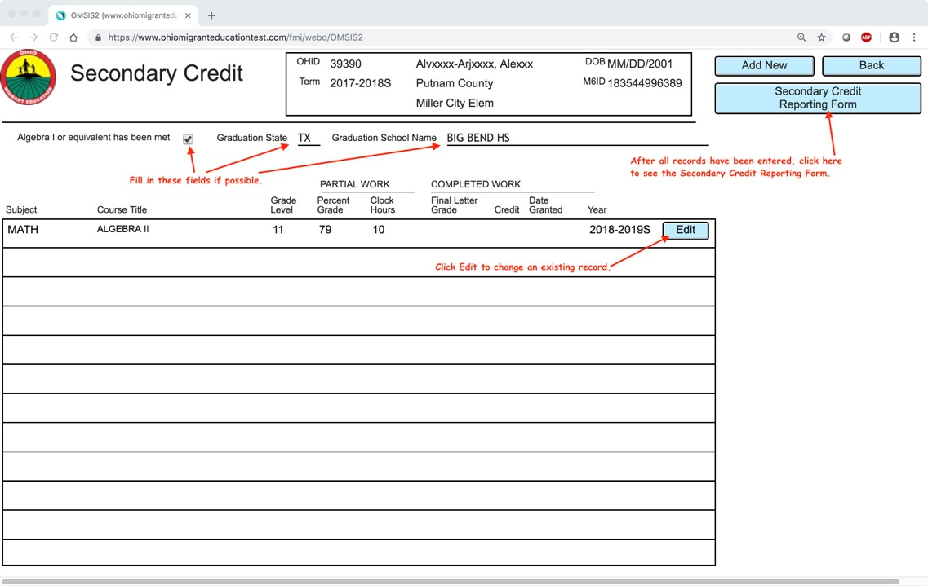
2023-24S
2020-2021S
2023-24S

Slide 20
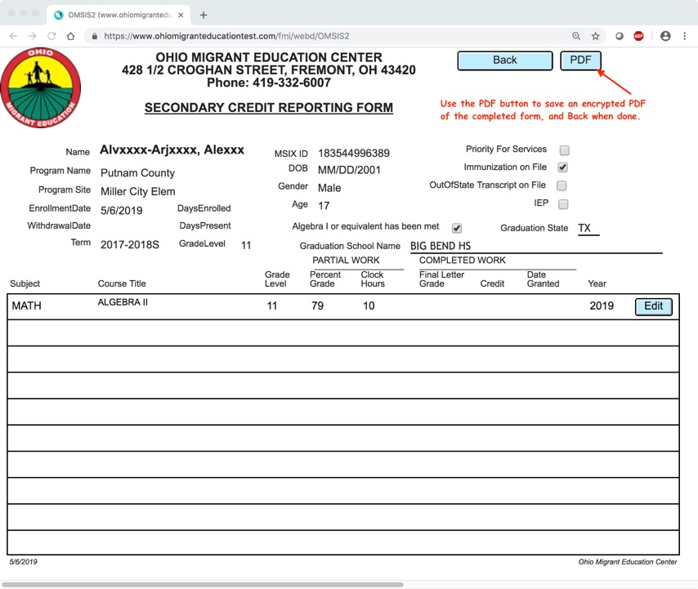
MM/DD/10
2023-2024S
2024

Slide 21
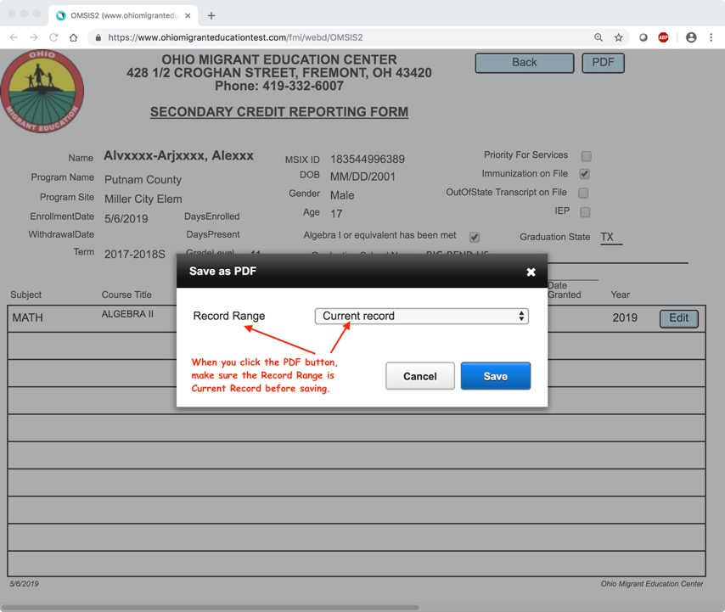

Slide 22
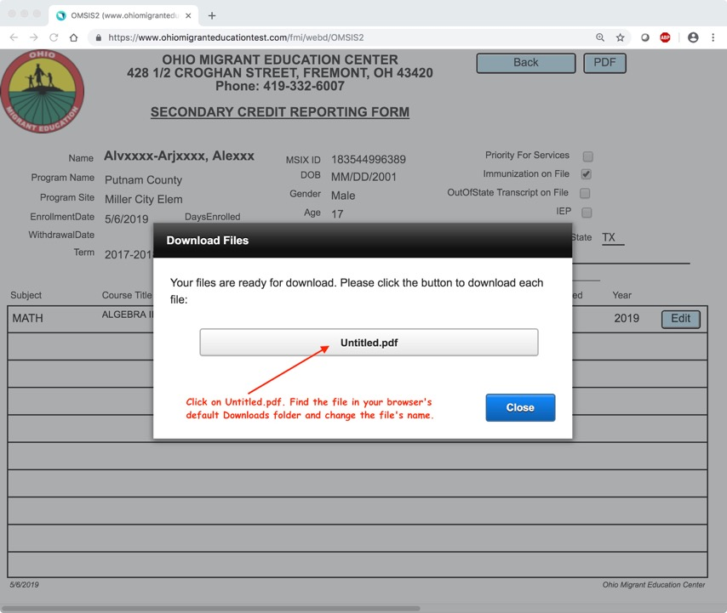

Slide 23
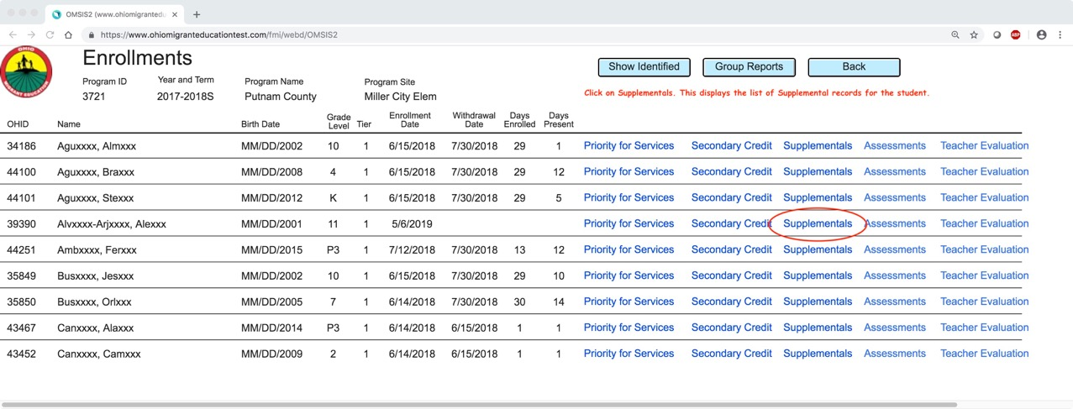
2023-2024S
Click on Supplementals. This displays the list of Supplemental records for the student.

Slide 24
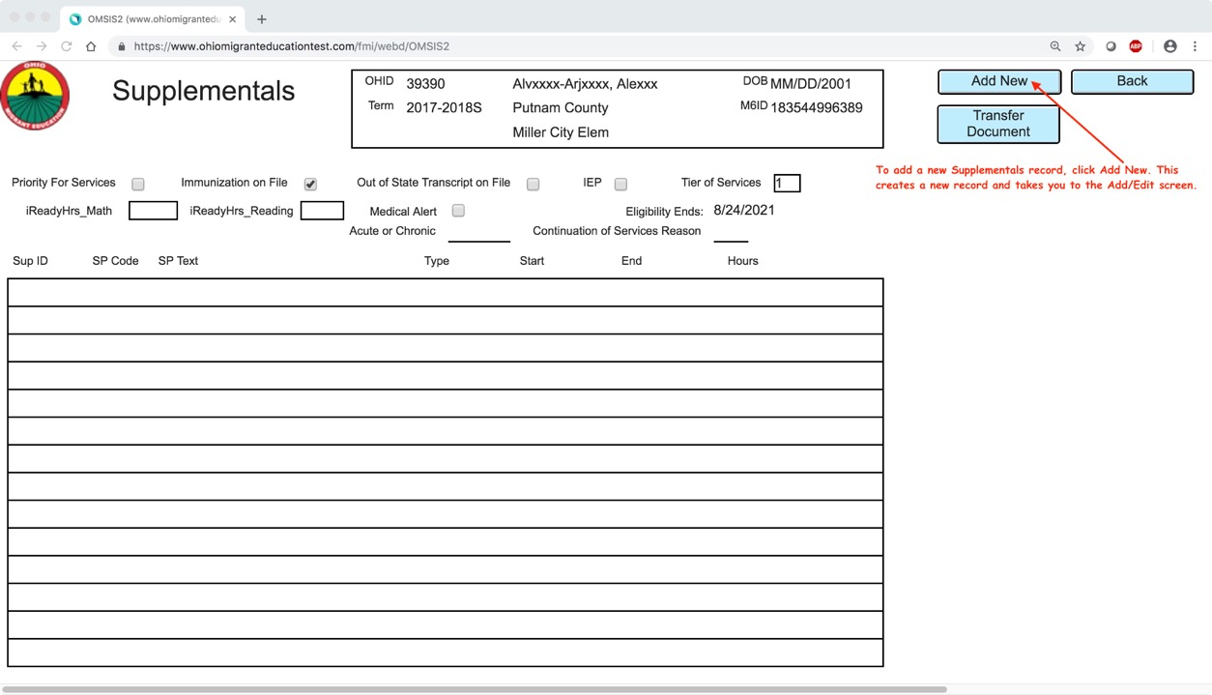
2023-2024S
To add a new Supplemental record, click “Add New.” This creates a new record and takes you to the Add/Edit screen.

Slide 25
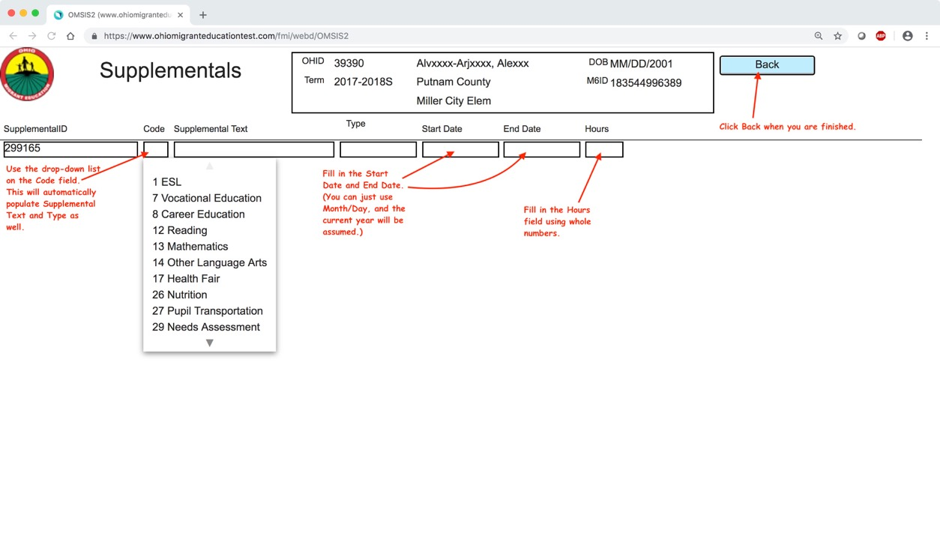
2023-2024S

Slide 26
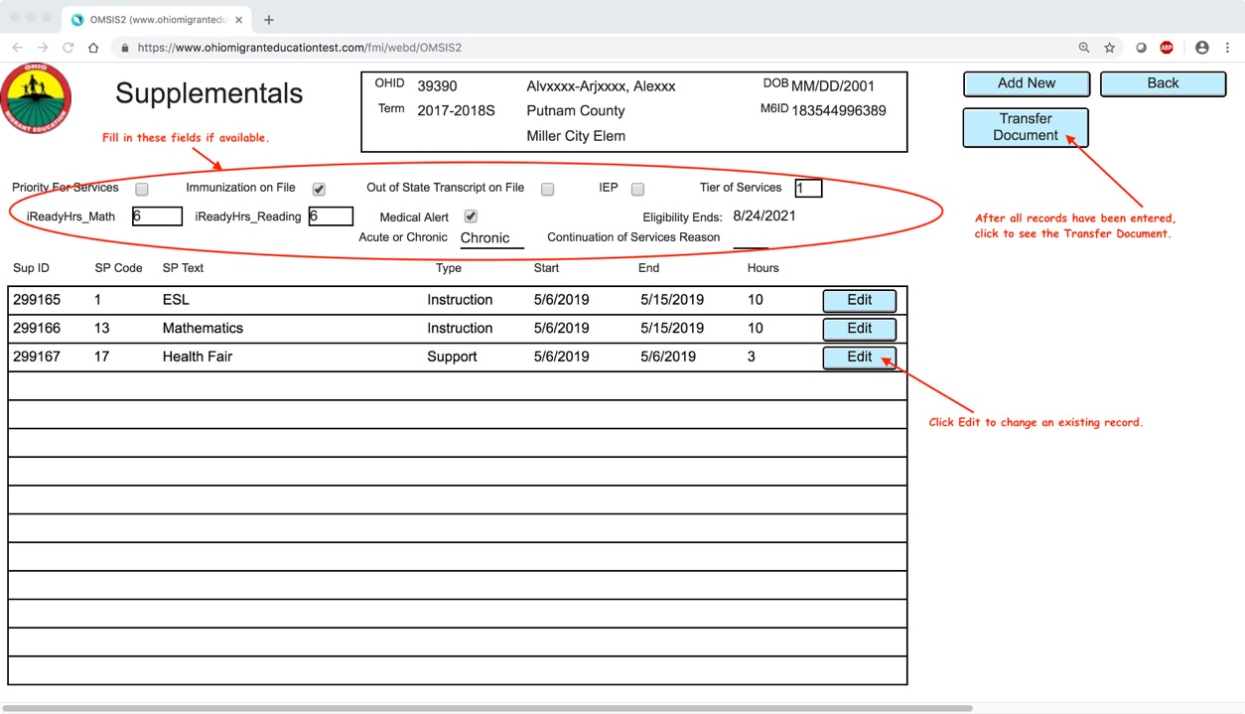
2023-2024S
After all records have been entered, click to see the Transfer Document.
Click edit to change existing record.

Slide 27
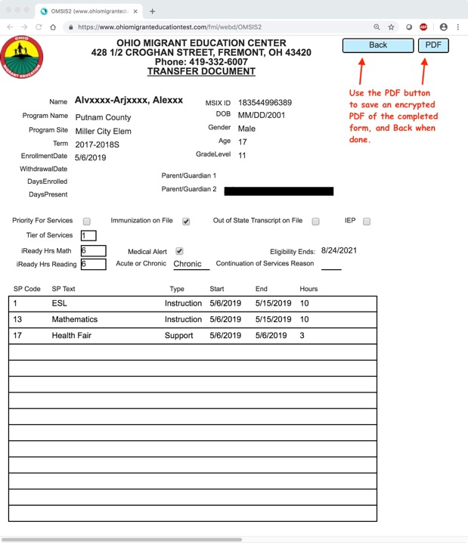
2023-2024S

Slide 28
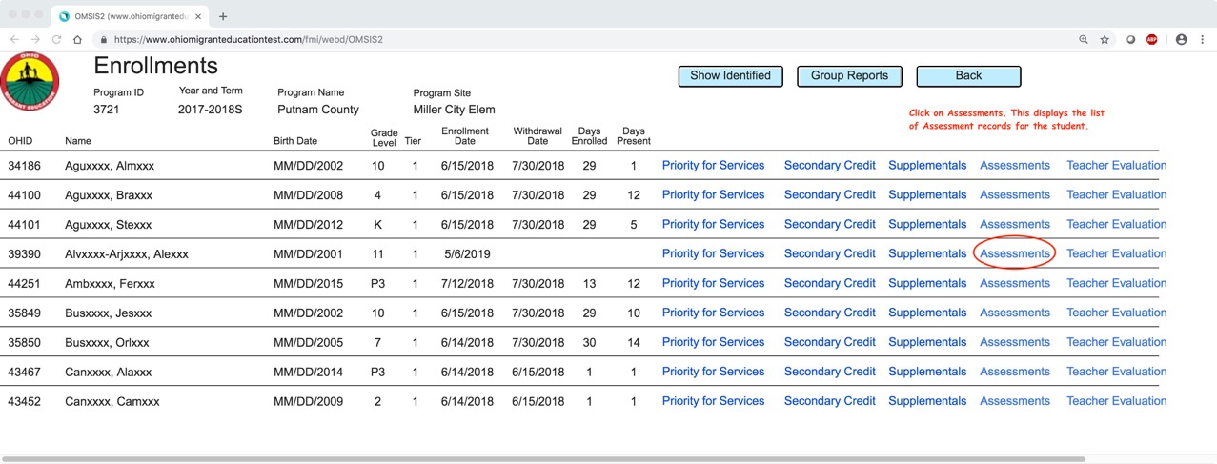
2023-2024S
Click on Assessments. This displays the list of Assessment records for the student.

Slide 29
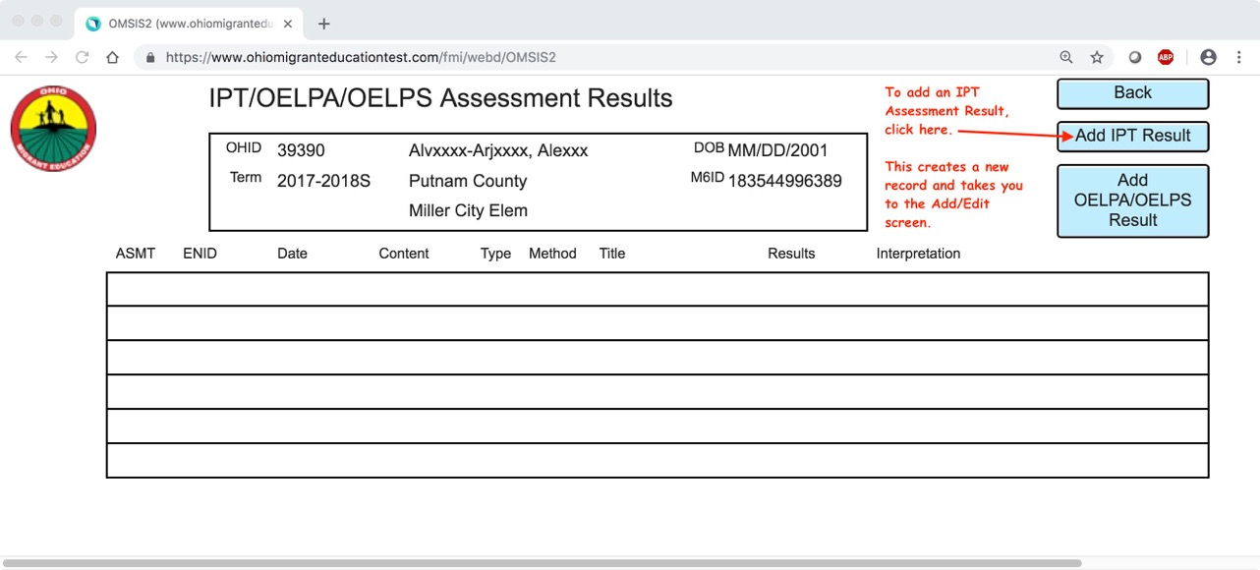
2020-2021S
2023-2024S

Slide 30
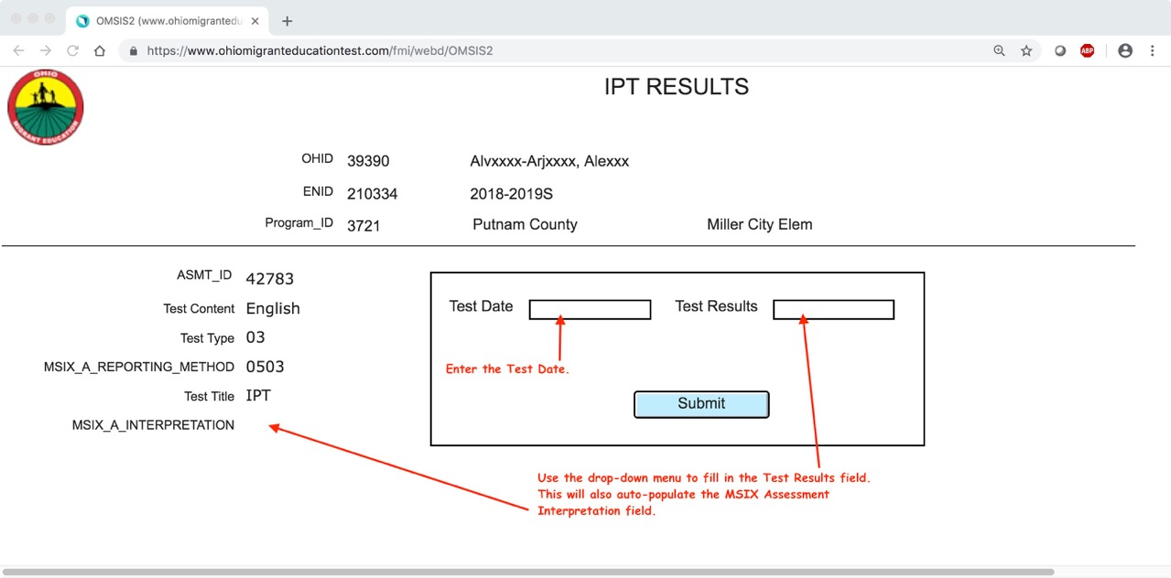
2023-2024S

Slide 31

2023-2024S

Slide 32
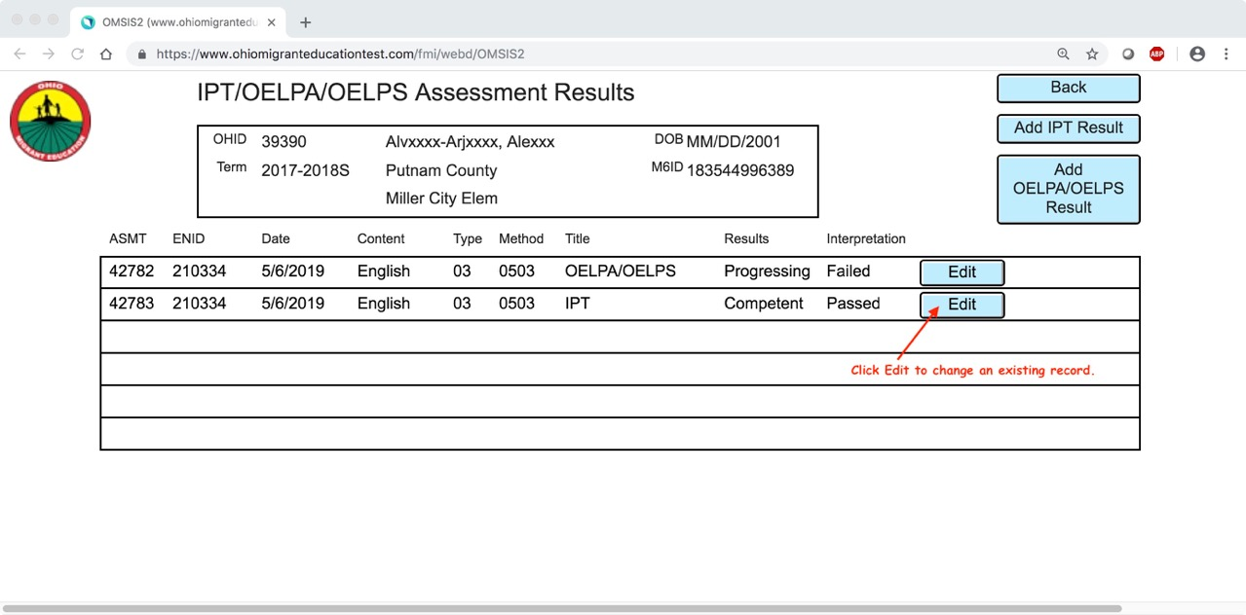
2023-2024S
06/16/21
6/15/24
6/15/24
06/16/21

Slide 33
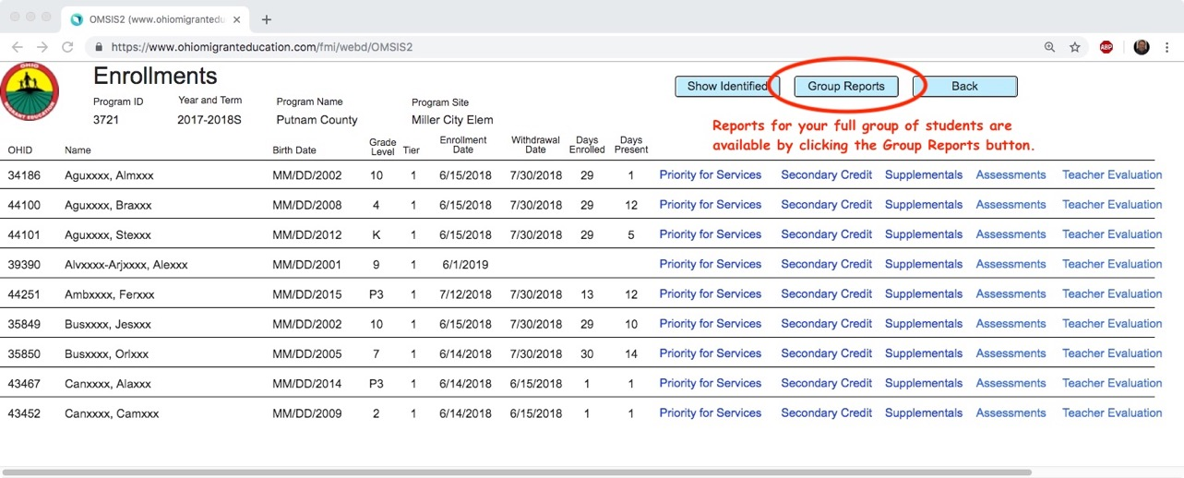
2023-2024S

Slide 34
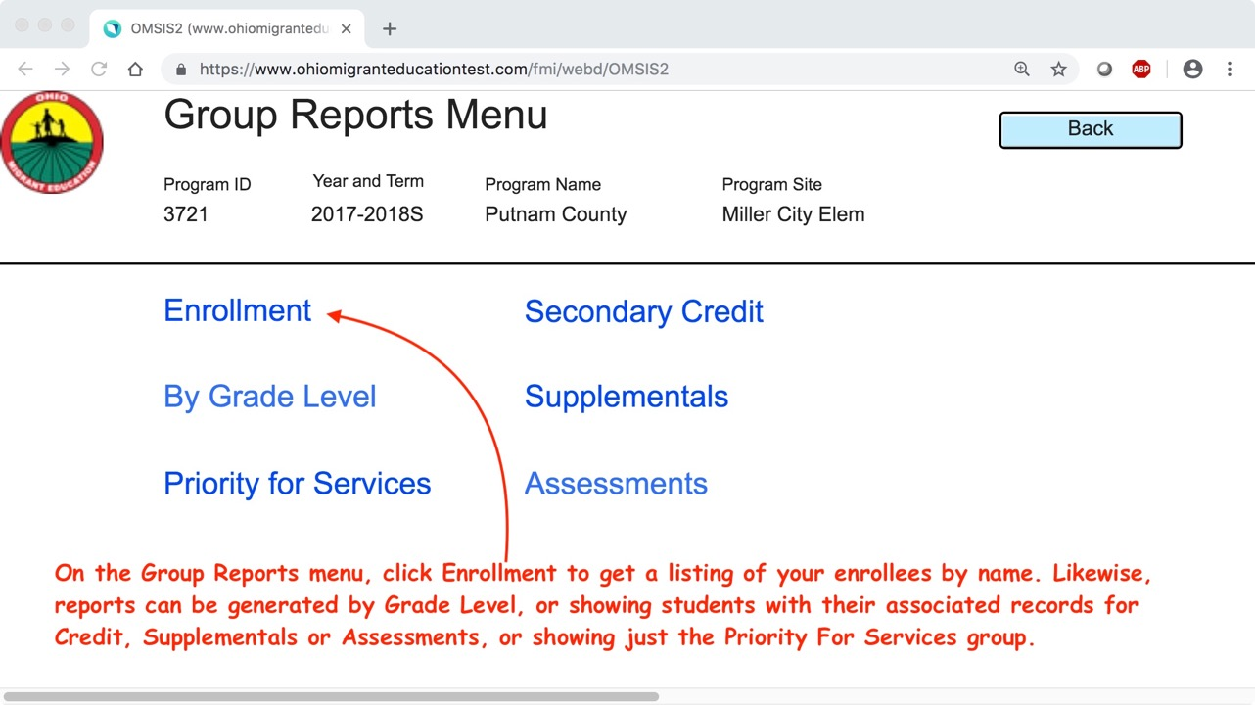
2023-2024S

Slide 35
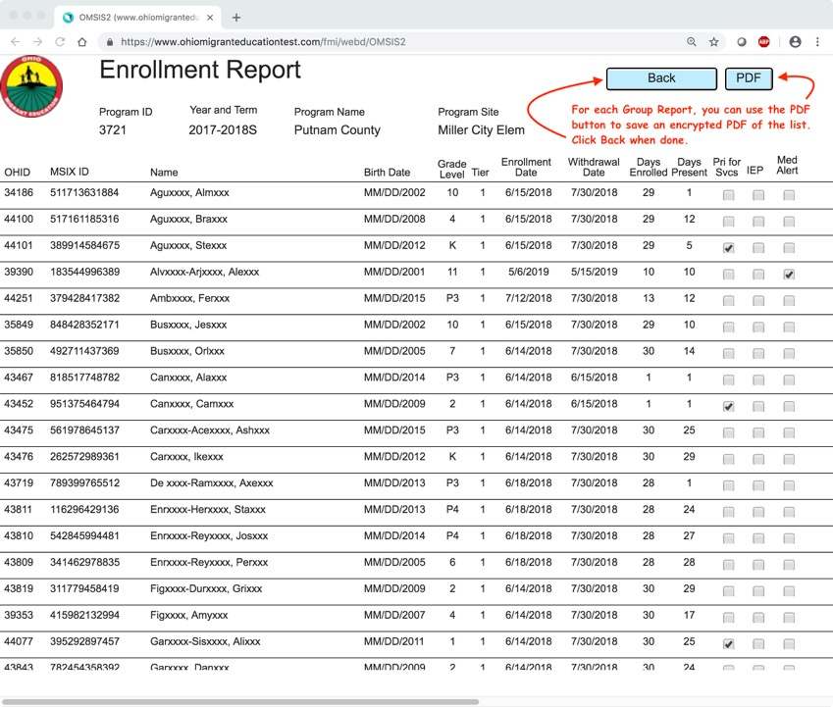
2023-2024S

Slide 36
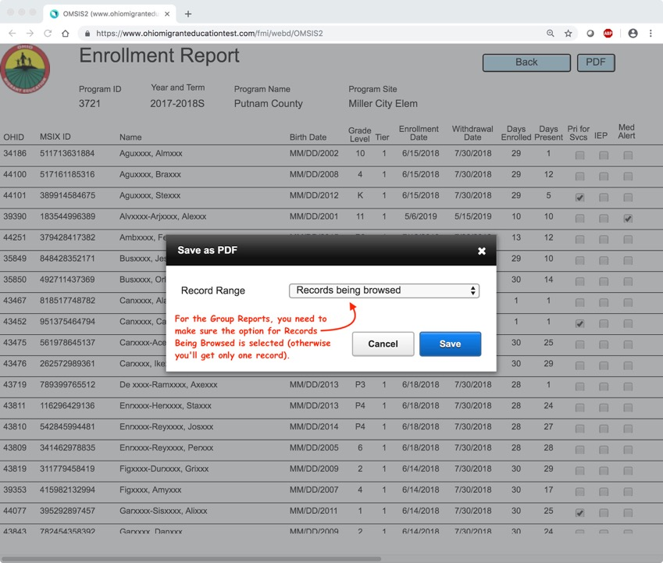

Slide 37
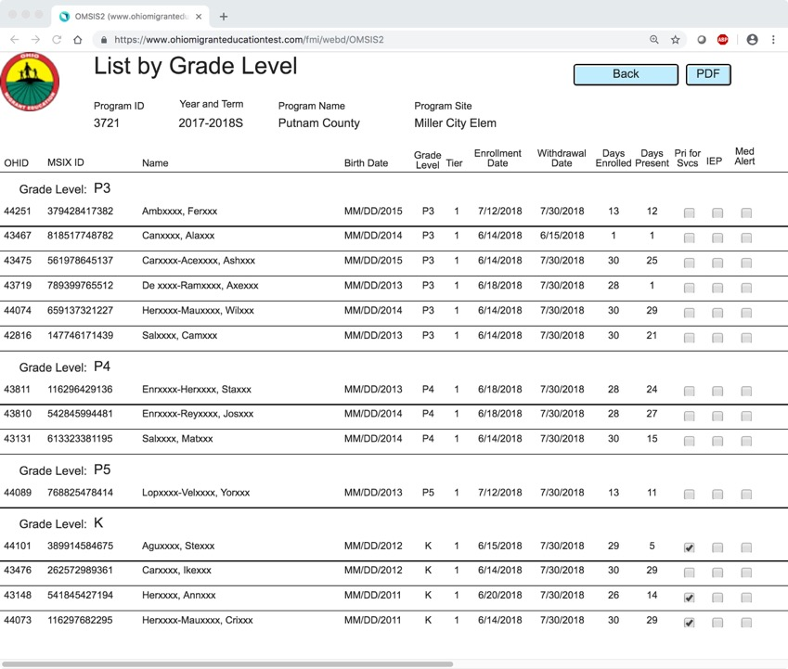
2023-2024S

Slide 38
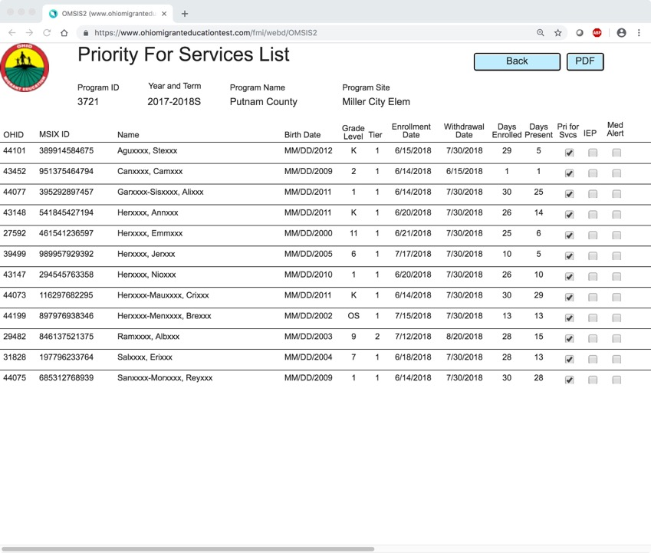
2023-2024S

Slide 39
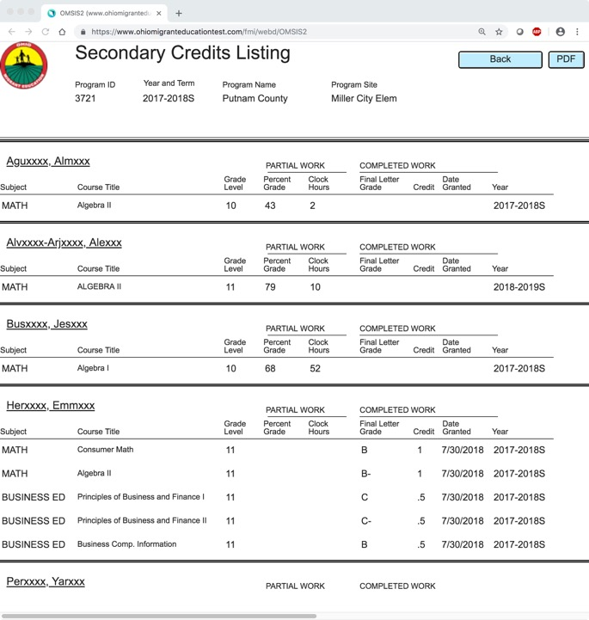
2023-2024S

Slide 40
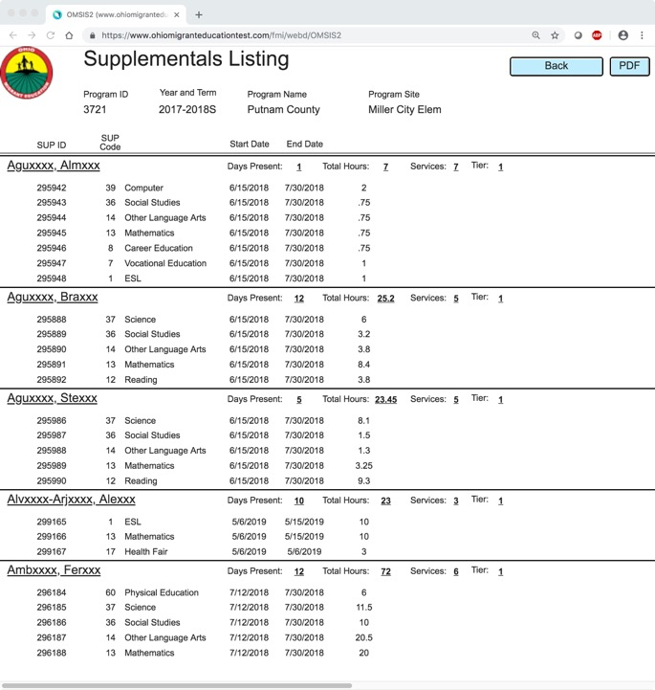
2023-2024S

Slide 41
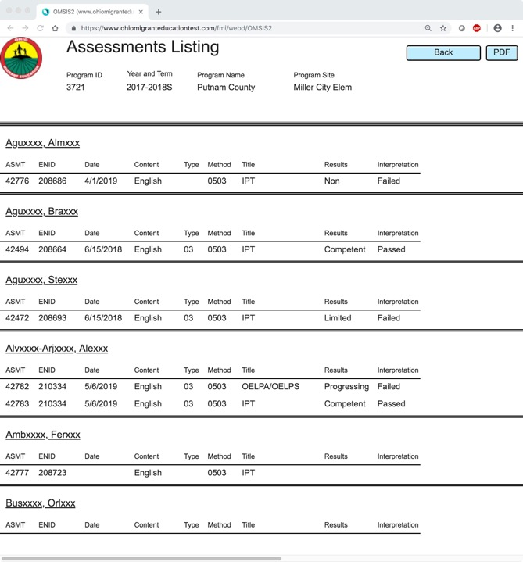
2023-2024S

Slide 42
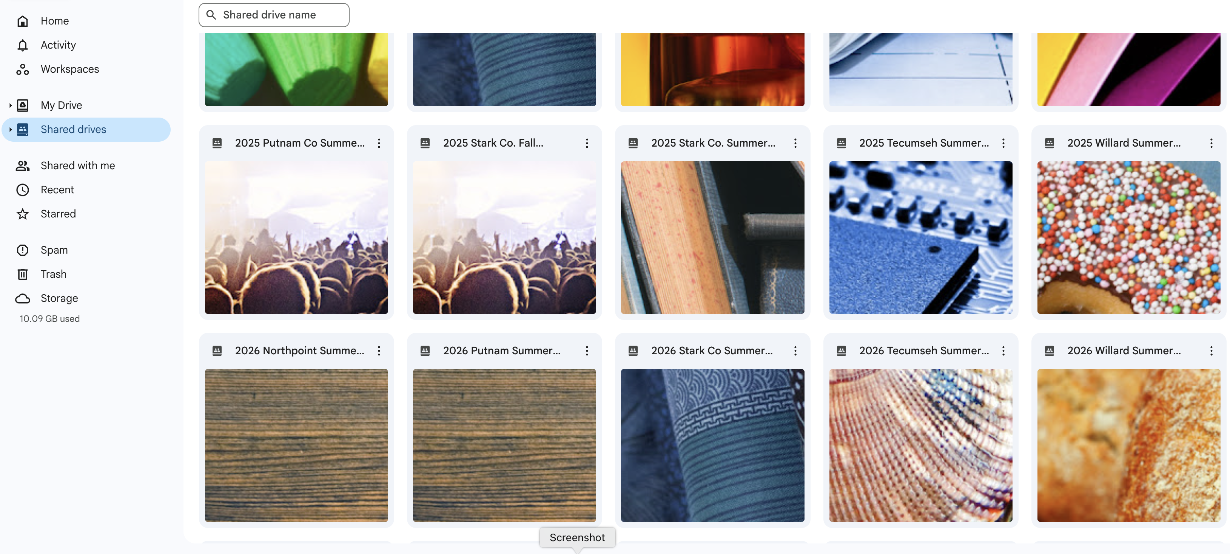
GOOGLE DRIVE FOR TR CLERKS & Teachers
Reports
Documentation
Summer Forms
IMAGE forms

Slide 43
GOOGLE DOCS
All forms are live and only you, I and any MEP staff that need access have access to our drive
All required forms should be up to date in your drive daily
Shared drives, folders and documents show up in your drive
Training PowerPoints will also be shared as requested

Slide 44
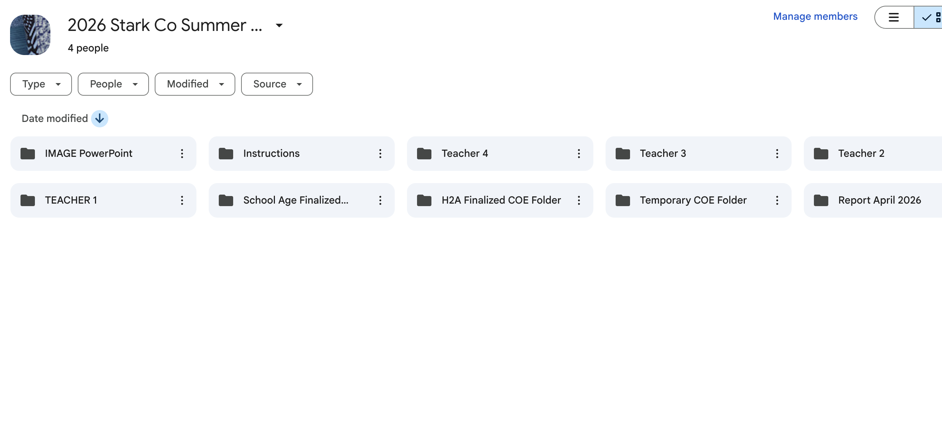
Once granted access each teacher will have their own folder they can document their paperwork to avoid confusion with other teachers.
Powerpoint and guidance on how to complete forms will also be here.

Slide 45
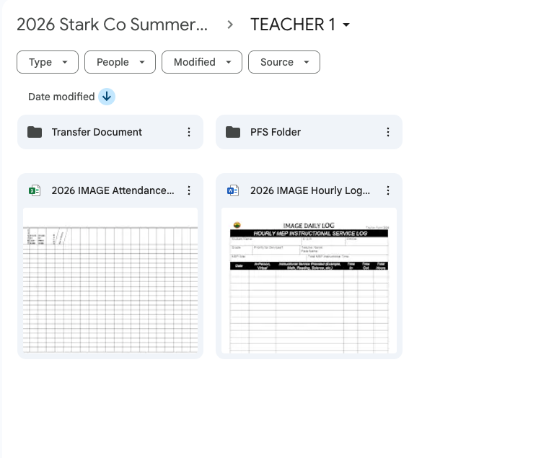
Name of Teacher/ Para will go in place of “teacher”
Each teacher will have their own PFS folder to stay organized
Each will also have a transfer Document Folder

Slide 46
MANDATED SUMMER FORMS
  IMAGE Student Attendance Form
  Transfer Documents – All Students
  Secondary Credit Reporting Form (9-12) IF needed
  Priority for Services – All Students within 3 days or as soon as possible
  Continuation of Services Form – If needed
  Course Verification Form (9-12) If Needed
  IMAGE Attendance Record
  Daily Hourly Log

Slide 47
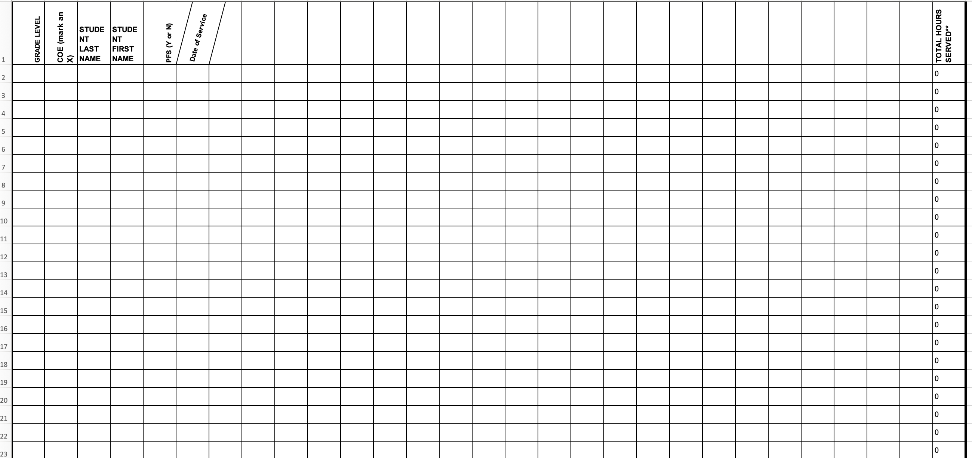
STUDENT ATTENDANCE FORM
(1 PER TEACHER/ SITE)
CLICK & DRAG CORNER OF DATE CELL TO INSERT DATES AUTOMATICALLY.
ONLY INSERT 1 OR A AS THE TOTALS ARE AUTOMATICALLY CALCULATED.
STUDENT MUST BE PLACED IN GRADE LAST COMPLETED or OSY
YES OR NO IF YOU HAVE A COE ON FILE & IF THE STUDENT IS PFS (PFS SHOULD BE DONE WITHIN 3 DAYS)

Slide 48
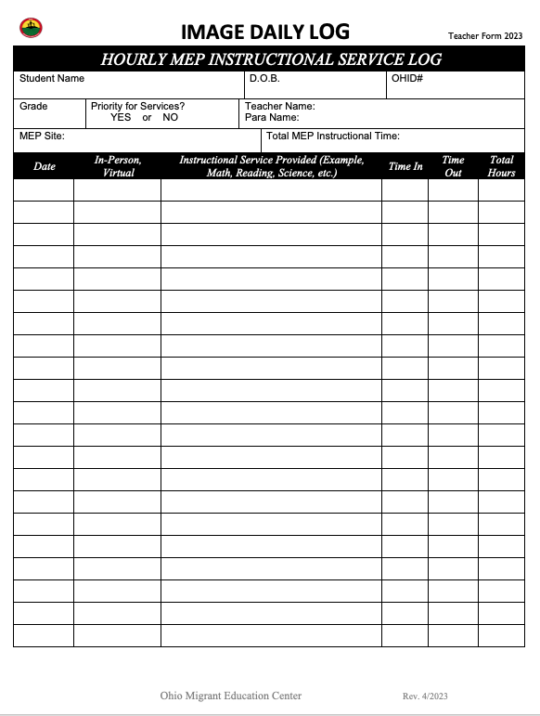
IMAGE DAILY LOG
2024
STUDENT NAME – NO NICKNAMES, USE NAME ON COE
DOB – DATA ON COE.
OHID# - DATA ON FINALIZED COE.
GRADE – SHOULD BE THE LAST GRADE THE STUDENT COMPLETED.
PFS - MARK YES OR NO IF THE STUDENT HAS BEEN DETERMINED TO BE ELIGIBLE FOR PFS.
TEACHER NAME – THE TEACHER AND AIDE PROVIDING THE EDUCATIONAL SERVICE.
MEP SITE – YOUR MEP NAME SUCH AS Stark CO OR Northpoint, ETC.
INSTRUCTIONAL SERVICE – WHAT EDUCATIONAL SERVICE WAS PROVIDED TO THE STUDENT (MATH, READING, SCIENCE, ESL, ETC.) AND HOW MANY HOURS EACH DAY.
DATE OF INSTRUCTION – EACH DAY YOU MEET WITH A STUDENT.
IN-PERSON OR VIRTUAL – WHETHER EDUCATIONAL INSTRUCTION IS IN PERSON OR VIRTUAL.
TIME IN & TIME OUT – THE TIME INSTRUCTION WAS STARTED AND THE TIME IT ENDED.
TOTAL HOURS PER DAY.
Rev. 4/2024

Slide 49
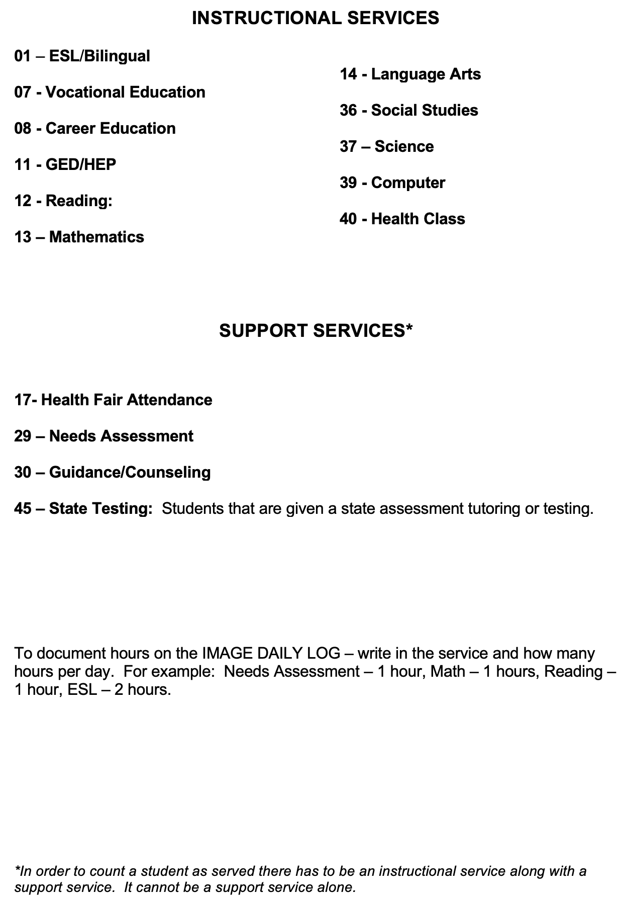
MEP IMAGE
INSTRUCTIONAL SERVICES

Slide 50

ONLINE IPT TESTING - SUMMER 2024
ORAL Assessment... (Required)
Used for identifying LEP students. This is a minimum data element that USDoE expects all states to collect.
Teachers are only required to pre-test on the student’s first day of attendance. No need to post-test at the end of the summer program.
Reading & Writing Assessment... (Optional)
Teachers are welcome to assess their students’ reading level or if they want to see a sample of their writing .
*You are welcome to use your OELPA data
to identify LEP students instead of the IPT

Slide 51

Options/Information for Online Coursework through the Ohio Migrant Education Program

Slide 52
APEX 2026 - GOALS
Credit Accrual/Recovery – This should be the primary goal
Career Exploration
(limited under APEX)
Can have more options for additional cost
Remediation
Course List:
bit.ly/ApexMigrantCourseOptions

Slide 53
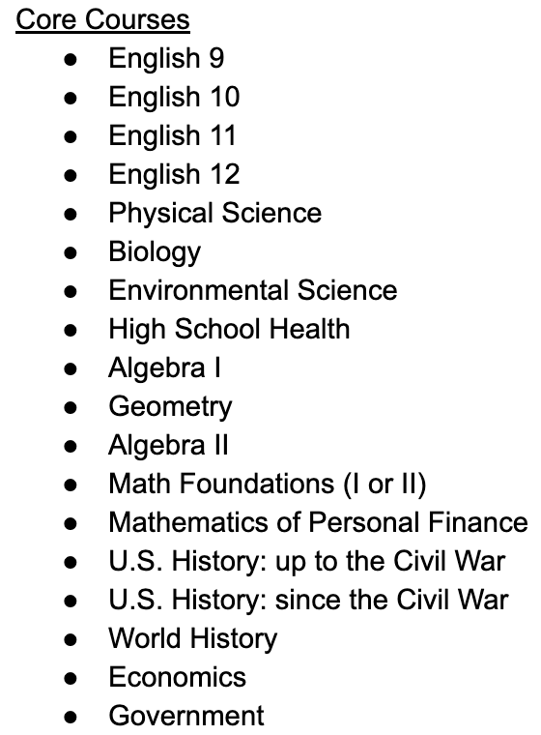
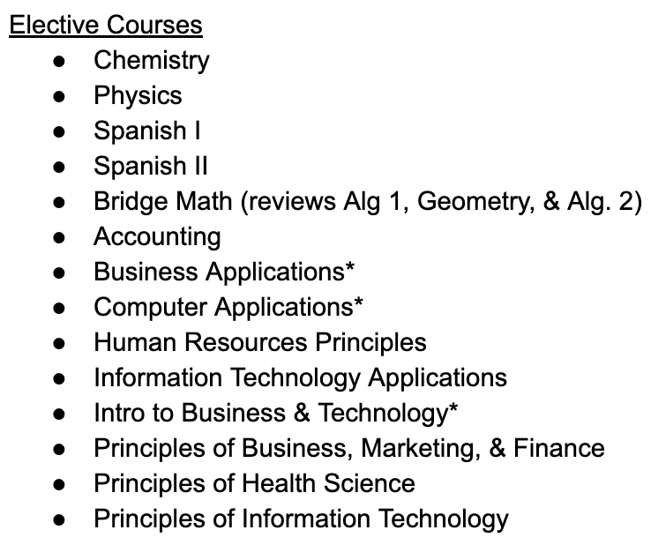
* = Semester course

Slide 54
APEX REGISTRATION PROCESS
1. Contact Corina for verification of course option
Corina.Barranco@nwoesc.org
2. Fill out online Registration Form: bit.ly/MigrantCourseRegistration
Person filling out request will receive a PDF copy to confirm it has been submitted. Link will be emailed to TR Clerks.
3. Please contact me if you are unsure or have any questions
Gary.Herman@putnamcountyesc.org

Slide 55
ASSESSMENT TOOLS
IPT Testing Reports
  K-12
  Only Oral is required (can do reading & writing)
  Do not have to post test
IMAGE Assessment Forms
  San Diego Quick Assessments
    Pre-K (both building & IMAGE are required to complete)
    Kinder through OS

Slide 56
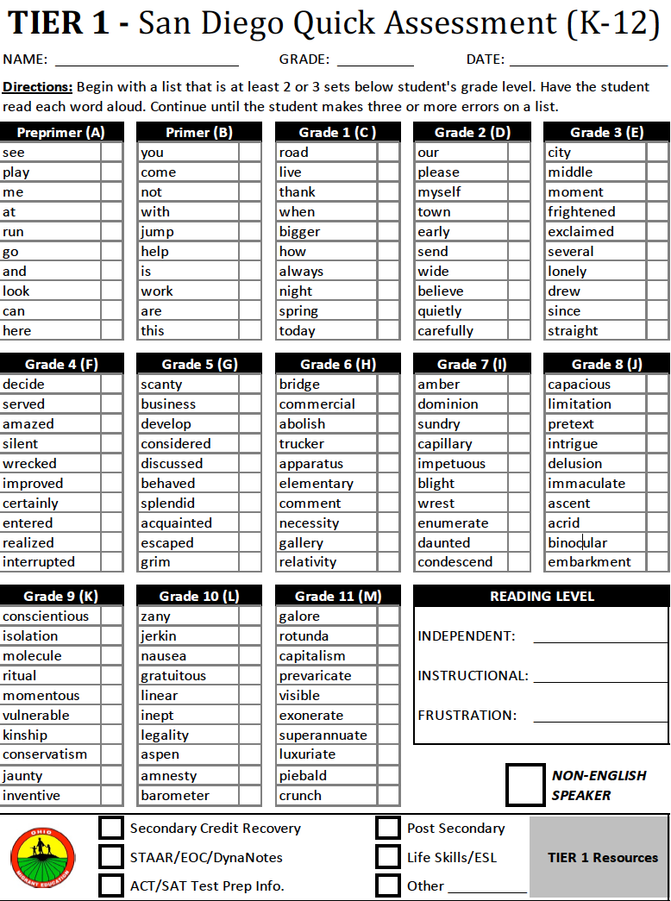
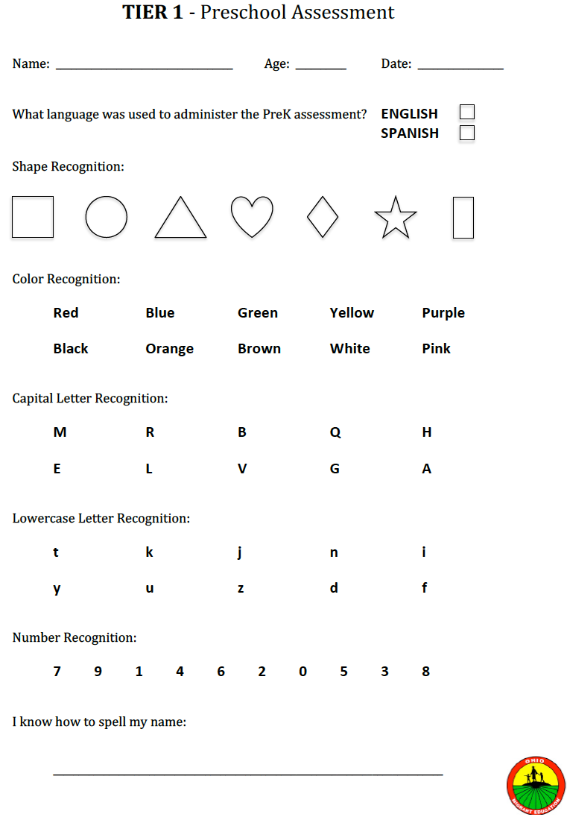
SAN DIEGO QUICK ASSESSMENTS
Prek in building program will also need to use the San Diego quick assessment with all Prek students.

Slide 57
MEP ACRONYMS
What are the abbreviations?
OMEC-Ohio Migrant Education Center
IPT- Idea Proficiency Test
COE-Certificate of eligibility
EOE-End of Eligibility
ID&R-Identification & Recruitment
LQM-Last Qualifying Move
ODEW- Ohio Department of Education and Workforce
OME-Office of Migrant Education
PFS – Priority for Services
MEP- Migrant Education Program
CNA-Comprehensive Needs Assessment
HEP-High School Equivalency Program
CAMP – College Assistance Program
COS-Continuation of Services
OMSIS II- Ohio Migrant Student Information System II
SEA-State Education Agency
LOA-Local Operating Agency
QC-Quality Control

Slide 58
TECHNICAL ASSISTANCE VISITS
Contact me to schedule a date and time
Have questions ready
Have Paperwork ready to be reviewed
2nd Visit or Virtual meeting for those needing additional guidance

Slide 59
INFORMATION NEEDED & DEADLINE DATES
IMAGE Paperwork Needs finalized 2 days after last day of any term.

Slide 60
GROUP ACTIVITY #2
In your regional group, review your migrant student list.
Use this list to divide the migrant students among yourselves.
Be aware of the child’s End of Eligibility (EOE) date.
Your regional recruiter is available to assist with logistics and provide specific information about each families.
Identify which migrant students (or regional areas) will not be served.

Slide 61
Regional Migrant Student List
Garcia, Jose P. 1818 Elmwood Drive
DOB: 02/25/2013 Age: 13 Grade: 5 Toledo, OH 43604
OHID: 12345 Res Date: 4/16/2023
End of Eligibility: 4/15/2026 (419) 448-0444
Salinas, Manuel 4349 Starr Ave.
DOB: 03/21/2003 Age: 18 Grade: OS Toledo, OH 43601
OHID: 12345 Res Date: 6/13/2024
End of Eligibility: 6/12/2027 (419) 333-1467

Slide 62


Thank You!
Corina Barranco
Corina.barranco@nwoesc.org

