Slide 1

SST Region #10 Meeting
November 10, 2025
OMECohio.org
  Title I - Part C, Migrant Education Program

Slide 2
Purpose of Title I – Part C
Ensure that migrant children have access to the same educational opportunities as other children.
Help migrant children overcome barriers to education.
Help migrant children graduate from high school and be prepared for postsecondary education or employment.

Slide 3
Migrant… not “Immigrant”
A migrant worker, or migratory agricultural worker is someone who:
Seeks agricultural employment of a seasonal or temporary nature.
Typically makes multiple interstate or intrastate residency changes to follow the qualifying work.
*A person’s citizenship status is not a factor for qualifying for the Title I-C program

Slide 4
Federal Definition of a “Migrant Child”
For Title I-C eligibility, a migrant child must…
be under the age of 22 years old.
not have graduated from a U.S. high school.
not have earned a GED.

Slide 5
Basic Eligibility Criteria for Title I-C
Both Statements must be true:
Family must have moved into the school district sometime in the past 36 months,
...AND someone is the family must have engaged in “Qualifying Work” sometime during those 36 months.

Slide 6
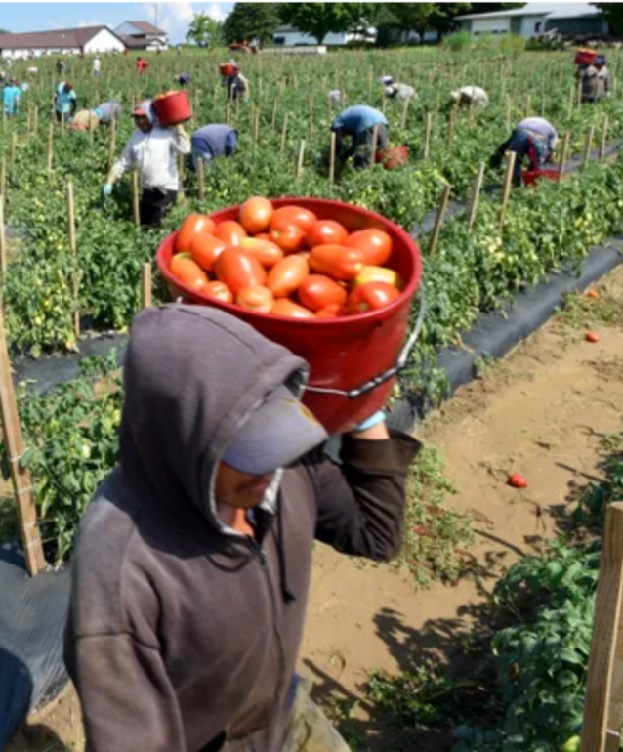
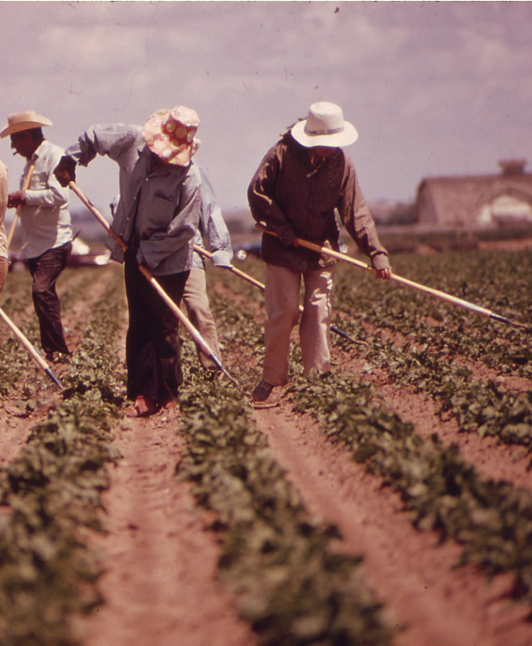




Examples of “Qualifying Work”

Slide 7

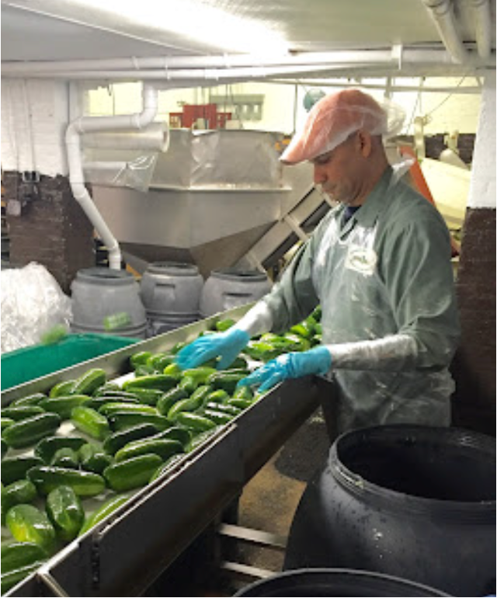
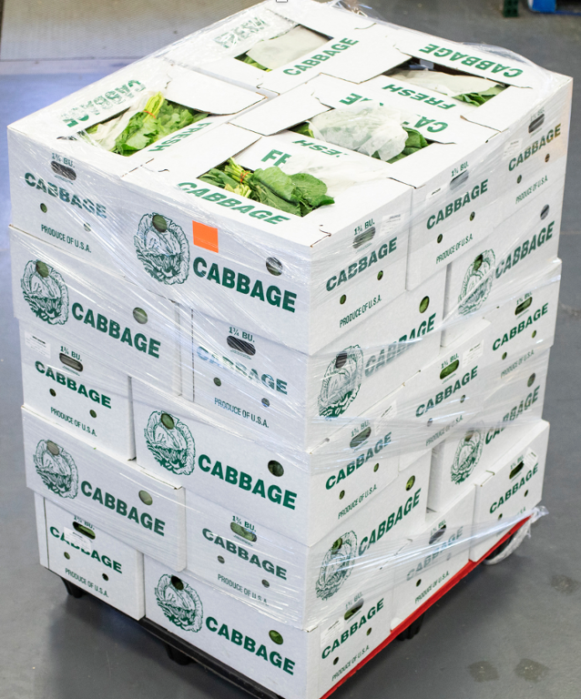



Examples of “Qualifying Work”

Slide 8
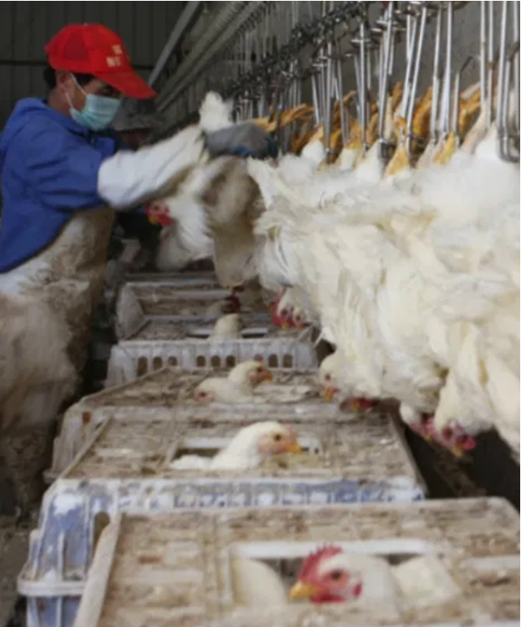
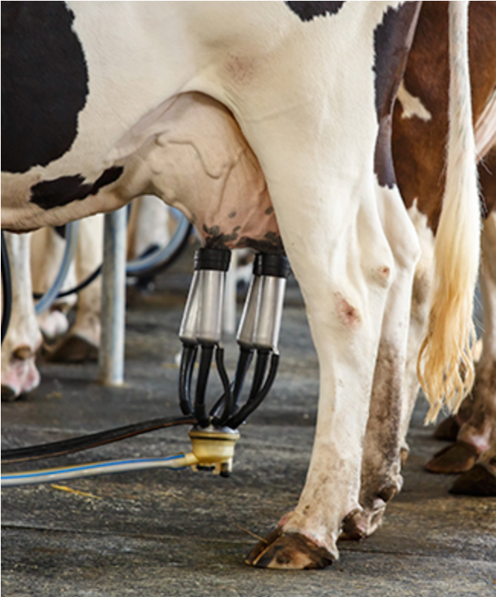
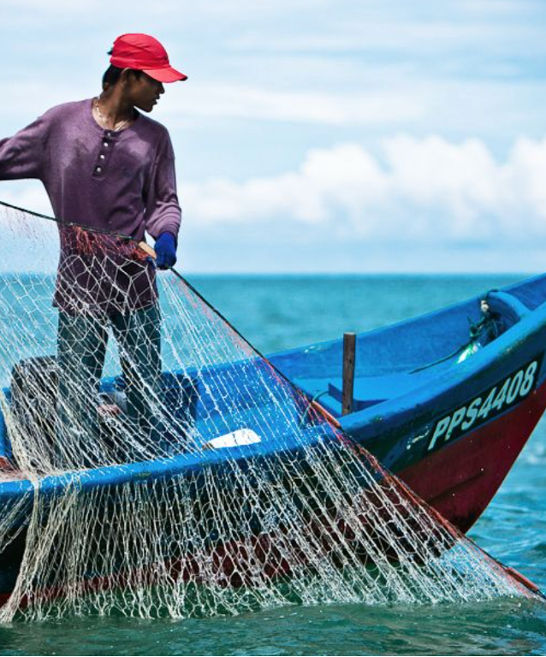



Examples of “Qualifying Work”

Slide 9







Examples of “Non-Qualifying” Work

Slide 10

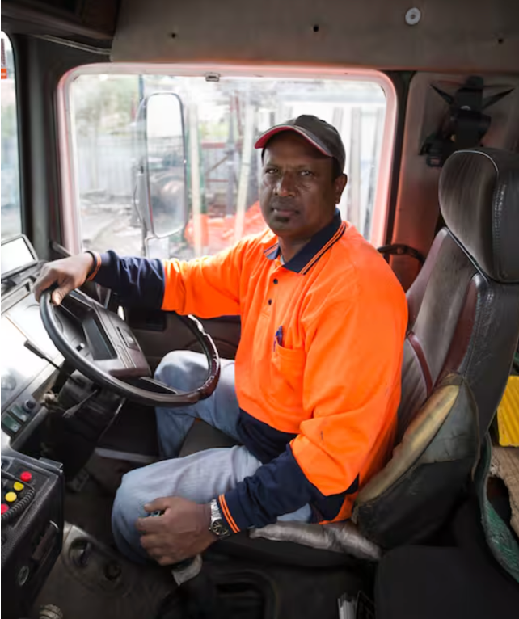
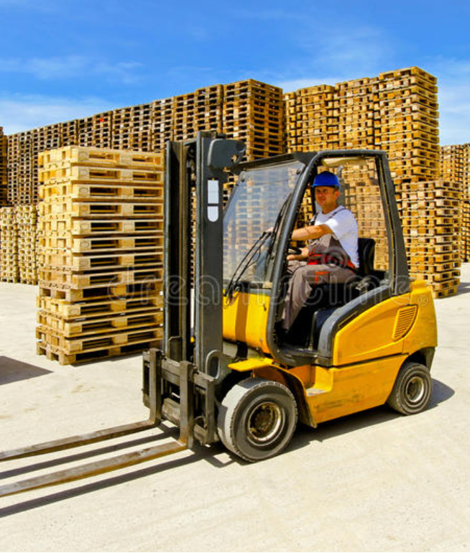



Examples of “Non-Qualifying” Work

Slide 11

Only recruiters who have completed our certification training can interview families for the migrant education program.
Title I-C State Recruiters

Slide 12
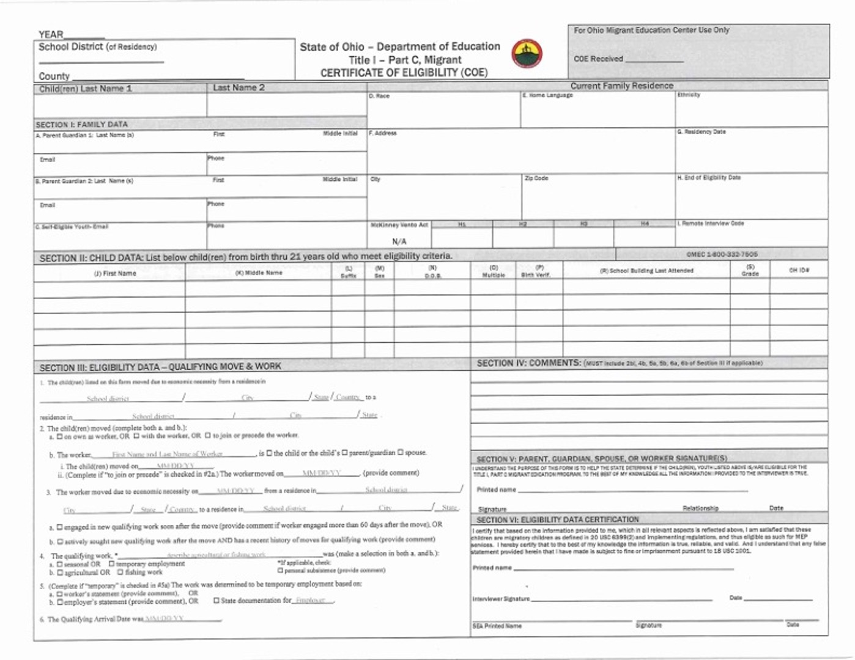
Certificate of Eligibility

Slide 13
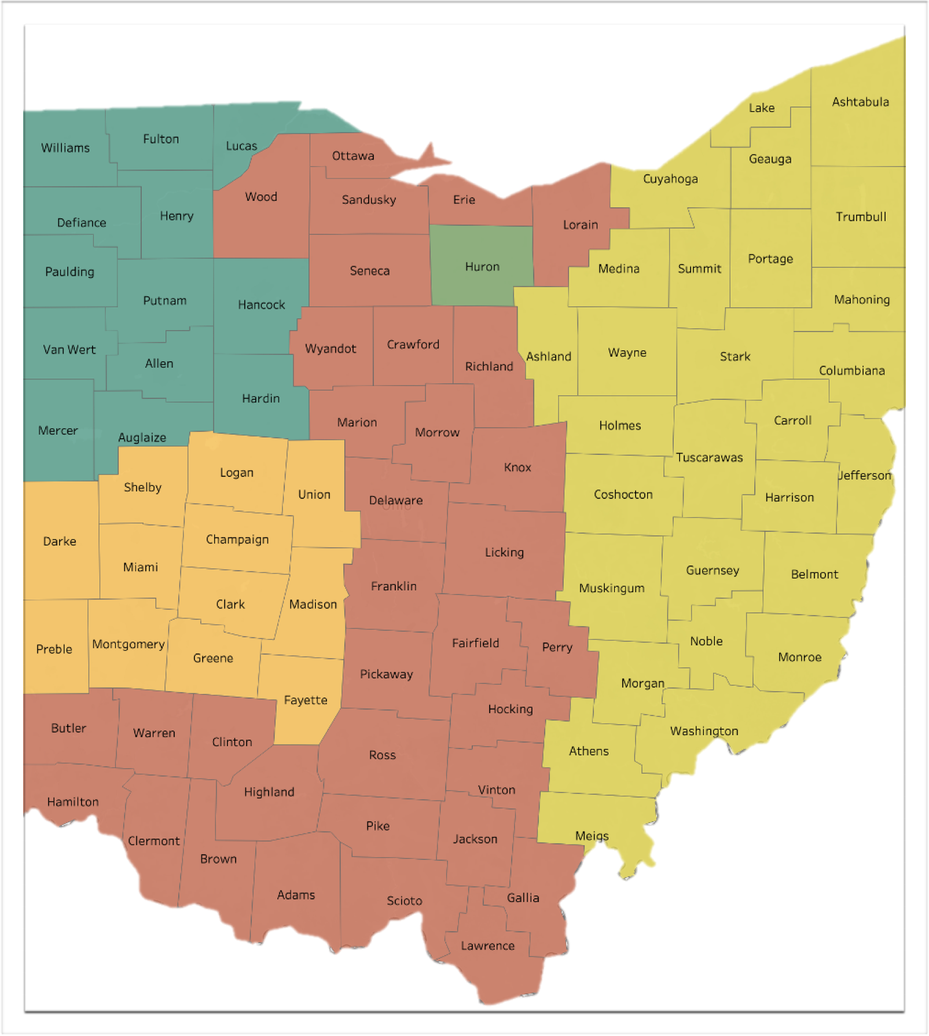
Title I-C
Regional Programs
3.
1.
4.
5.
Putnam County ESC
Tecumseh Local Schools
North Point ESC
Willard City Schools
Stark County ESC
2.

Slide 14
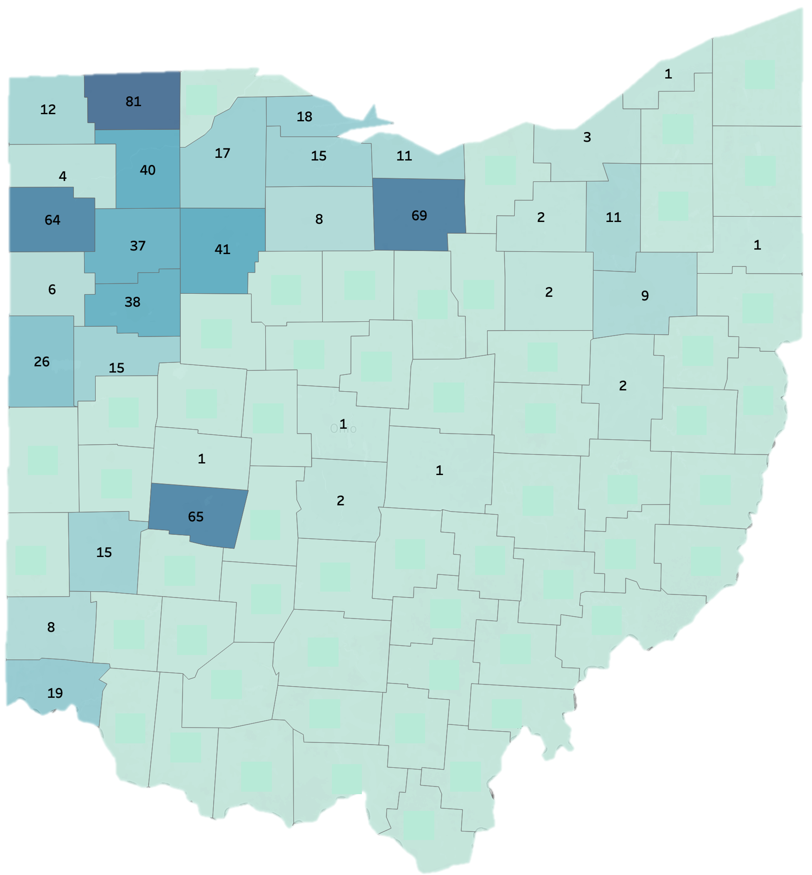
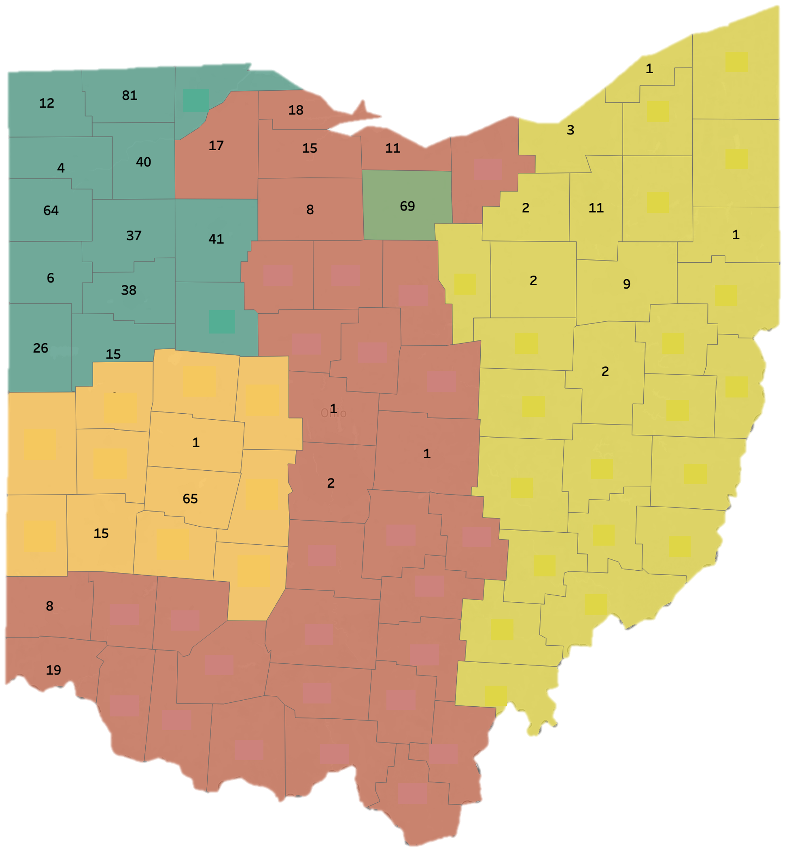
Identified by County
Identified by Region

Slide 15
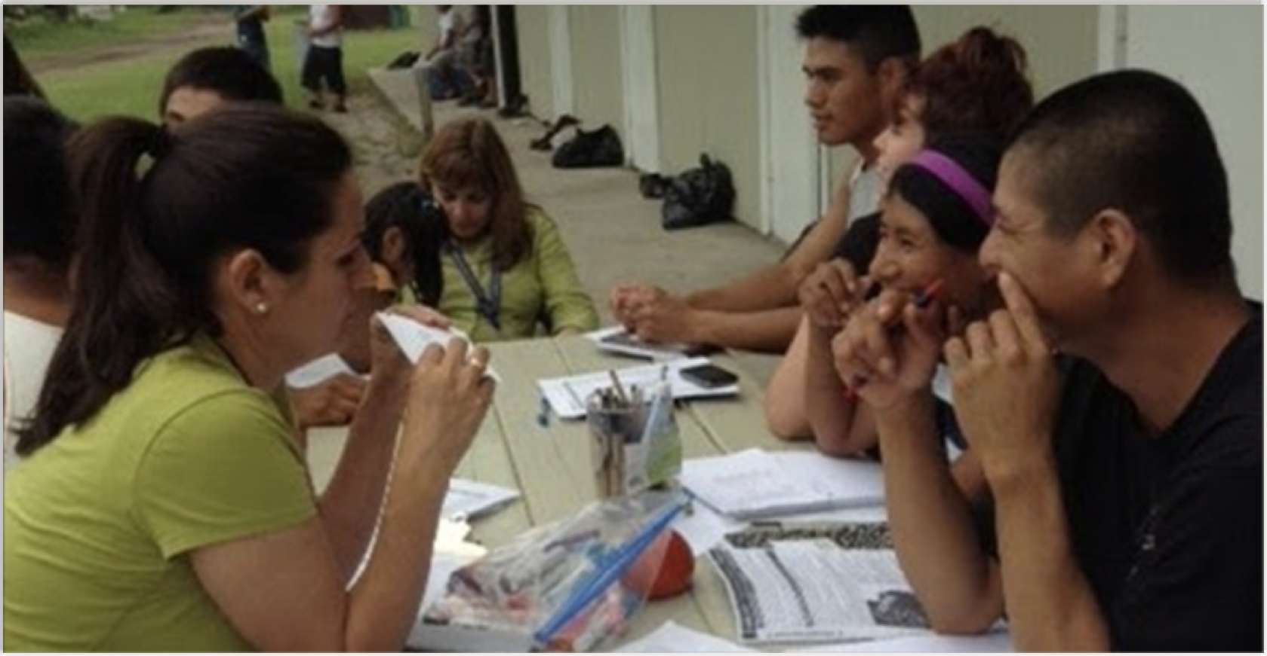
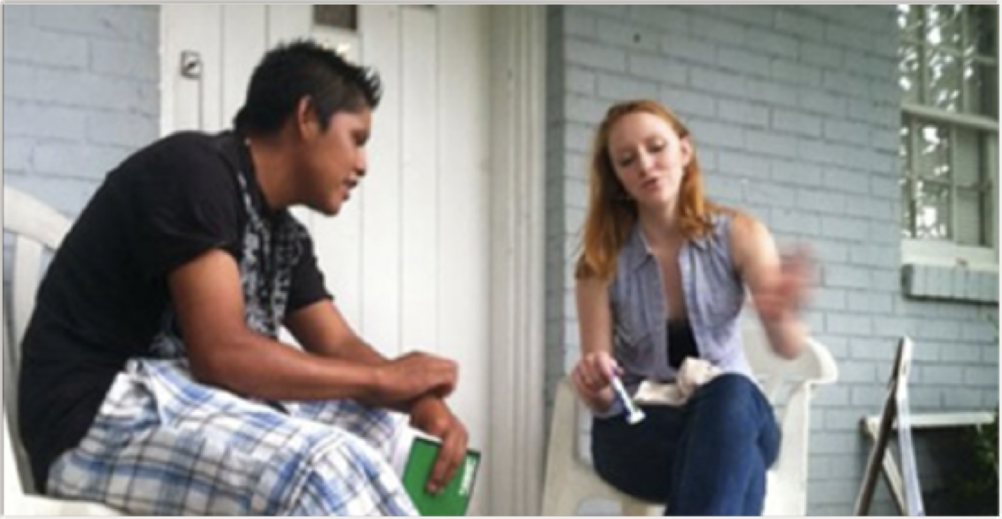
Summer Services for Non-Project Districts
Home visits by teachers who deliver instructional lessons to eligible migrant students.

Slide 16


Slide 17
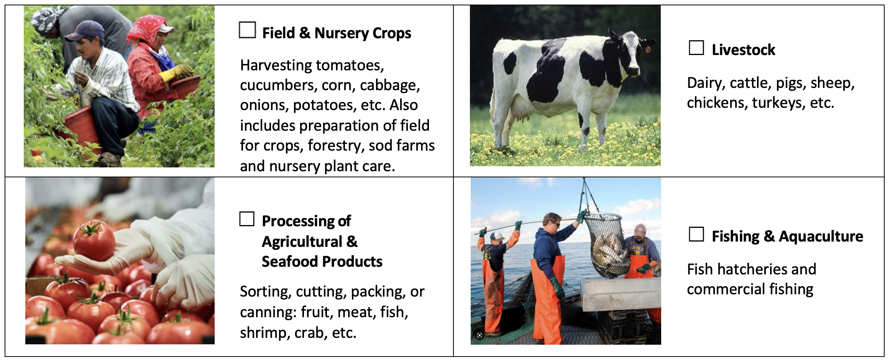
Please mark if you or anyone in your household has worked in any of the following occupations in the past 36 months.
(Check all that apply)

Slide 18
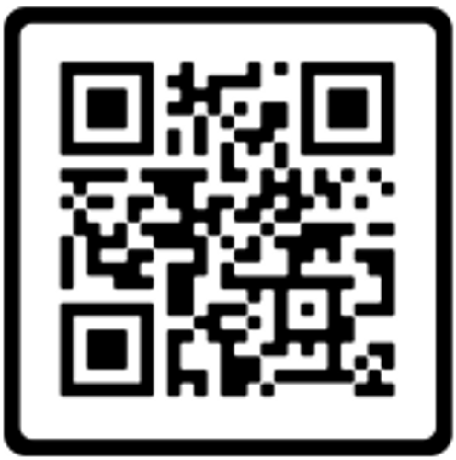

Title I – Part C, Referral System
The QR code will connect you to the online referral system.
It only take about 2 minutes to enter the lead information.
https://idrreferrals.net

Slide 19
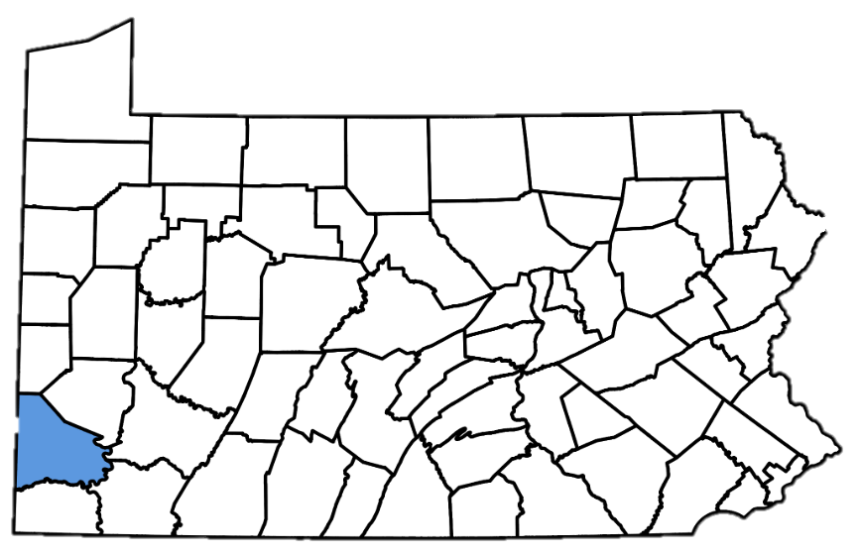
Haitian Communities
Dady
Marc
Charleroi, Pennsylvania

Slide 20
José P Salinas, EdD. - Director
Ohio Migrant Education Center
428 1/2 Croghan St.
Fremont, OH 43420
  jose.salinas@nwoesc.org
  (419) 332-6007

