Slide 1
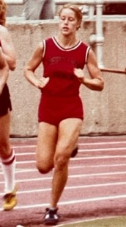
2024 Hall Of Fame Inductee Leslie Orr Steinlage Class of 1981
4 Varsity Letters in Track & Field
1st Team Mid State League 1600M 1979
1st Team Mid State League 880 Yard Run 1979
1st Team Mid State League 800M 1980, 1981
OHSAA State Track Meet Qualifier 880 Yard Run 1978
OHSAA State Track Meet Qualifier Mile Run & Mile Relay 1979
OHSAA State Track Meet Qualifier 880 Yard Run – 2 Mile Relay 1980
6th Place OHSAA State Track Meet 800 M Run 1980
4th Place OHSAA State Track Meet 800 M Run 1981
OHSAA State Track Meet Qualifier 1600 M Run & 1600 M Relay 1981
School Record 800 M Run

Slide 2
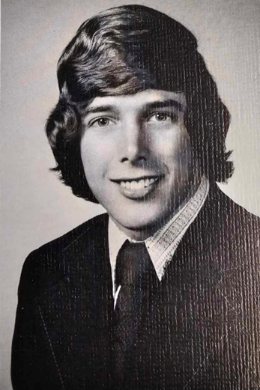
2024 Hall Of Fame Inductee Jack Garey Class of 1973
2 Varsity Letters in Basketball
3 Varsity Letters in Baseball
Honorable Mention Mid State League 1971
2nd Team Mid State League 1972
1st Team Mid State League 1973
Mid State League Player of the Year 1973
1st Team Central District 1973
All Ohio 1973
Member of the 1973 OHSAA East-West All Star Series Team

Slide 3
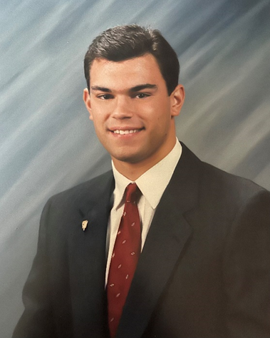
2024 Hall Of Fame Inductee Kyle Farmer Class of 1992
4 Varsity Letters in Football
1st Team Mid State League 1990, 1991
2nd Team All District 1990, 1st Team All District 1991
Special Mention Division IV All Ohio 1990, 2nd Team Division IV All Ohio 1991
Football MSL Cardinal Division Lineman of the Year 1991
Member of the Columbus Dispatch-Agonis Club All-Star Football Team 1991
Sports Medicine Grant Central Ohio All-Star Football Game Participant 1991
4 Varsity Letters in Track
1st Team Mid State League – Shot Put Champion 1990, 1991, 1992
1st Team Mid State League – Discus Champion 1992
MSL Cardinal Division Record – Shot Put
League Record – 1st 3X League Shot Put Champion
1st Team All District – Indoor Shot Put Champion 1991
1st Team All-District – Shot Put 1992
OHSAA State Track & Field Meet Qualifier – Shot Put 1991
Varsity Assistant Football Coach 1993-2003
Varsity Track Coach 1998-1999, 2001, Cardinal Division Coach of the Year 2001
Varsity Softball Coach 2020-2021

Slide 4
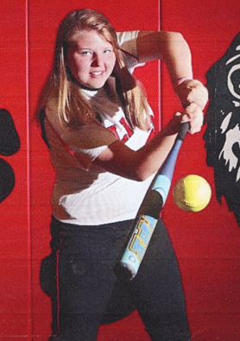
2024 Hall Of Fame Inductee Megan Van Almsick Class of 2011
4 Varsity Letters in Volleyball
2nd Team Mid State League 2010
2nd Team All District 2010, 3rd Team All District 2009
4 Varsity Letters in Softball
2nd Team Mid State League 2008, Honorable Mention MSL 2009
1st Team Mid State League 2010, 2011
1st team LEG All County 2008, 2009, 2010, 2011
Columbus Dispatch All Metro 1st Team 2011
1st Team All District 2010, 2011
3rd Team All Ohio 2010, 2011
Mid State League Champions 2008, 2010, 2011
Mid State League Runner Up 2009
Central District Champions 2010, 2011
OHSAA Division III State Runner Up 2011
School Record 9 Homeruns
Class of 2011 Valedictorian

Slide 5
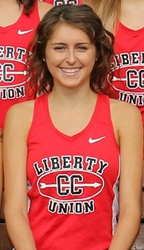
2024 Hall Of Fame Inductee Sydnee Mangette Class of 2018
4 Varsity Letters in Cross Country
1st Team Mid State League 2014, 2015, 2016, 2017
Mid State League Individual Champion 2015, 2016
1st Team Central District 2014, 2015, 2016, 2017
Central District Champion 2015, 2016
OHSAA State Cross Country Qualifier 2015, 2017
OHSAA Division III State Cross Country Meet 4th Place 2016
4 Varsity Letters in Track & Field
Mid State League Champion 800M, 1600 M 2015
Mid State League Champion 4X800, 800M, 1600 M 2016
2nd Team Mid State League 3200M 2017, 4X800 2018
1st Team Central District 800M, 1600M 2015, 2016
1st Team Central District/Regional Qualifier 3200M 2017
State Qualifier 800 M 2015, 2016 / 1600M 2016
Academic All Ohio – Track 2016 / Cross Country 2016, 2017
School Records – Cross Country 2014 / Track 800 M/1600M 2016
Sydnee continued Track & Cross Country at Northern Kentucky University

